Slide 2
Marine Corps Leadership and Coaching for Success
Why we’re here - To help you win and develop the next generation of leaders
Every Marine is a leader, and the key to a successful unit or team is the people involved
Marines have years of experience leading men and women under adverse conditions, and know the principles necessary to achieving success
As coaches you have a tremendous impact on the youth of America; the Marine Corps shares that responsibility

Slide 3
Agenda
Marine Corps Overview
Parallels
Transformation
Leadership Principles
Questions and Answers

Slide 4
USMC Vision Statement
The Marine Corps of 2025 will fight and win our Nation’s battles with
multicapable MAGTFs, either from the sea or in sustained operations
ashore.
Our unique role as the Nation’s force in readiness, along with our
values, enduring ethos, and core competencies, will ensure we remain
highly responsive to the needs of combatant commanders in an
uncertain environment and against irregular threats.
Our future Corps will be increasingly reliant on naval deployment,
preventative in approach, leaner in equipment, versatile in
capabilities, and innovative in mindset.
In an evolving and complex world, we will excel as the Nation’s
expeditionary “force of choice.”
Notes:
This statement of intent, simple in its meaning, rests at the top of the conceptual hierarchy that will drive Marine capability development for years. Creating the capabilities necessary to achieve this vision will not be simple. It will continue to take great thought, great leadership, continuous critical examination and reexamination of every aspect of it. The Marine Corps is an institution. It is not like a building, a highway, or even a ship. It is constantly evolving and adapting to ensure that as operational environments and technology changes, it has the capabilities necessary to stay a step ahead.
Marines have a history of taking the good ideas of others and making them even better. The spirit of innovation, experimentation, adaptation, and perseverance that pervades the history of our Corps is a key ingredient in our current process as well.

Slide 5
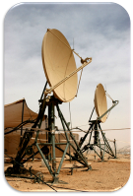
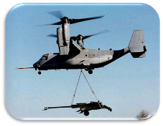
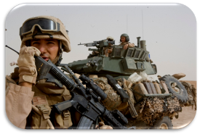
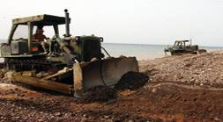
MAGTF – Marine Air Ground Task Force
Command
Element
Aviation
Combat Element
Ground
Combat Element
Logistics
Combat Element
Notes:
Within the MAGTF there is an inherent command and control structure, which makes sure all of these pieces and parts work together as a whole. With the mission constantly changing, this allows the Marine Corps to be a light force, a very agile force, and a thinking force. It is this structure that makes the Marine Corps America’s Expeditionary Force in Readiness – forward deployed and always ready to respond during times of crisis or conflict.

Slide 6
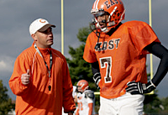
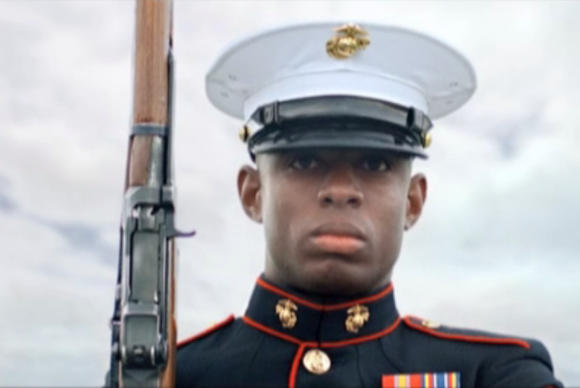
The Parallel
Football Coaches:
Make Football Players
Build Winning Teams
Develop Student Athletes
The Marine Corps:
Makes Marines
Wins Battles
Develops Quality Citizens

Slide 7
Transformation
The Marine Corps transforms young men and women, mentally and physically, to be better prepared to fight and win our nation’s battles, and also to be better Americans
USMC Phases:
Recruiting
Recruit Training
Marine Combat Training
Initial Fleet Assignment
Sustainment Training
Football Team Phases:
Pre-Season Orientation
Pre-Season Practice
In Season
Post Season
Off Season Training
The end result is transforming “me oriented” individuals into “we oriented” teammates
Notes:
USMC and Football phases of transformation are very similar – they vary only in time, 4 years versus 1 year

Slide 8
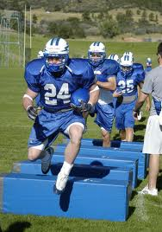
Concepts Supporting Transformation
Marines Teach
Character Development
Discipline
Esprit de Corps
Military Bearing
General Military Subjects
Basic Combat Tasks
Combat Conditioning
Coaches Teach
Character Development
Discipline
Pride in belonging to the team
How team-members should act
Rules of the game
Blocking and Tackling
Conditioning
Notes:
The goals are very similar

Slide 9
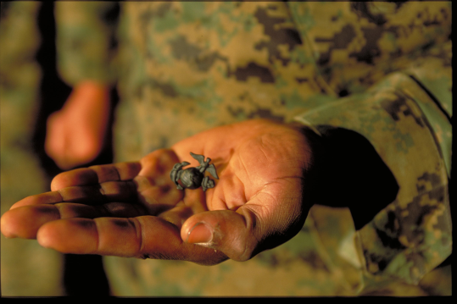
Transformation
Marine Corps Rite of Passage:
12 Weeks of recruit training at Parris Island or San Diego
The Crucible (week 11) is the culminating event: a 54 hour moral, mental and physical test of stamina, judgment and commitment
After recruits finish the crucible the transformation is complete, and they have earned the title Marine.
The importance of oversight, control and close supervision cannot be overstated
Notes:
The transition phase begins at the Emblem Ceremony immediately following the completion of the nine-mile Crucible hike. In this ceremony, the Company First Sergeant talks to the new Marines as a mentor and leader, highlighting where they’ve been and what expectations the future holds for them as Marines.
The Recruits are then asked if they accept the challenge and responsibility that accompany the title of Marine and, after answering in the affirmative, each Recruit is personally presented the Eagle, Globe, and Anchor by his/her DI and called Marine for the first time.
The new Marines also have their Oath of Enlistment re-administered by their Company Commander, reminding them of their obligation to support and defend the Constitution of the United States.
Following the Emblem Ceremony, the new Marines celebrate their accomplishment with a Warrior’s Breakfast. This is the start of Marine Week

Slide 10
Millennials
Today’s football players and Marines (Born between 1980-2002)
Influenced by the Internet, TV, cell phones, national tragedies, and significantly by their parents ; they are also very patriotic
They value education, change, innovation, balance of work and play, close relationships with their parents, and self-expression
Diversity is not an issue; they accept cultural and social deviations
They live for today and crave challenges. They also tend to be socially responsible and are civic-oriented
They are team oriented and want to understand the big picture
They seek flexibility and results; their respect must be earned
They tend to trust individuals over institutions
Millennials seek to be part of a team that is fair, challenging, serves people, and builds confidence and self-reliance
Notes:
It’s important to understand the person you intend to transform.
What we teach and how we act must account for these factors.

Slide 11
Teambuilding
Characteristics of an Effective Team
Teams create a culture of positive interdependence
Loyalty
Trust
Dependability
Individual and group accountability
Teams create a clear understanding of goals and intent
What?
When?
Why?
Teams develop and maintain:
A common purpose
A common situational awareness
Effective decision making
…And the strength of the pack is the wolf And the strength of the wolf is the pack.
Notes:
Read and discuss.
To lead into next slide: As important as it is to work as a team, it is equally important that members of that team exhibit leadership characteristics

Slide 12
Leadership Traits
The Marine Corps defines leadership as “the sum of those qualities of intellect, human understanding and moral character that enables a person to inspire and guide a group of people successfully.”
The United States Marine Corps recognizes 14 distinct traits that make for strong leadership and instills these traits in every Marine:
JUDGMENT
JUSTICE
DECISIVENESS
INTEGRITY
DEPENDABILITY
TACT
INITIATIVE
ENTHUSIASM
BEARING
UNSELFISHNESS
COURAGE
KNOWLEDGE
LOYALTY
ENDURANCE
Notes:
Speak more in depth about a couple of these traits. Explain how a few of these are as applicable to a football team as they are a Marine unit. For example, Integrity is the backbone of character and teams need men of character to win. Courage is physical, mental, and moral. You can learn a lot about your team by measuring your men by these traits.

Slide 13
Marine Corps Leadership
Leadership Principles:
Keep your Marines informed
Set the Example
Train your Marines as a team
Be technically and tactically proficient
Know yourself and seek self-improvement
Know your Marines and look out for their welfare
Ensure assigned tasks are understood, supervised, and accomplished
Make sound and timely decisions
Develop responsibility among subordinates
Employ your unit within its capabilities
Seek responsibility and be responsible for your actions
Notes:
-Is leadership a natural trait or can it be taught?
-How are some coaches/leaders able to achieve greatness when others can’t?
-What are the different types of leaders? – Achievement-oriented, success oriented, significance oriented.

Slide 14
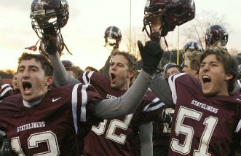
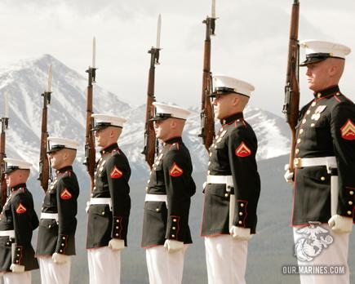
Leadership Essentials
Environment
Vision
Values
Identity / Mantra
Success Defined
Notes:
Sets the framework for what every leader needs to establish within his unit or team.

Slide 15
Leadership Essentials
The Environment:
Assessment
Threats – Remove them
Loyalty – Knowing who is part of the team
Fence-sitters – Get them on board or get them moving
Vision:
Where have we been?
Where are we now?
Where do we want to go?
How are we going to get there?
How do we get better everyday?
Notes:
Vision – past, present and future should be examined. A comprehensive plan should be developed and continue to take action and improve beyond that plan

Slide 16
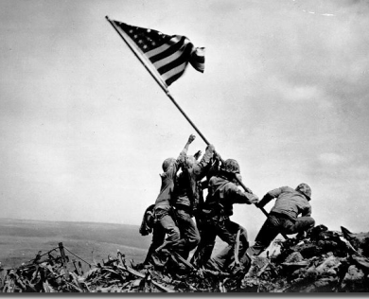
Leadership Essentials
Values:
Honor– Living with integrity, responsibility, honesty, and respect
Courage– The mental, moral and physical strength to do what is right in the face of fear, uncertainty or intimidation
Commitment – Unwavering, selfless dedication to mission accomplishment, and personal and professional responsibilities
Notes:
Mental discipline is focused on the development of the warrior mind through discipline (control gained by enforcing obedience or order) and through a commitment to learn the profession of being a warrior.
Moral discipline is focused on the development of a warrior spirit. Strength, actions, and behavior guided by our values and leadership traits and principles lead to sound judgment and the moral courage to do the right and honorable thing.
Physical discipline is focused on the development of the warrior body. Training is structured to develop the physical strength, confidence, and physical courage required to succeed in combat and withstand hardship and obstacles in any clime or place.

Slide 17
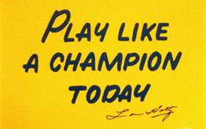
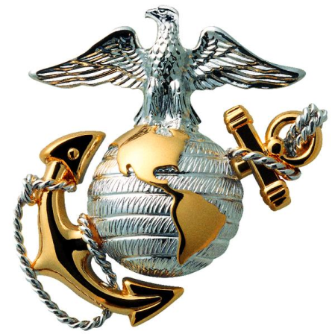
Leadership Essentials
Identity / Mantra
A Rallying Cry: motto or saying that all players feel an obligation to fulfill
Tradition: every unit or team should have one; establish a tradition and build on it
Motivation: what makes your team tick? Build on an established goal that will maximize the “fire” of the players
Be Unique: As Marines we pride ourselves on being “First to Fight” and “Most Ready,” when the Nation is least ready. These ideas are reflected in Marine Corps symbols
Notes:
Tradition - Marines have a proud tradition of success on the battlefield and are proud members of their respective fighting units and know their duty is to maintain and build on traditions set by their forefathers (i.e.. 1st and 2d MarDiv)

Slide 18
Leadership Essentials
Success Defined
WHAT IS SUCCESS
Winning Records?
Championship Titles?
Coaches Hall of Fame?
Prestige and Power?
Notes:
This is a set up for the next slide – Your LEGACY. Many of the coaches will believe the accomplishments on the slide are what is most important. However, this will be introduced and then immediately move into what is really the measure of success. This should be an excellent attention gainer because this is what much of society values…especially in coaching – Wins and Loses.

Slide 19
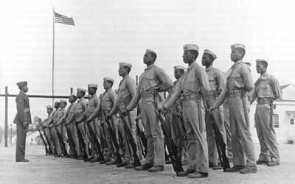
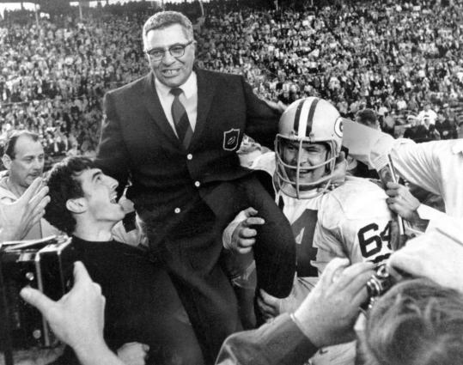
Legacy
Notes:
This is what really matters, because it has a lasting effect long after you are done coaching. What will be your legacy? Images show: the Montford Point Marines – the first African Americans to join the Marine Corps in 1942. Vince Lombardi – who’s name is synonymous with winning and motivation. He won 5 championships in 9 years - his players were devoted to him and his mantra of hard work and dedication made him a hero to millions of football fans.

Slide 20
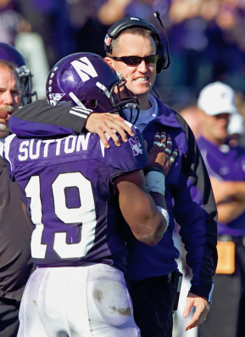
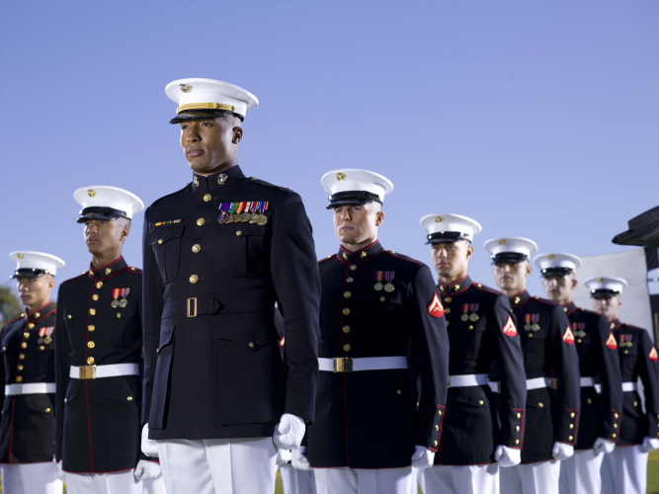
The End Result
The product of our efforts is the lasting change we make in PEOPLE.
During these times of financial difficulty it has become more apparent that success will not be measured by material things, but rather by the impact you make during your time on this earth.
Bottom line – how will you be remembered?

Slide 21
The Marine Corps Opportunity
“My Marine experience helped shape who I am now personally and professionally, and I am grateful for that on an almost daily basis.
I often find myself wishing everyone had a similar opportunity, to learn about shared dependence, loyalty, responsibility to and for others, about mutual respect and honor, and about the power of appealing to the best that's in us as human beings, not the worst.”
-Jim Lehrer, News Anchor

Slide 22
Learn More
Leadership and CFT Program
Marines will visit your school to develop mental toughness in your teams by employing the USMC Combat Fitness Test as a teaching tool
Educator’s Workshop
Visit Recruit Depot Parris Island or San Diego to see firsthand how the transformation to Marine occurs
NROTC
Program to pay for college before entering the service, covers all tuition and fees to any school with an NROTC detachment (valued over $150K)
H.S. Juniors can begin applying in May; visit: MarineOfficer.com
Receive commission as a 2nd Lieutenant
Competitive selection based on GPA, ACT, extracurricular participation, physical fitness
Notes:
Visit the Marine Corps booth for more information
To contact a recruiter visit Marines.com or call 1-800-Marines

Slide 23
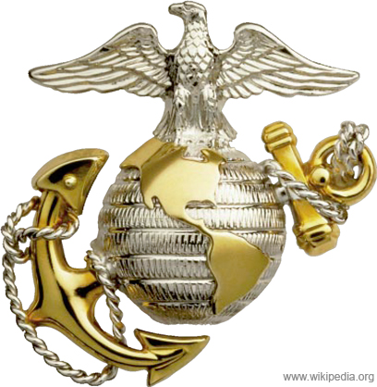
QUESTIONS?

