Slide 1
2023 Georgia Milestones Parent Information and Resources
Updated February 10, 2023

Slide 2
Agenda
What will my child be assessed on?
What does my child’s school do to prepare for the test?
How can I support my child in being successful on the Georgia Milestones?
What resources can I use to help my child be successful?
How will my child be expected to show what they know or demonstrate their knowledge?
Questions

Slide 3
What will my child be assessed on?
Measures students’ knowledge and skills on the state-adopted content standards in English Language Arts, Mathematics, Science, and Social Studies.
Elementary tudents taking an advanced class will need to take the End of Grade for the overall grade level for which they are enrolled.
The test is used as part of our state accountability system, which is CCRPI.
Georgia Milestones | ELA | Mathematics | Science
End-of-Grade (EOG) | Grades 3 – 8 | Grades 3 – 8 | Grades 5 & 8

Slide 4
What does the test look like?
Content Area and Number of Sections | Selected Response | Constructed Response (2 points) | Extended Constructed Response (4 points) | Extended Writing Response (7 points) | Technology Enhanced (2 points)
English Language Arts (ELA) (3 sections) | ✓ | ✓ | ✓ | ✓ | ✓
Mathematics (2 sections) | ✓ |  |  |  | ✓
Science (2 sections) | ✓ |  |  |  | ✓
Technology Enhanced Items include: Evidence Based Selected Response, Drag and Drop/Paste, Drop-down list, Multi-Select, Keypad Input or Graphing.
Notes:
‹#›

Slide 5
How long is the test?
Content Area/Course | Test Section(s) | Typical Testing Time | Maximum Time Per Section(s) | Maximum Time Per Section(s) (1.5)
ELA | 1 | 45-65 | 90 | 135
 | 2 | 40-60 | 80 | 120
 | 3 | 40-60 | 80 | 120
Mathematics | 1 | 30-50 | 65 | 98
 | 2 | 30-50 | 65 | 98
Science | 2 | 20-30 | 40 | 60
 | 3 | 20-30 | 40 | 60
Note: There is no minimum time for testing. If all students have submitted the test, the examiner should complete the test section.
Notes:
Schools can test AM & PM sessions or AM only.
This information is to ensure when you are building your schedules you have enough time to provide the minimum time in the allotted time.
Please make sure to include start time in your presentation.

Slide 6
When will your child test? (Grades 3 – 5)
Elementary School Spring 2023 EOG: April 25 - May 3, 2023
Date | Content Area
April 25 | ELA Part I
April 26 | ELA Part II/III
April 27 | Math
April 28 | Science
May 1 - 3 | Make-ups
Notes:
Notes to the Presenter:
This schedule is reflective for the GaDOE requirements for the 2022-2023 school year.
Any changes to future schedules will be determined based on a Georgia State Legislative decisions.

Slide 7
What types of questions will my child see on the Georgia Milestones assessment?

Slide 8
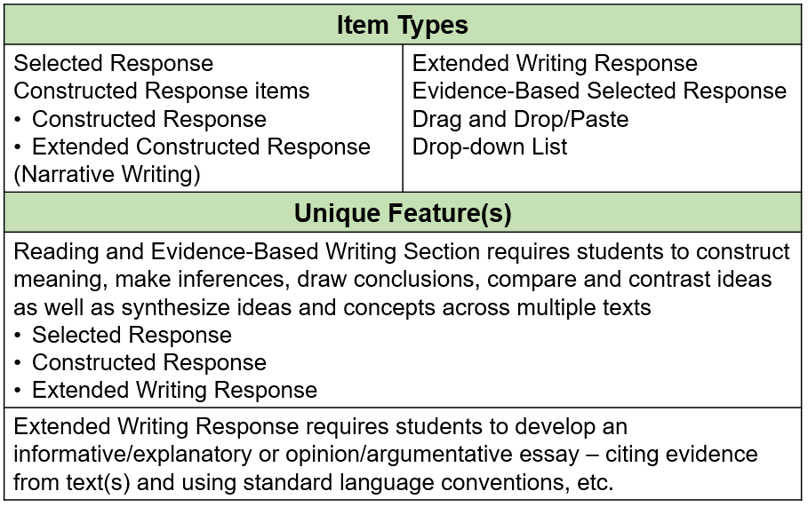
English Language Arts

Slide 9
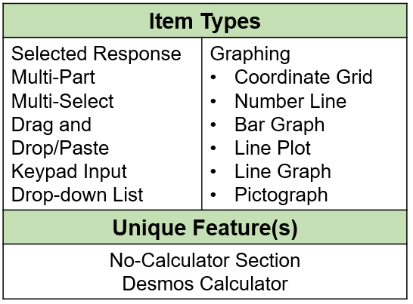
Mathematics

Slide 10
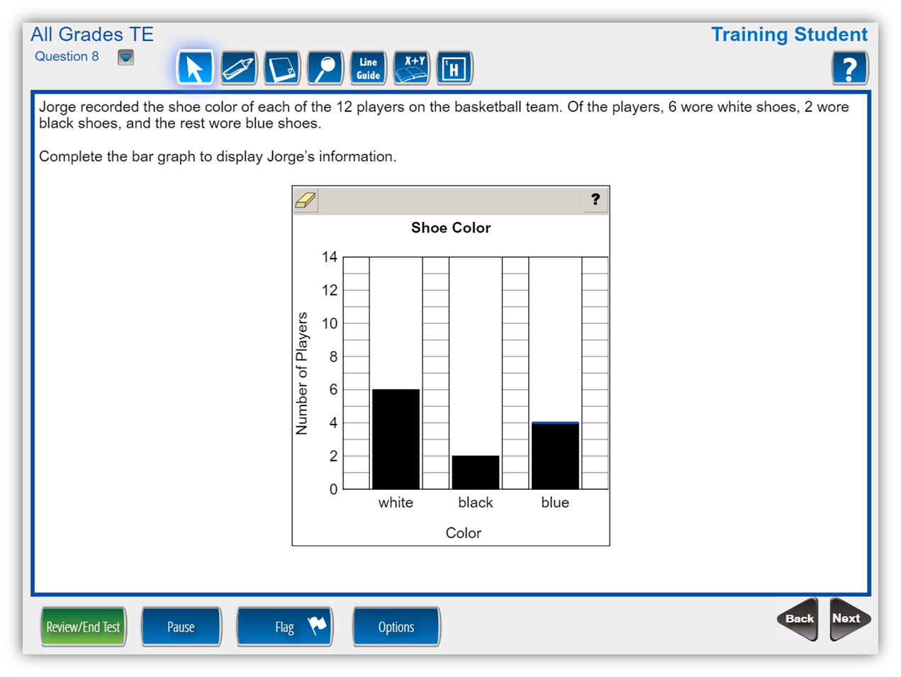
Math Technology- Enhanced Item
Notes:
This math item asks the student to complete a bar graph. Technology-enhanced items encourage students to construct an answer as opposed to merely selecting a response. Students are required to think critically. The items gain a better understanding of a student’s depth of understanding and knowledge.

Slide 11
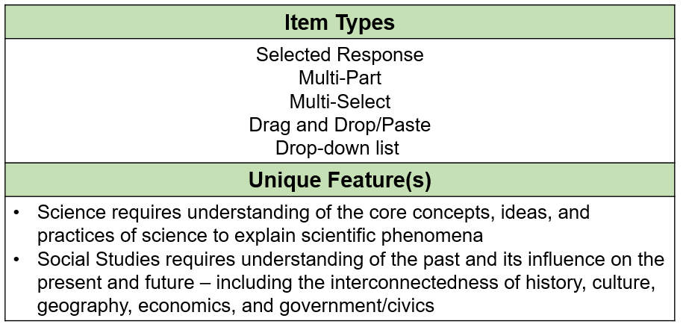
Science

Slide 12
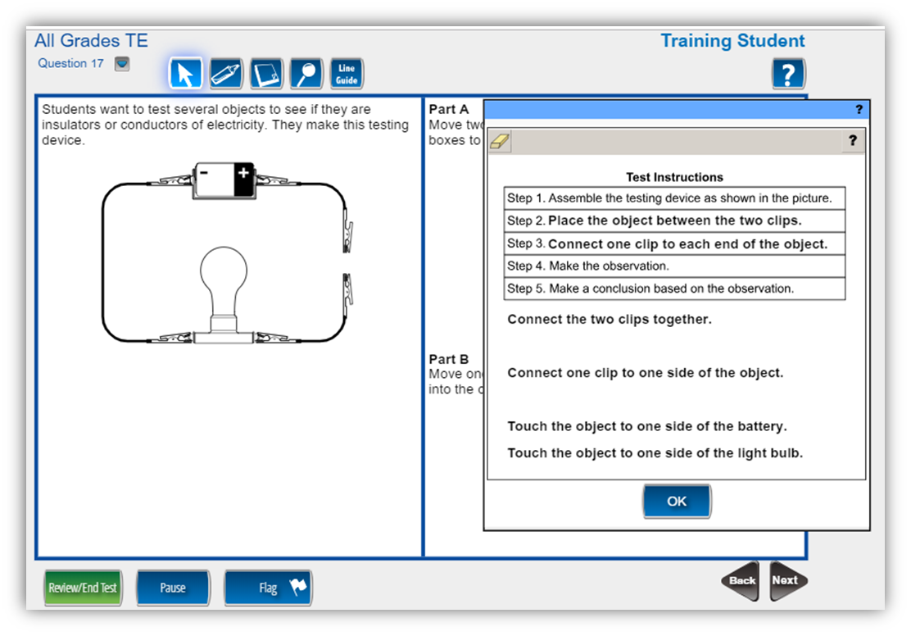
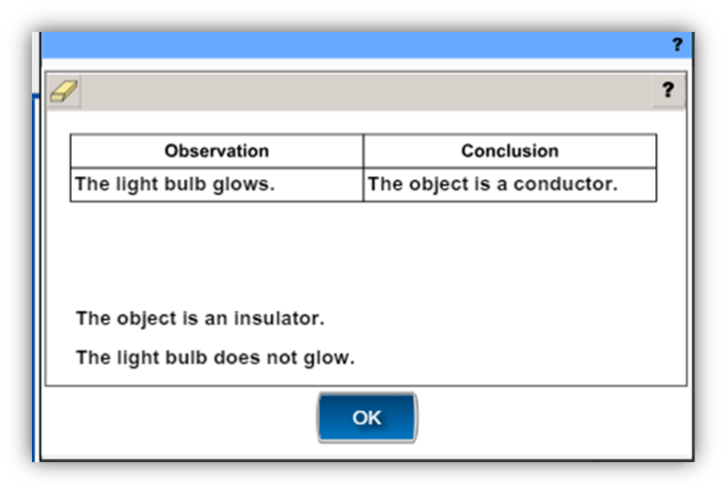
Science Technology-Enhanced Item
Notes:
Drag-and-drop items may also appear in Science and Social Studies courses. In this example, after reviewing an investigation, the student is asked to complete instructions to determine if objects are insulators or conductors of electricity. In the section part, the student chooses an observation and a matching conclusion. Some technology-enhanced items use a strategy of scaffolding to elicit different types of knowledge from students. First, the student is required to correctly sequence the experiment, then they must correctly observe and make a conclusion.

Slide 13
What will testing look like at HES?
Testing will begin by 8:15. Please be sure that your student arrives to school on time during testing days. If your student arrives after the test has begun they will need to make up that section at a later date.
Be sure to get a goodnight sleep and eat a healthy breakfast.
Please have students fully charge devices every night.
Students will have a break in between testing sessions. Students will be provided with a snack during the breaks.
Encouraging letters will be shared with students the day of testing.
We will have testing theme days to help relax students and make testing less stressful.

Slide 14
How are teachers preparing students?

Slide 15
Testing Strategies
#1 – Underline key words in the question.
#2 – Eliminate incorrect answers.
#3 – Read the questions before the passage.
#4 – Practice scoring open-ended responses.
#5 – Make practicing fun.

Slide 16
Utilizing the Writeable platform (paired passages, constructive responses)
Showing their mathematical thinking on paper
Close Reading (annotating the text)
Practice reading the entire text and not rushing through the reading

Slide 17
Practice Test
-A practice test will be held on April 18th at 8:00 AM to familiarize the students with the testing platform.

Slide 18
What Can Parents Do During Testing Week?
Be encouraging!
Remind students to read directions carefully and to check their work.
Point out that some items will be more difficult than others.
Help them in getting a good night’s rest.
Plan a balanced breakfast.
Stick to the schedule.
Don’t focus your conversations too heavily on the test.
Practice using the same materials that the students can use on the test, i.e. scratch paper, timed activities, pencils and graph paper.

Slide 19
What resources can I use to help my child be successful?

Slide 20
Study Guides
The Georgia Milestones Study/Resource Guide for Students and Parents is intended as resource for parents and students. It contains sample questions and helpful activities to give you an idea of what content the test covers and what the test questions will look like on the assessment.
The sample questions are fully explained and will tell you why each answer is either correct or incorrect.
Study Guides can be found on the Georgia Department of Education’s Georgia Milestones Resources page at: https://www.gadoe.org/Curriculum-Instruction-and-Assessment/Assessment/Pages/Milestones_Resources.aspx

Slide 21
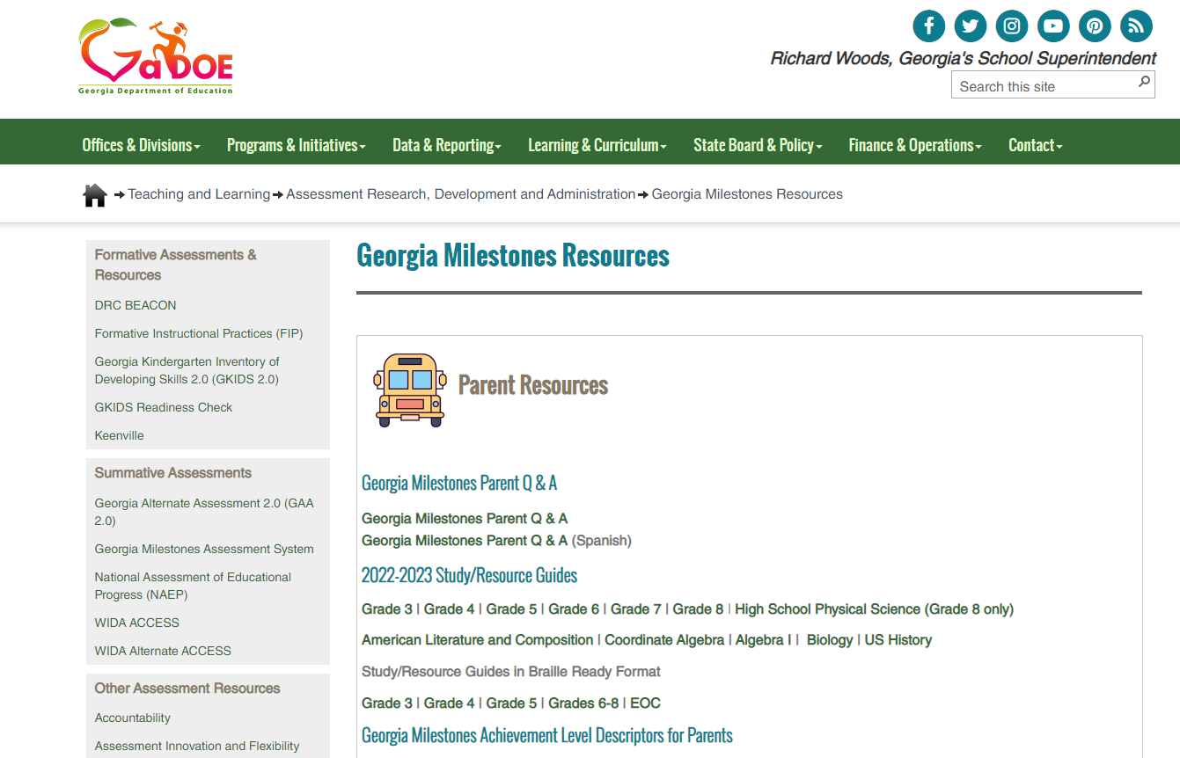

Slide 22
Study Guides – How to use them
Gather your child’s materials that you will need such as the guide, pen or pencil, highlighter, scratch paper, classroom notes and textbooks.
Find a comfortable place for your child to sit that has good lighting and time to focus. That means, no TV, gams or phones.
Set aside some time for your child after school dedicated to studying. Set a goal of how long you are going to study. Remember, they can do a little every day.
Invite a study buddy like a friend, sibling or even yourself to practice together – anyone can help! Ask questions and don’t forget to read the directions before your start. You can also ask your teacher for help. It is better to ask now and get answers.
Don’t forget to encourage your child to read each question and answer choices carefully. Your child should be encouraged to use scratch paper and always check their work.

Slide 23
How will my child need to show what they know?
Let’s take a look at the GA Experience Online Platform.
Link: http://www.gaexperienceonline.com/
The items on the demonstration tests are general and are organized into the three grade bands in the content areas of English Language Arts, Mathematics, Science, and Social Studies.
The items do not necessarily represent the specific grade-level content that students learn daily in their classrooms.
The primary purpose is to let students experience, firsthand, the functionality of the online testing platform. The sample tests are not graded, so have fun!
A guided video tutorial is also available to review all of the features the GA Experience Online Platform has to offer.
Notes:
Note to Presenter:
Walk through questions & see the various formats of test questions.
Look for:
Technology enabled items
Multi-select

Slide 25
How will your child’s school & your child’s teacher use the test results to support your child & school?
School Improvement
Determine Placement into specialized programs and services such as:
Accelerated Math Programs (3rd, 4th, 5th)
Gifted Testing
Remediation classes

Slide 26
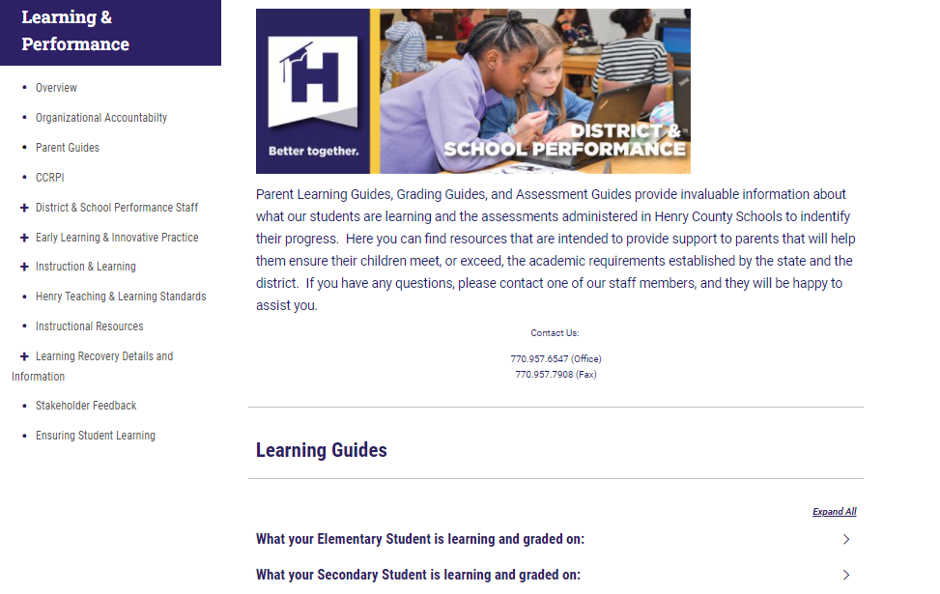
Available Resources
Georgia Milestone resources can be retrieved from our Henry County Schools Website.
https://schoolwires.henry.k12.ga.us/Page/151339

Slide 27
Questions

