Slide 1
Thursday
September 12,2014
Overall Mastery: 84 % Gap to goal: +4
By the end of the day, Students will be able to:
Catalyst:
What is the isotope that have 8 protons and 7 neutrons? Write it in both formats
SWBAT: Calculate average atomic mass of an isotope
And answer a question like this:
What is the average atomic mass?
No C-notes today
3.5 minutes

Slide 2
Agenda
Catalyst | 5 minutes
Weighted average intro video | 5 minutes
Average atomic mass Quick notes | 10 mins
Candium Lab
Closing/ Exit ticket | 10 minutes
30 mins

Slide 3
Get organized- On your unit 3 (Purple) TOC
Table of Contents
Date Assignment
9/5
Atomic Theory Graphic Organizer
9/6
Bohr Model and PT families chart
9/10
Isotope C-notes
9/12
Average atomic Mass Quick Notes

Slide 4
http://www.youtube.com/watch?v=7fYpEnxhKQk

Slide 5
What is the Average Atomic Mass?
the weighted average of the atomic masses of all naturally occurring isotopes of an element.

Slide 6

Where do we find the average atomic mass?
ON THE PERIODIC TABLE!
Average Atomic Mass

Slide 7
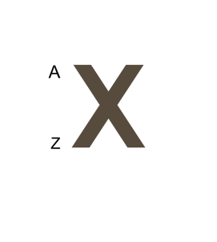
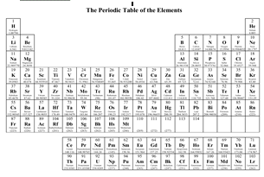
What is the difference??
The A or ‘Mass Number’ is the mass of that specific isotope
The number on the periodic table is the average of all the existing isotopes

Slide 8
Isotopes have occur at different rates…
Isotope | Mass Number | Percentage Natural Abundance
Copper-63 | 63 | 69.17%
Copper-65 | 65 | 30.83%
ABUNDANCE IS HOW OFTEN THAT ISOTOPE OCCURS IN NATURE

Slide 9
Calculating the average atomic mass…
Isotope | Mass Number | Percentage Natural Abundance
Copper-63 | 63 | 69.17%
Copper-65 | 65 | 30.83%
Step 1: Change the percent abundance to decimals.
69.17%/ 100 = .6917 30.83%/ 100 = .3083
Step 2: multiply the mass number by the percent abundance in decimal form and add those products together.
(63 x 0.6917) + (65 x 0.3083) = 63.61 amu

Slide 10
Step 2: multiply the mass number by the percent abundance in decimal form and add those products together.
(63 x 0.6917) + (65 x 0.3083) = 63.61 amu

Slide 11
You Try!
Isotope | Mass Number | Percentage Natural Abundance
Rubidium-85 | 85 | 72.2%
Rubidium-87 | 87 | 27.8%
Step 1: Change the percent abundance to decimals.
72.2%/ 100 = .722 27.8%/ 100 = .278
Step 2: multiply the mass number by the percent abundance in decimal form and add those products together.
(85x 0.722) + (87 x .278) =85.55 amu

Slide 12
Candium!
Take 2 mins to SILENTLY read the objective and introduction.
On your desk-
Triple beam balance
A candy Cup – do not eat any now you will have a chance later
** Where it says skittles I mean pretzel m&ms
You will be following the procedure and filling out the data table.

Slide 13
Balance Reminders:
Before you take the mass
  Make sure that it is on grams
  Zero the balance With the weighing paper

Slide 14
EXIT TICKET:
Complete the conclusion questions

