Slide 1
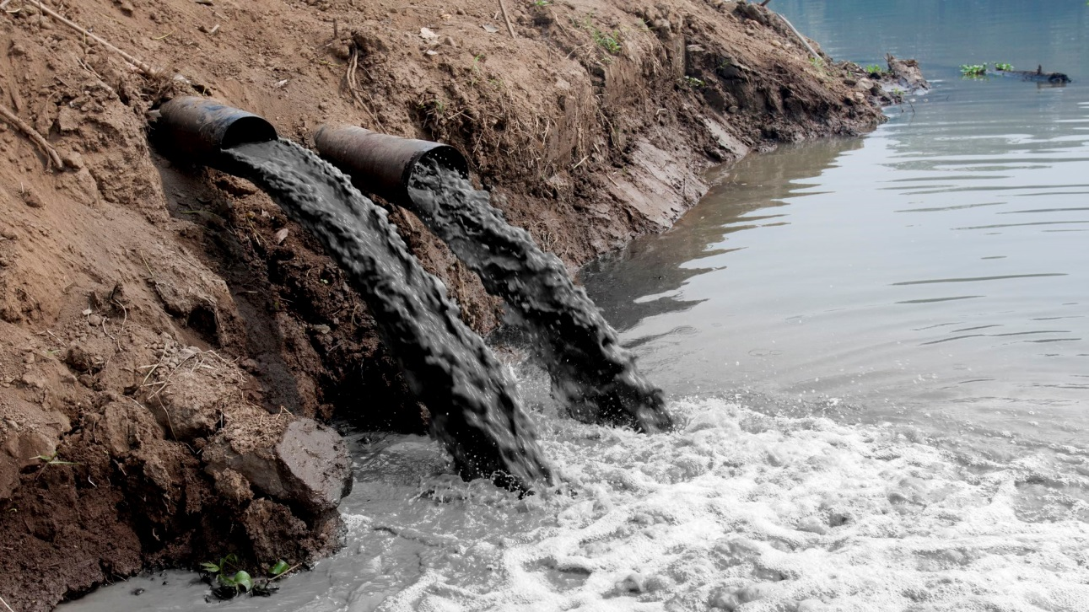
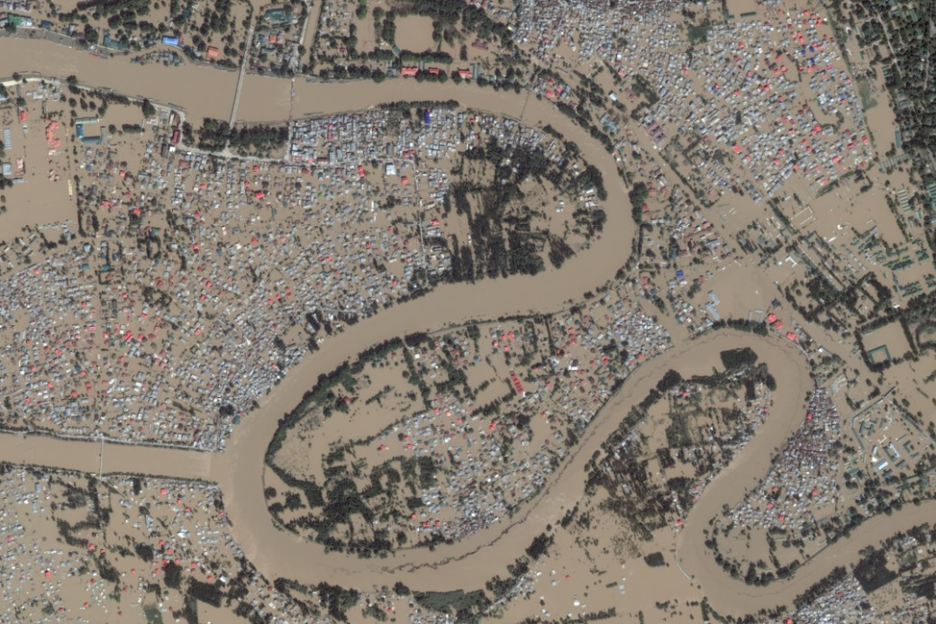
What environmental issues are illustrated in the pictures?

Slide 2
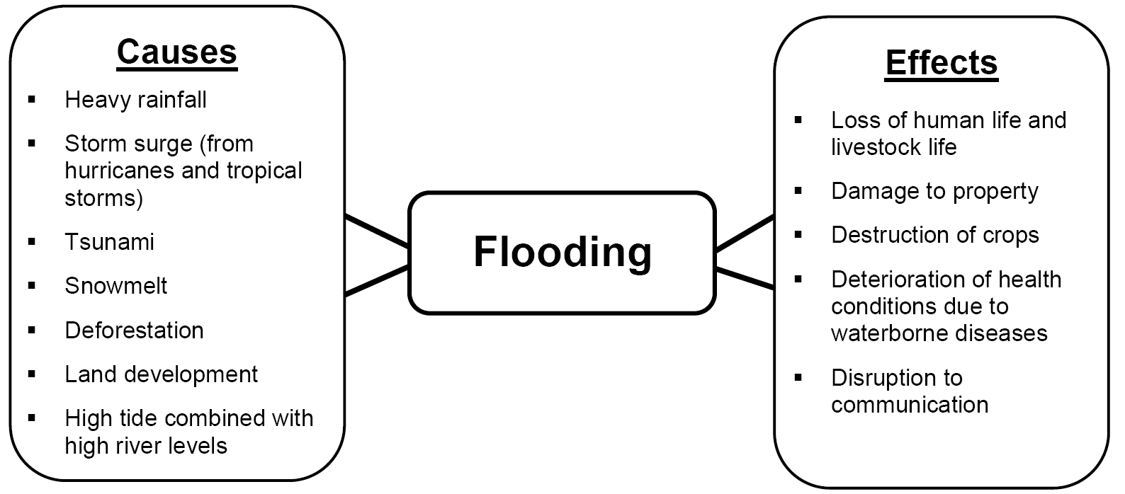

Slide 3
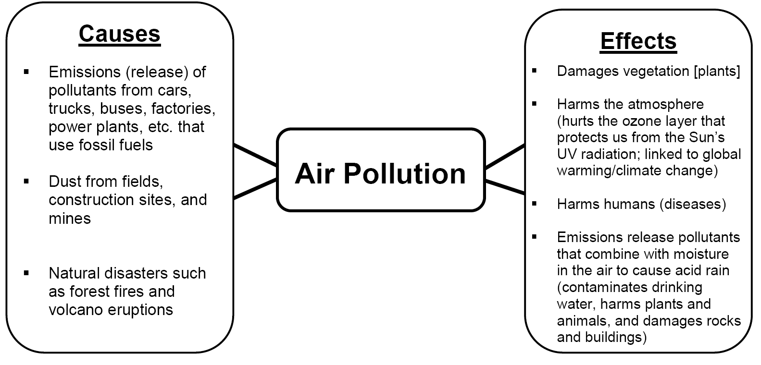

Slide 4
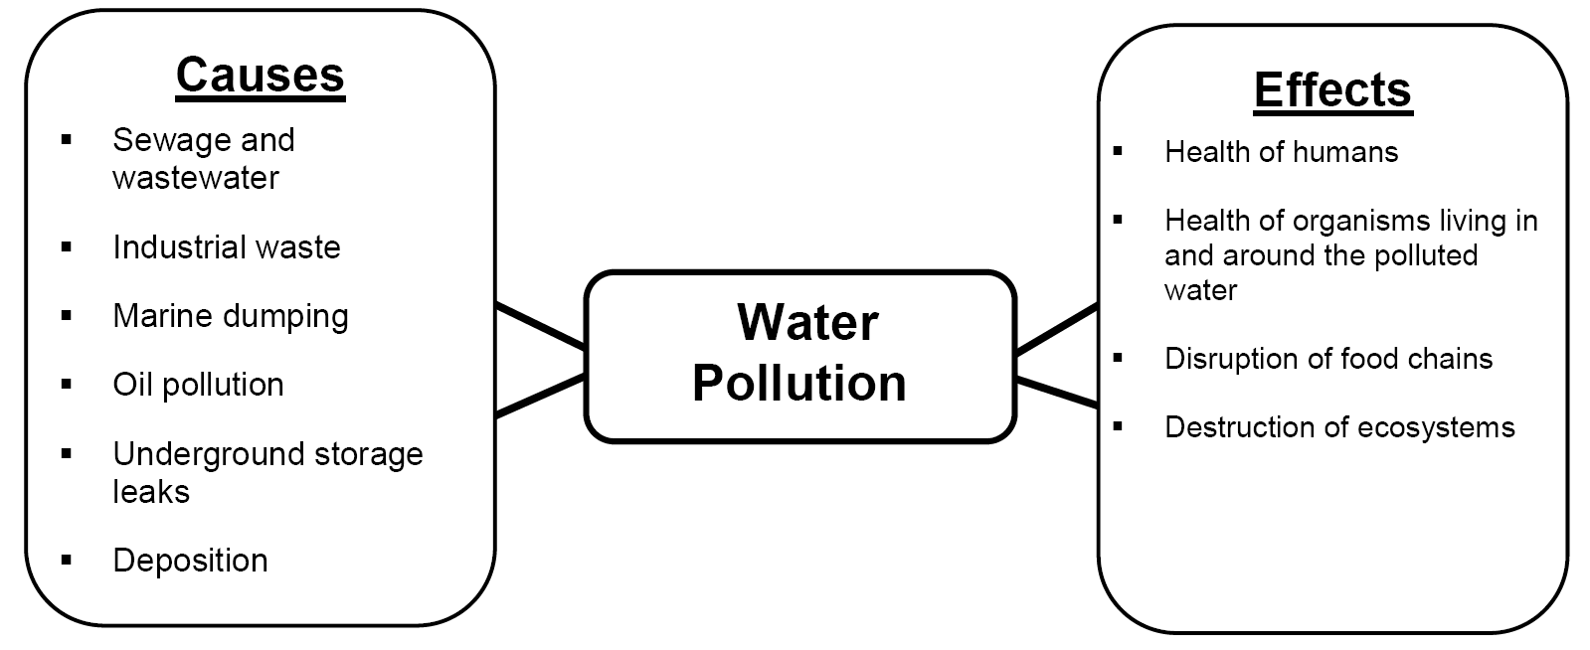

Slide 5
Essential Question:
How has pollution and flooding affected Southern & Eastern Asia?
Standard:
SS7G10a. Describe the causes and effects of pollution on the Yangtze and Ganges Rivers.
SS7G10b. Describe the causes and effects of air pollution and flooding in India and China.

Slide 6
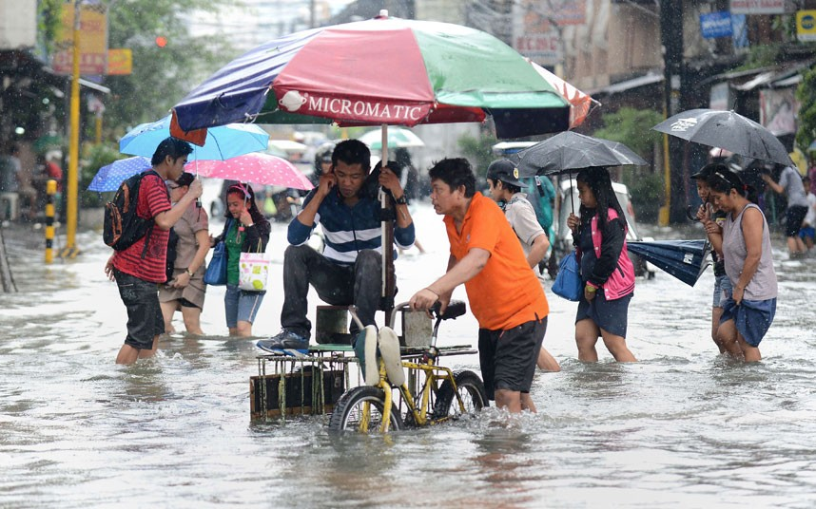
Flooding in India and China

Slide 7
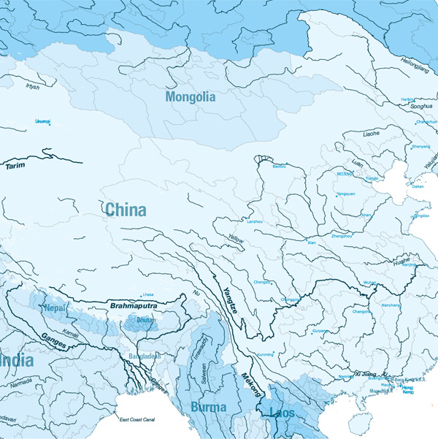
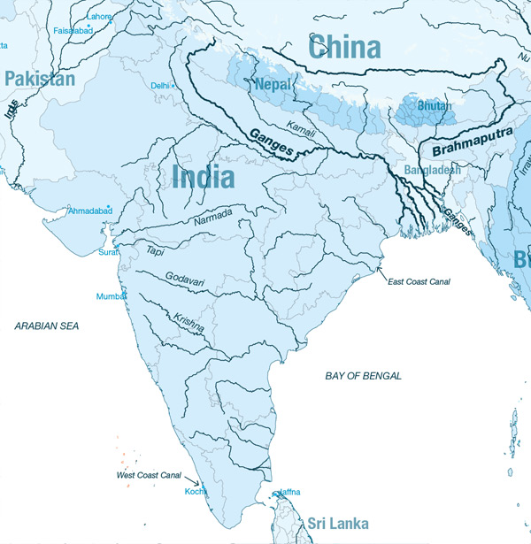
Because parts of China and India are located along waterways, they are subject to flooding, which can damage the soil and make areas practically uninhabitable.

Slide 8
Monsoons cause the majority of flooding in India and China. What are monsoons?
A monsoon is a seasonal change in the direction of the strongest winds of a region. Monsoons cause wet and dry seasons. Flooding can occur during the wet season.

Slide 9
Monsoons
[select one or two videos below]
Indian Monsoon Mechanism Animation
[3:08 animation explaining monsoons but there is no audio]
Monsoon in Kerala, India [1:22]
Effects of Monsoon Rain on India [3:25]

Slide 10
Think, Pair, Share
Why are monsoons a mixed blessing?
Monsoons help farmers because they rely on rainfall. Water from the rainfall can also be used to generate electricity.

Slide 11
What types of human activity increase the effects of rainfall during the monsoon season?
Deforestation, Land Development, Removing Wetlands

Slide 12
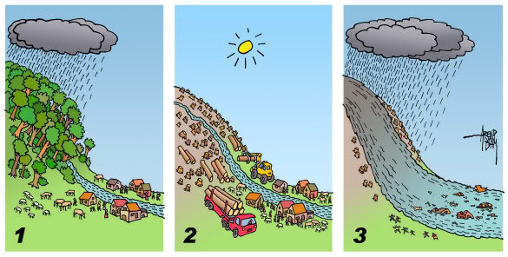
Human Activities that can Affect Flooding

Slide 13
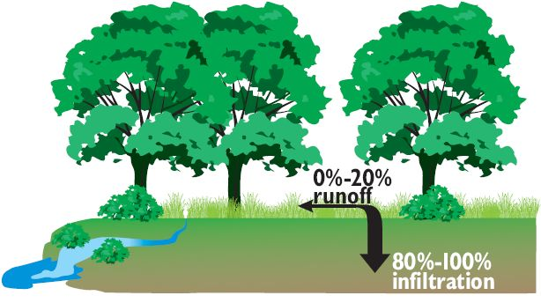
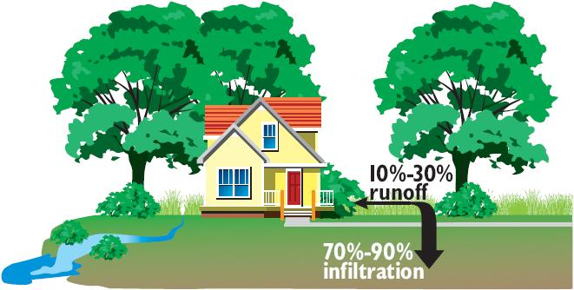
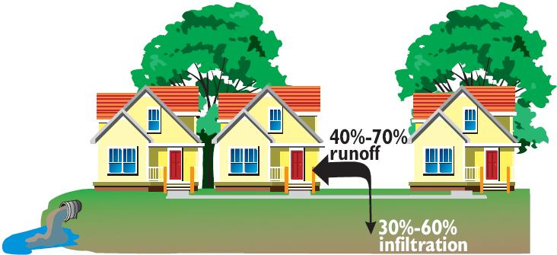

Slide 14
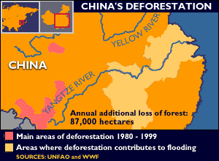
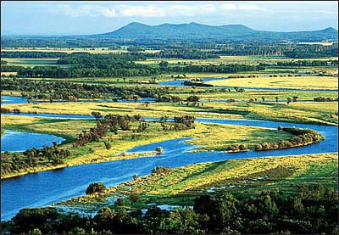
Deforestation and the loss of wetlands has increased the effects of flooding in China.

Slide 15
Summarize the Cause(s) and Effect(s) of Flooding in India and China on your graphic organizer.

Slide 16
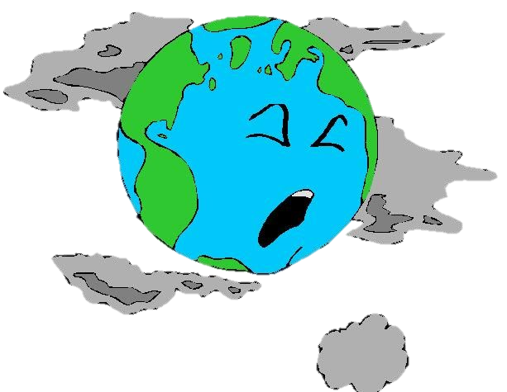
Air pollution is the introduction of harmful materials into the Earth’s atmosphere.

Slide 17
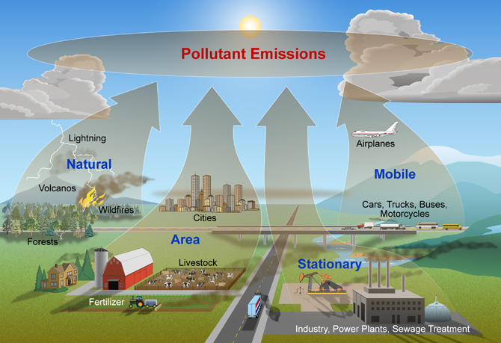
Causes of Air Pollution

Slide 18
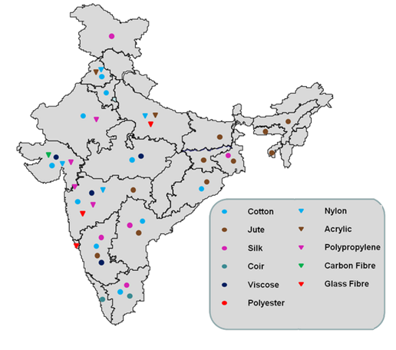
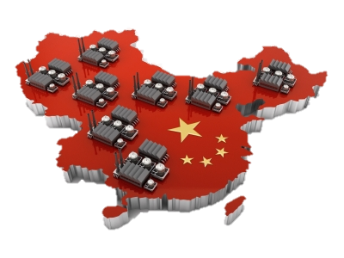
The growth of industry has increased air pollution in India and China (burns fossil fuels).

Slide 19
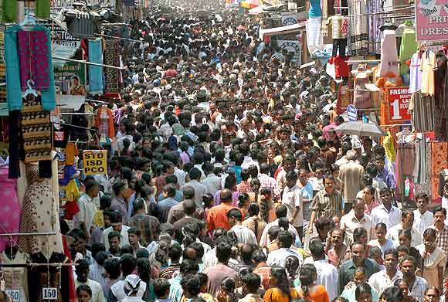
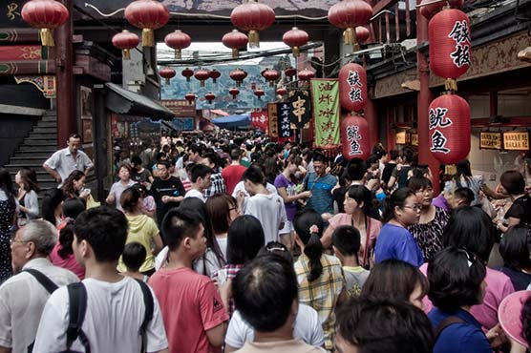
Population growth has increased air pollution in India and China.

Slide 20
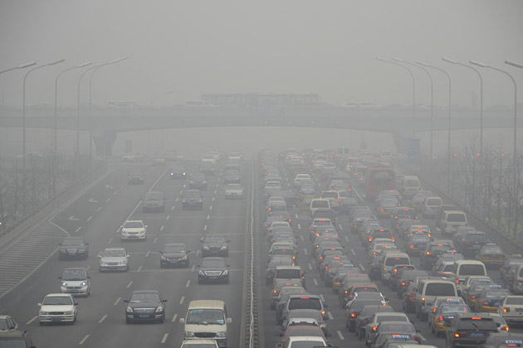
Vehicle emissions has increased air pollution in India and China.

Slide 21
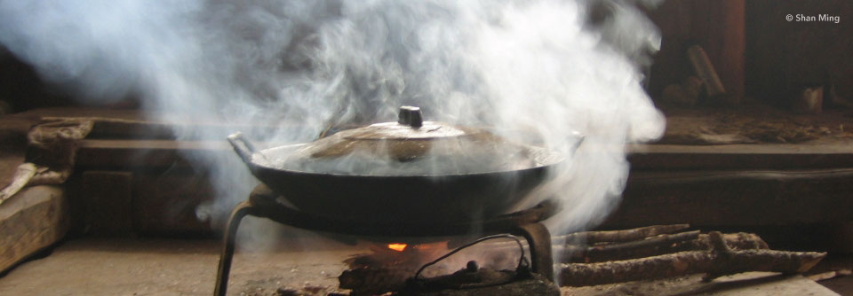
Indoor Air Pollution is an increasing problem in India and China.

Slide 22
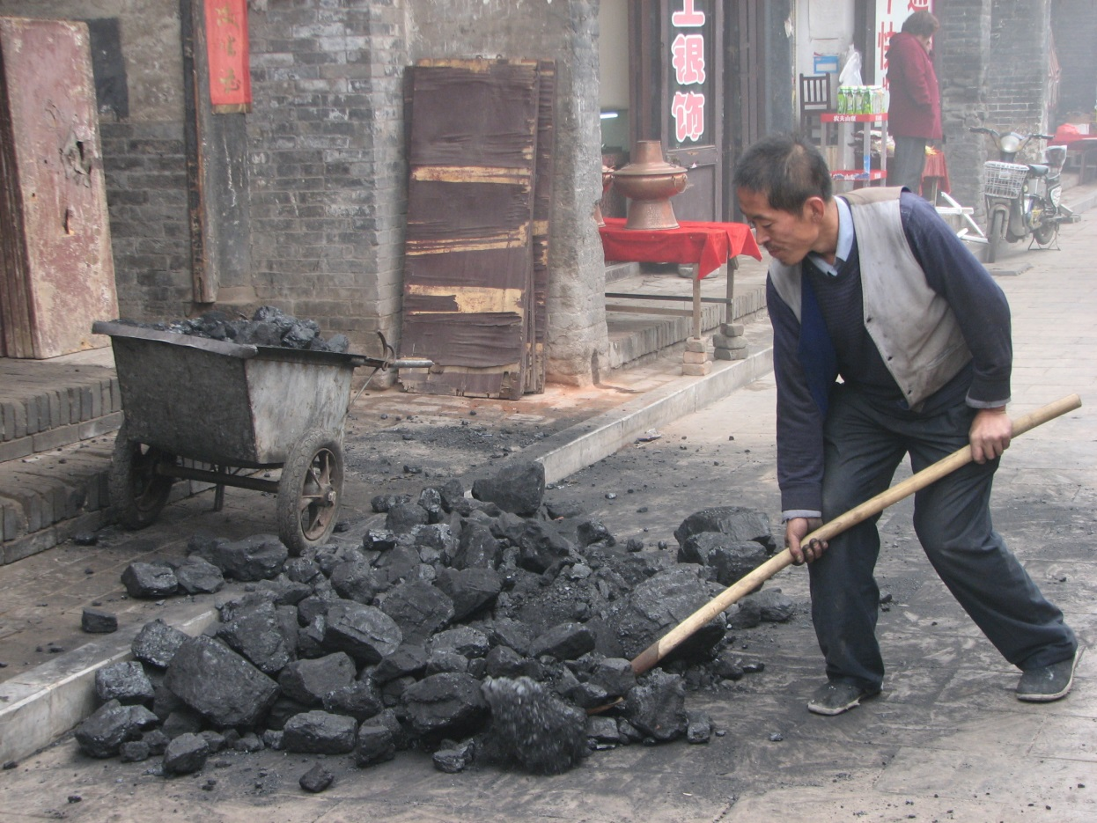
Many Chinese people use coal (fossil fuel) to heat their homes which increases air pollution.

Slide 23
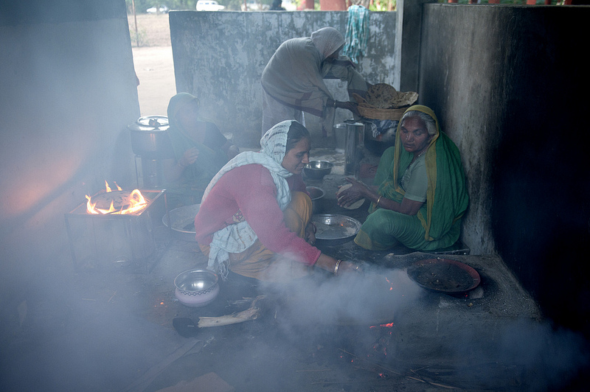
The use of biomass fuels for cooking has increased indoor air pollution.

Slide 24
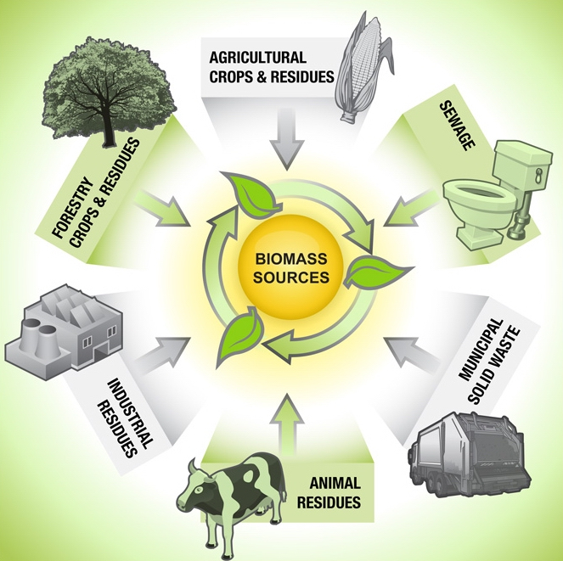
Biomass is biological material derived from living, or recently living organisms

Slide 25
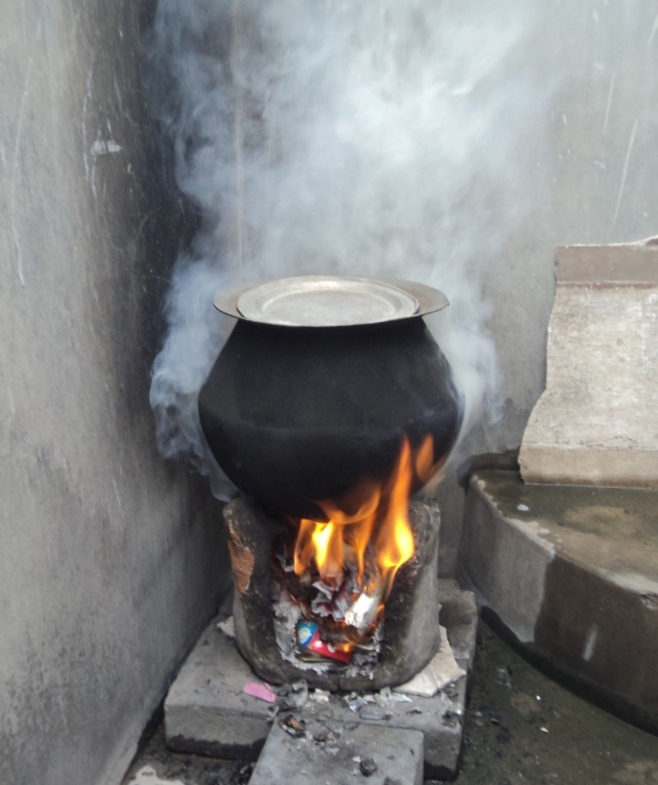
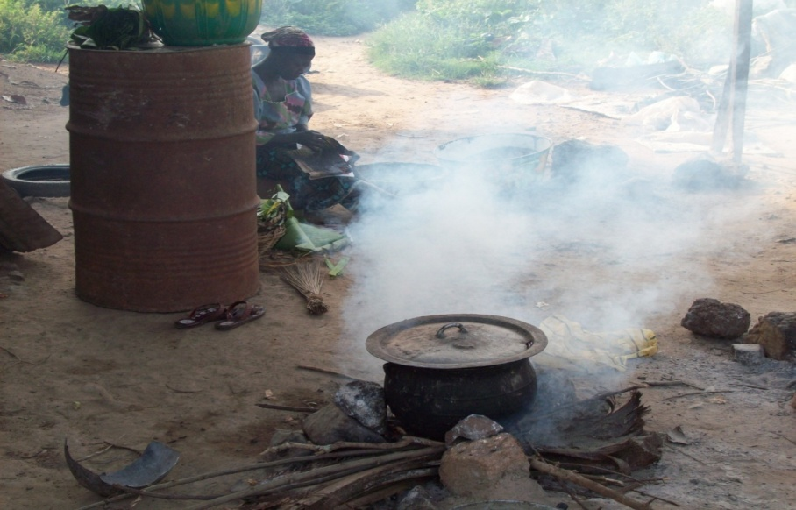
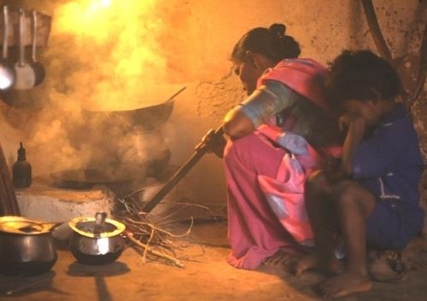
Cooking that Kills [3:00]

Slide 26
Think, Pair, Share
What are the causes of air pollution in India and China?
What are some of the effects of air pollution?

Slide 27
Watch one of the video clips below about air pollution in China:
  Air Pollution becoming life-and-death Issue in China [1:56]
  4,000 People in China Die Every day from Air Pollution [44 seconds]
  China Pollution Levels Hit 20 Times Safe Limit [59 seconds]

Slide 28
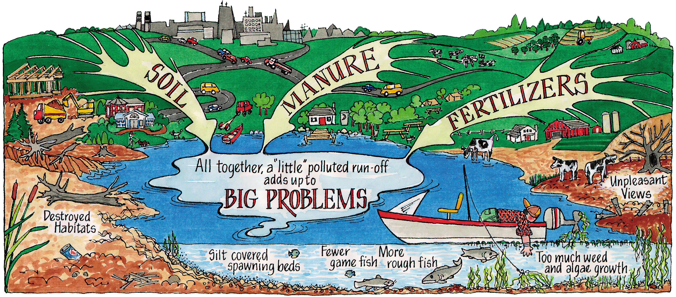
Water Pollution
Dumping sewage and industrial and agricultural wastes cause river pollution, which in turn threatens plant and wildlife species.

Slide 29
Water Pollution in India
Water pollution only worsens India’s water shortage problems.
Artificial fertilizers from farming and industrial waste from factories seep into India’s rivers and pollute them.
India’s Ganges River has been heavily polluted by industrial waste, sewage, and even human remains.

Slide 30
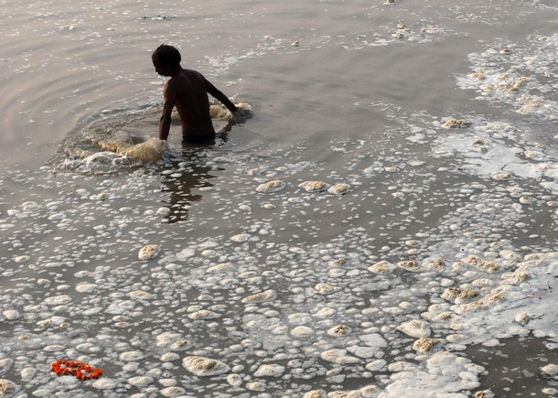
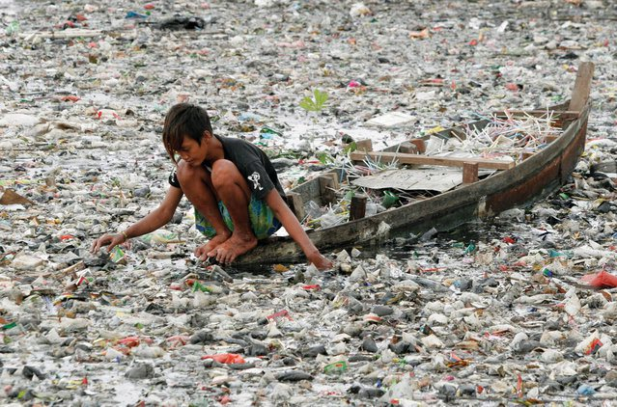
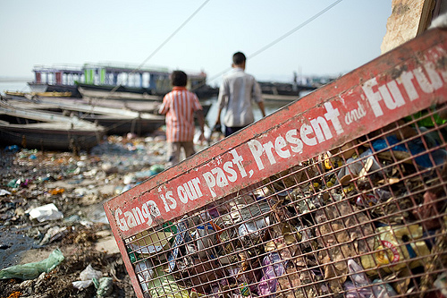
Water
Pollution in India

Slide 31
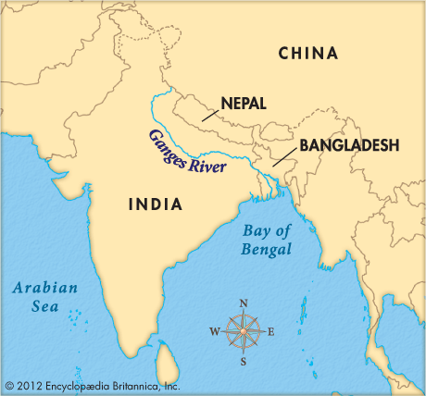
Pollution in India’s Ganges River

Slide 32
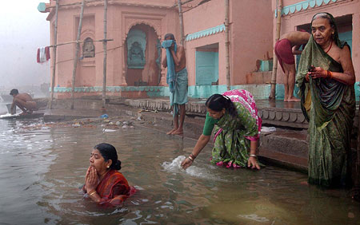
Pollution in India’s Ganges River
The Ganges River serves 500 million people, most of whom believe it is of religious significance.
As a result, many people bathe in the river, which contributes to the pollution.

Slide 33
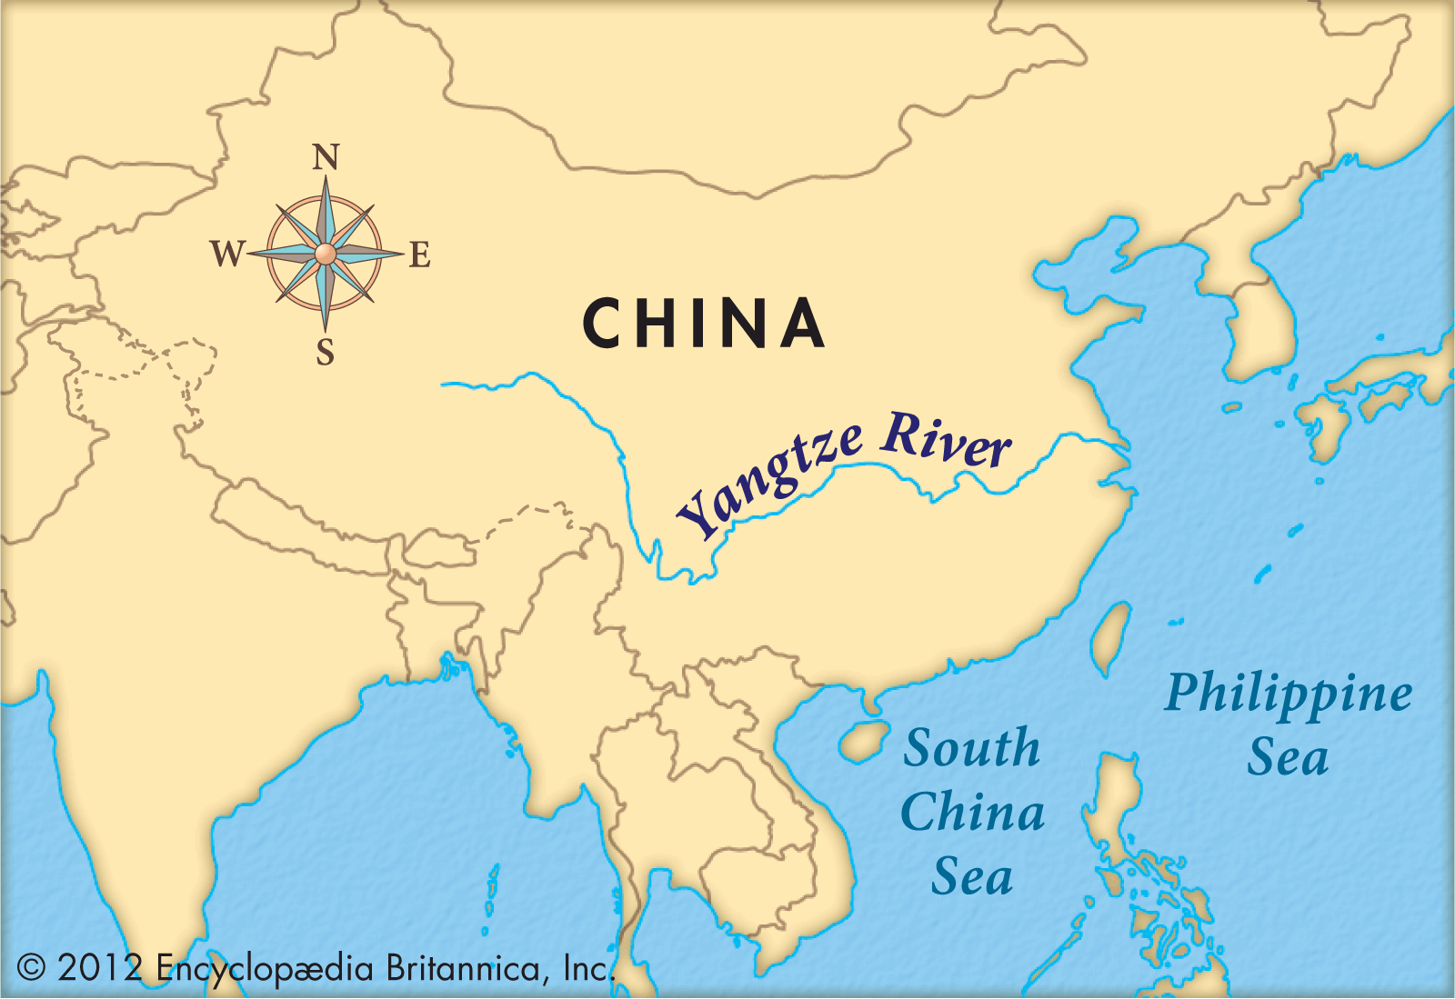
Pollution in China’s Yangtze River

Slide 34
Water Pollution in China
Pollution in the river has increased over 73% in the past 50 years.
Most agree the pollution is caused by large-scale industrial and domestic development, as well as agricultural runoff.
Hundreds of cities located along the river contribute to the pollution.

Slide 35
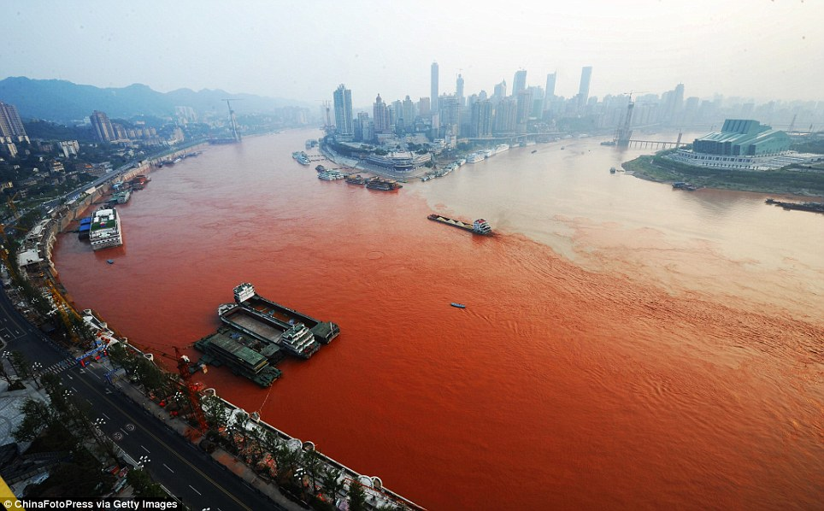
Pollution in China’s Yangtze River

Slide 36
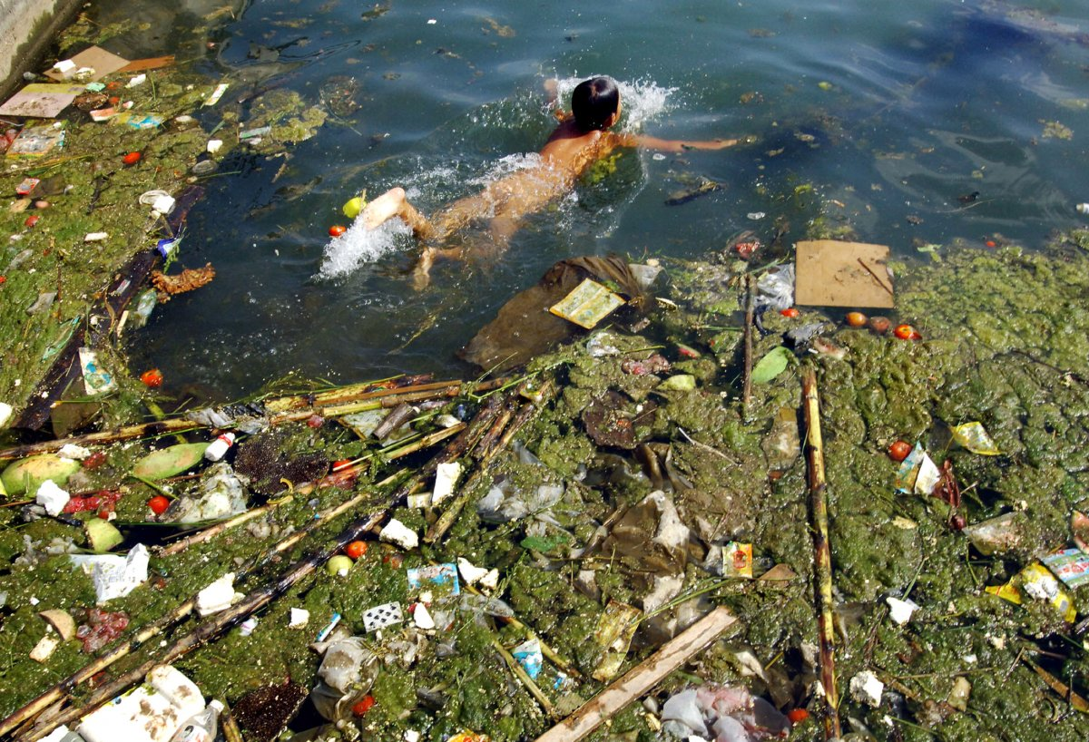
Pollution in China’s Yangtze River

Slide 37
Think, Pair, Share
What are the causes of water pollution in India and China?
What are some of the effects of water pollution?

Slide 38
Summarize the Cause(s) and Effect(s) of Water Pollution in India and China on your graphic organizer.

Slide 39
Watch the video clips below about water pollution in India and China:
Move Over Smog: China’s Water Pollution Off the Charts [3:45]
India’s Polluted Water Systems [4:53]

Slide 40
Summarizer
Identify the causes of air pollution in India and China.
Identify the effects of air pollution.
Identify the causes of water pollution in the Ganges River.
Identify the causes of water pollution in the Yangtze River.
Identify the effects of water pollution.

