Slide 1
Numberless Word Problems
Equal Groups - Unknown Product
Brian Bushart | @bstockus

Slide 2
Notes
This problem set contains 10 numberless word problems organized around one CGI problem type.
There are sample discussion questions in the notes section on each slide.
The idea is that each slide of a problem will be revealed and discussed one at a time to scaffold students’ understanding of the situation and the question ultimately asked.
Feel free to change numbers in the problems.

Slide 3
1
There were some mother mice. They each had some babies.
Notes:
What are you picturing in your mind when you read this story?
How many mother mice do you think there are?
What does the phrase “each had some babies” mean?

Slide 4
1
There were 2 mother mice. They each had some babies.
Notes:
What changed? What did we learn from this new information?
If the word “some” in the second sentence changes to a number, what number do you think it could be?
You might want to do a Google search to find out how many baby mice a mouse usually has in a litter. This might help students understand what might be a reasonable number.

Slide 5
1
There were 2 mother mice. They each had 6 babies.
Notes:
What changed? What did we learn from this new information?
What question could we ask about this situation?

Slide 6
1
There were 2 mother mice. They each had 6 babies. How many baby mice were there altogether?
Notes:
Are there 6 baby mice altogether? How do you know?
How can you use objects, pictures, or numbers to answer this question?

Slide 7
2
Edwin saw some praying mantises while he was taking a walk. Each praying mantis had the same number of legs.
Notes:
What are you picturing in your mind when you read this story?
How many praying mantises do you think Edwin saw?
How many legs do you think a praying mantis has?
If your students are not familiar with praying mantises, the following three slides include pictures. The third slide makes it easy to count the number of legs.

Slide 8
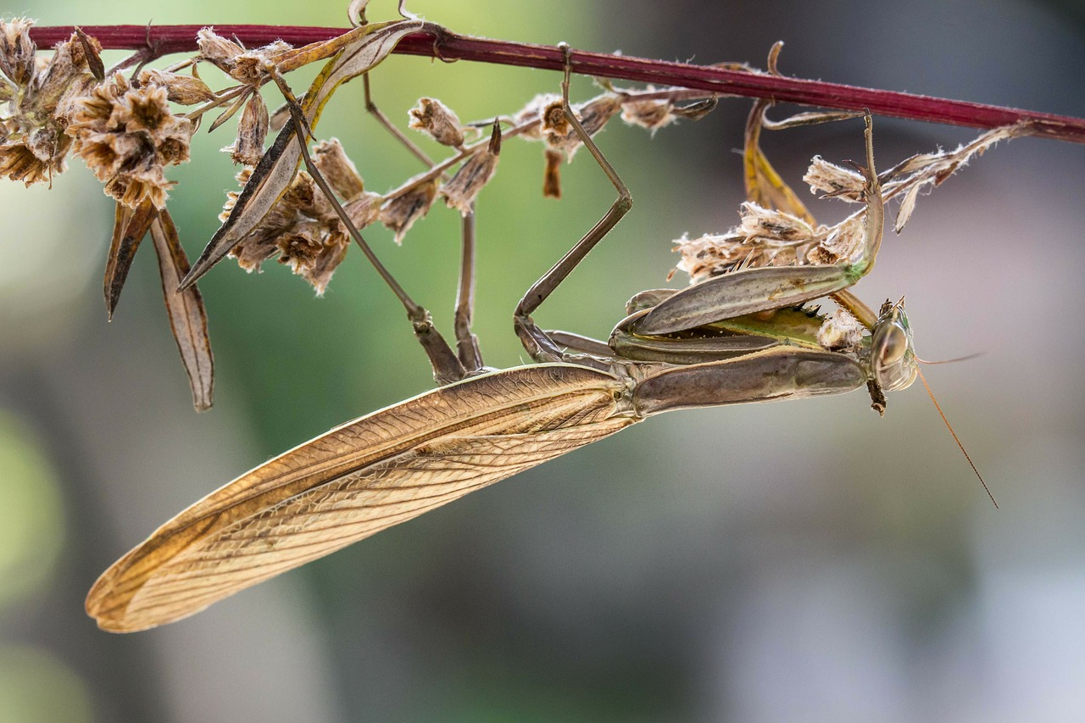
Notes:
Source: https://pixabay.com/en/praying-mantis-insect-macro-nature-283266/

Slide 9
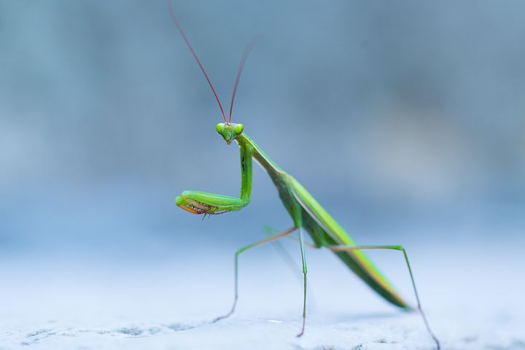
Notes:
Source: https://pixabay.com/en/wild-praying-mantis-insect-macro-1681187/

Slide 10
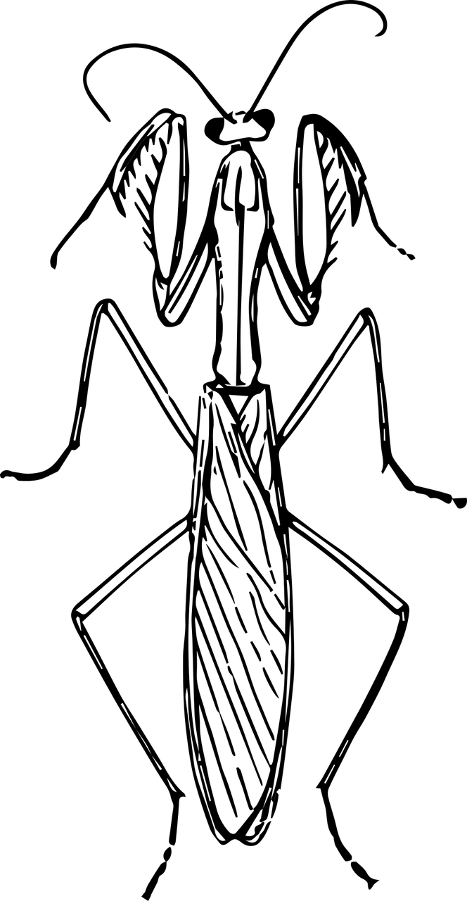
Notes:
Source: https://pixabay.com/en/animal-bug-insect-mantis-praying-1295178/

Slide 11
2
Edwin saw some praying mantises while he was taking a walk. Each praying mantis had 6 legs.
Notes:
What changed? What did we learn from this new information?
What does it mean that “each praying mantis had 6 legs?”

Slide 12
2
Edwin saw 4 praying mantises while he was taking a walk. Each praying mantis had 6 legs.
Notes:
What changed? What did we learn from this new information?
What question could we ask about this situation?

Slide 13
2
Edwin saw 4 praying mantises while he was taking a walk. Each praying mantis had 6 legs. How many legs were there altogether?
Notes:
Was the number of legs less than 6, equal to 6, or greater than 6? How do you know?
How can you use objects, pictures, or numbers to answer this question?

Slide 14
3
There were some beavers chewing trees to cut them down. Each beaver cut down the same number of trees.
Notes:
What are you picturing in your mind when you read this story?
What numbers do you think would make sense in this problem?
If students are not familiar with beavers or their work of chewing through trees, the following slides contain helpful images. You might also do a Google search for a video of a beaver at work.

Slide 15
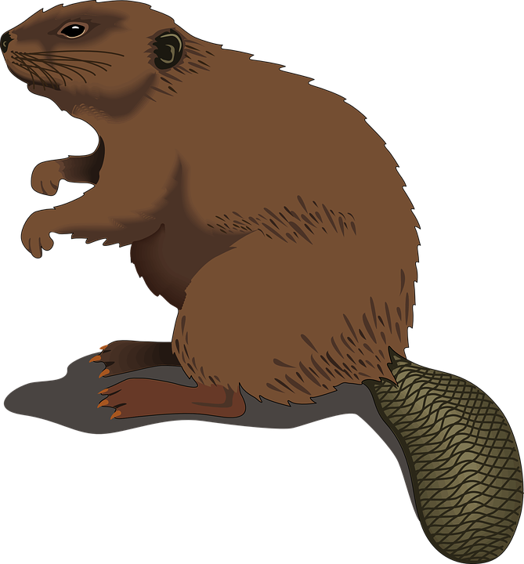
Notes:
Source: https://pixabay.com/en/beaver-wood-standing-tail-log-48437/

Slide 16
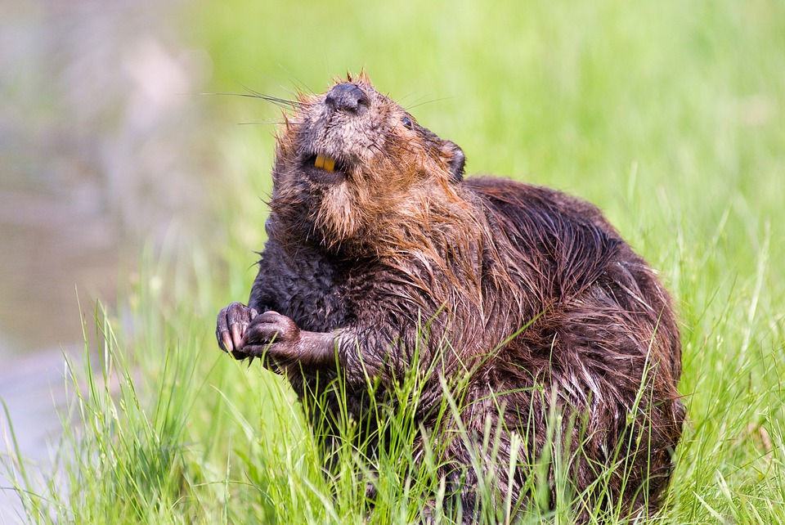
Notes:
Source: https://pixabay.com/en/beaver-pond-wildlife-aquatic-cute-1528947/

Slide 17
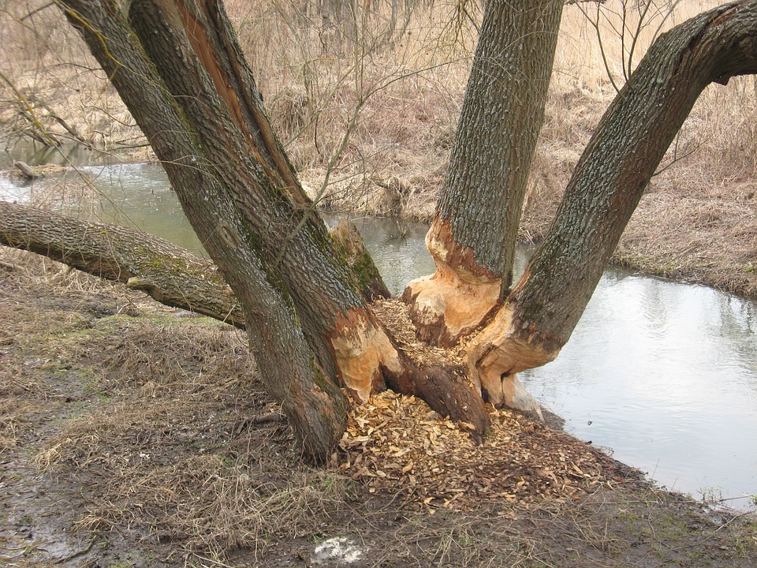
Notes:
Source: https://pixabay.com/en/beavers-tree-nature-beavers-work-1538687/

Slide 18
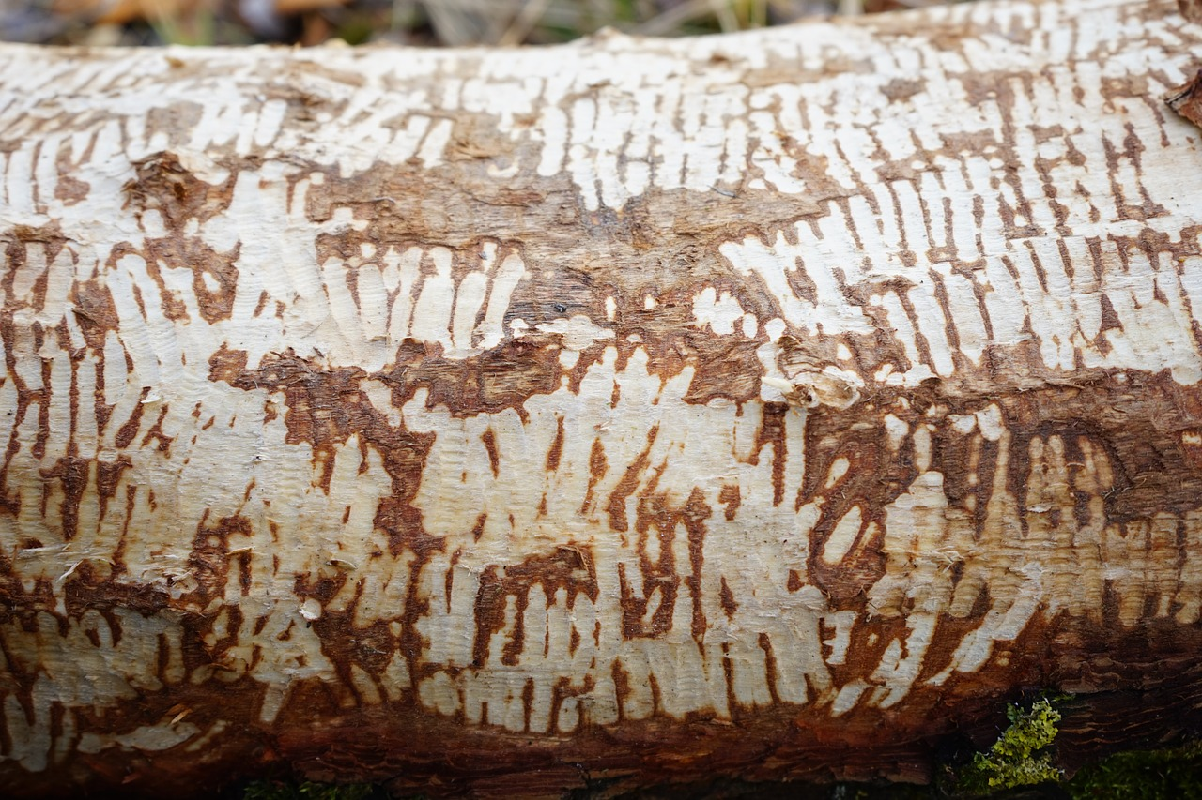
Notes:
Source: https://pixabay.com/en/log-bark-beaver-eating-gnawed-off-274998/

Slide 19
3
There were 3 beavers chewing trees to cut them down. Each beaver cut down the same number of trees.
Notes:
What changed? What did we learn from this new information?
What do we still need to find out? What do you think this number could be?

Slide 20
3
There were 3 beavers chewing trees to cut them down. Each beaver cut down 5 trees.
Notes:
What changed? What did we learn from this new information?
What question could we ask about this situation?

Slide 21
3
There were 3 beavers chewing trees to cut them down. Each beaver cut down 5 trees. How many trees did they cut down altogether?
Notes:
Do you think the answer is more than 10 or less than 10? Why do you think that?

Slide 22
4
There were some mother ducks. They are each sitting on some eggs.
Notes:
What are you picturing in your mind when you read this story?
How many mother ducks do you think there are?
What are the mother ducks doing?

Slide 23
4
There were some mother ducks. They are each sitting on 8 eggs.
Notes:
What changed? What did we learn from this new information?
Do we know how many mother ducks there are?
Do you think there are exactly 8 eggs or more than 8 eggs? Why do you say that?

Slide 24
4
There were 2 mother ducks. They are each sitting on 8 eggs.
Notes:
What changed? What did we learn from this new information?
What question could we ask about this situation?

Slide 25
4
There were 2 mother ducks. They are each sitting on 8 eggs. How many eggs are there altogether?
Notes:
How many groups of eggs are there? How do you know?
How many eggs are in each group? How do you know?
How can you use objects, pictures, or numbers to answer this question?

Slide 26
5
There are pairs of sneakers in the closet.
Notes:
What are you picturing in your mind when you read this story?
What are you picturing when you hear “pairs of sneakers”?
How many pairs of sneakers do you think are in the closet?

Slide 27
5
There are 7 pairs of sneakers in the closet.
Notes:
What changed? What did we learn from this new information?
What question could we ask about this situation?

Slide 28
5
There are 7 pairs of sneakers in the closet. How many sneakers are in the closet?
Notes:
How many groups of sneakers are there?
How many sneakers are in each group?
How can you use objects, pictures, or numbers to answer this question?

Slide 29
6
Kiara wrote a story on the computer. She printed some copies of it to share with her friends.
Notes:
What are you picturing in your mind when you read this story?
What do you think the story could have been about?
Why do you think the person wanted to share copies of the story with her friends?

Slide 30
6
Kiara wrote a story on the computer. She printed 5 copies of it to share with her friends.
Notes:
What changed? What did we learn from this new information?
What questions could we ask about this situation?

Slide 31
6
Kiara wrote a story on the computer. She printed 5 copies of it to share with her friends. Each copy of the story used 4 pieces of paper.
Notes:
What changed? What did we learn from this new information?
What questions could we ask about this situation?

Slide 32
6
Kiara wrote a story on the computer. She printed 5 copies of it to share with her friends. Each copy of the story used 4 pieces of paper. How many pieces of paper did she use in all?
Notes:
How many copies did she print?
How many pieces of paper did it take to make each copy?
How can you use objects, pictures, or numbers to answer this question?

Slide 33
7
Sahar’s mom bought some bags of apples. There were some apples in each bag.
Notes:
What are you picturing in your mind when you read this story?
Why do you think Sahar’s mom bought apples?

Slide 34
7
Sahar’s mom bought some bags of apples. There were 4 apples in each bag.
Notes:
What changed? What did we learn from this new information?
How many bags of apples do you think she bought?
What could she be doing with all these bags of apples?

Slide 35
7
Sahar’s mom bought 3 bags of apples. There were 4 apples in each bag.
Notes:
What changed? What did we learn from this new information?
What questions could we ask about this situation?

Slide 36
7
Sahar’s mom bought 3 bags of apples. There were 4 apples in each bag. How many apples did Sahar’s mom buy?
Notes:
What operation(s) can we use to solve this problem? How do you know?
Let’s estimate. Did Sahar’s mom buy more than 5 apples? More than 10 apples? How do you know?

Slide 37
8
Ty’s dog eats some dog food each day.
Notes:
What are you picturing in your mind when you read this story?
Does anyone here have a dog? Do you know how much your dog eats each day?

Slide 38
8
Ty’s dog eats 4 cups of dog food each day.
Notes:
What changed? What did we learn from this new information?
Does 5 cups seem like a lot of food or a little bit of food to you? Why do you say that?
What questions could we ask about this situation?

Slide 39
8
Ty’s dog eats 4 cups of dog food each day. How many cups of dog food does Ty’s dog eat in 7 days?
Notes:
What operation(s) can we use to solve this problem? How do you know?
Let’s estimate. Do you think Ty’s dog eats more than 10 cups of dog food in 7 days? More than 20 cups? How do you know?

Slide 40
9
There were some go-karts on the track. Each go-kart has the same number of wheels.
Notes:
What are you picturing in your mind when you read this story?
What numbers do you think would make sense in this problem?
If your students are not familiar with go-karts, the pictures on the next two slides may help them better understand the situation.

Slide 41
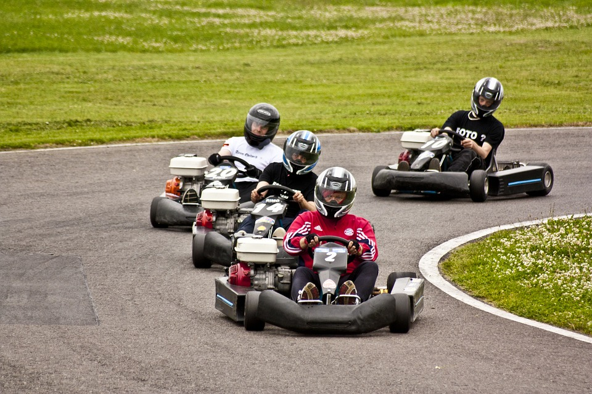
Notes:
Source: https://pixabay.com/en/kart-go-kart-race-track-kart-racing-1754533/

Slide 42
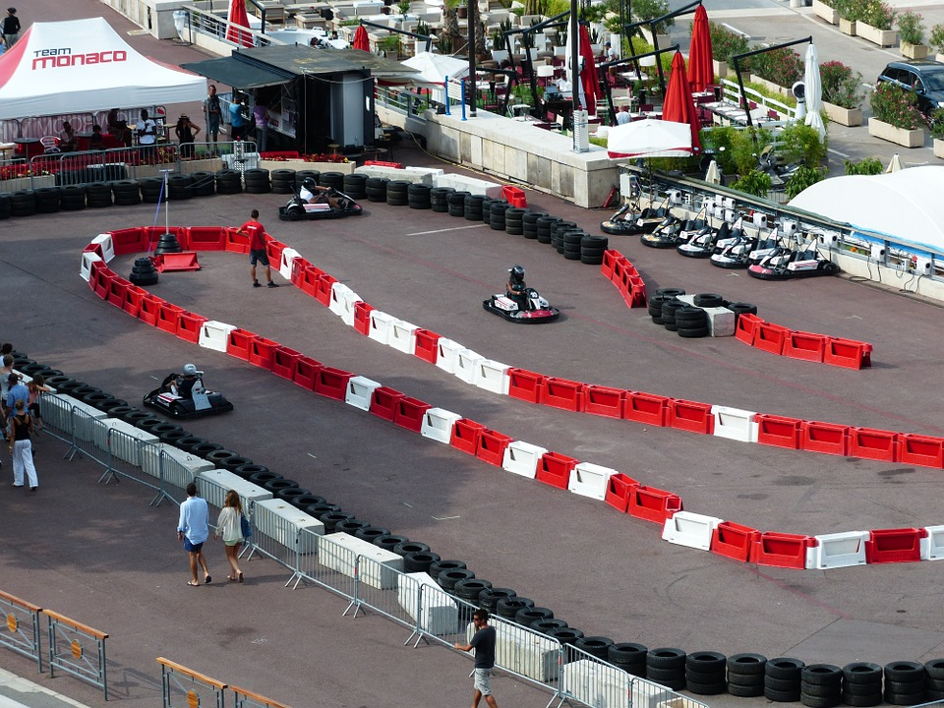
Notes:
Source: https://pixabay.com/en/go-kart-track-kart-go-kart-187490/

Slide 43
9
There were some go-karts on the track. Each go-kart has 4 wheels.
Notes:
What changed? What did we learn from this new information?
What do we still need to find out? What do you think this number could be?

Slide 44
9
There were 10 go-karts on the track. Each go-kart has 4 wheels.
Notes:
What changed? What did we learn from this new information?
What question could we ask about this situation?

Slide 45
9
There were 10 go-karts on the track. Each go-kart has 4 wheels. How many wheels are there altogether?
Notes:
Which operation(s) can we use to answer this question? How do you know?

Slide 46
10
Vivek bought some boxes of granola bars for a camping trip. Each box had the same number of granola bars.
Notes:
What are you picturing in your mind when you read this story?
How many boxes do you think he bought? What’s a reasonable amount? What’s an unreasonable amount?

Slide 47
10
Vivek bought 5 boxes of granola bars for a camping trip. Each box had the same number of granola bars.
Notes:
What changed? What did we learn from this new information?
How many granola bars do you think are in each box? What’s a reasonable amount? What’s an unreasonable amount?

Slide 48
10
Vivek bought 5 boxes of granola bars for a camping trip. Each box had 8 granola bars.
Notes:
What changed? What did we learn from this new information?
What question could we ask about this situation?

Slide 49
10
Vivek bought 5 boxes of granola bars for a camping trip. Each box had 8 granola bars. How many granola bars did Vivek buy altogether?
Notes:
What operation(s) can we use to answer this question? How do you know?
Let’s estimate. Do you think he bought more than 10 granola bars? More than 20 granola bars?

