Slide 1
Numberless Word Problems
Equal Groups – Number of Groups Unknown
Brian Bushart | @bstockus

Slide 2
Notes
This problem set contains 10 numberless word problems organized around one CGI problem type.
There are sample discussion questions in the notes section on each slide.
The idea is that each slide of a problem will be revealed and discussed one at a time to scaffold students’ understanding of the situation and the question ultimately asked.
Feel free to change numbers in the problems.

Slide 3
1
The florist has some roses. She is going to use some of the roses in each bouquet she makes.
Notes:
What are you picturing in your mind when you read this story?
What color roses are you picturing in your mind?
How many roses are you picturing in each bouquet?
If students are unfamiliar with the word “bouquet” the images on the next slide can help. To help students with visualizing, let them know the bouquets may only be roses, but they might also be mixed bouquets and we’re only talking about the number of roses in each bouquet.

Slide 4
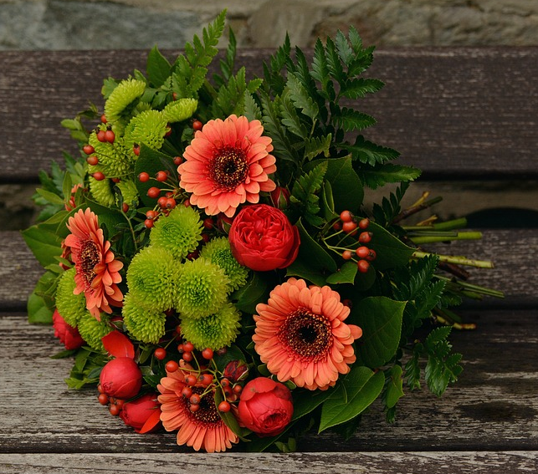
Notes:
Source:
https://pixabay.com/en/sunflowers-vase-fall-autumn-1719119/
https://pixabay.com/en/autumn-flowers-bouquet-gerbera-1721896/

Slide 5
1
The florist has 24 roses. She is going to use some of the roses in each bouquet she makes.
Notes:
What changed? What did we learn from this new information?
How many bouquets do you think she can make with 24 roses?
What do we know about each bouquet?

Slide 6
1
The florist has 24 roses. She is going to use 6 of the roses in each bouquet she makes.
Notes:
What changed? What did we learn from this new information?
What question could we ask about this situation?

Slide 7
1
The florist has 24 roses. She is going to use 6 of the roses in each bouquet she makes. How many bouquets can she make using all of the roses?
Notes:
Do you think she can make a lot of bouquets or just a few? Why do you say that?
How can you use objects, pictures, or numbers to answer this question?

Slide 8
2
Zoe is putting some chairs at tables for a party. She is putting the same number of chairs at each table.
Notes:
What are you picturing in your mind when you read this story?
How many tables are you picturing?
How many chairs do you think are at each table?

Slide 9
2
Zoe is putting 36 chairs at tables for a party. She is putting the same number of chairs at each table.
Notes:
What changed? What did we learn from this new information?
Why do you think she needs so many chairs?
How does this change what you are picturing in your mind?

Slide 10
2
Zoe is putting 36 chairs at tables for a party. She is putting 4 chairs at each table.
Notes:
What changed? What did we learn from this new information?
What question could we ask about this situation?

Slide 11
2
Zoe is putting 36 chairs at tables for a party. She is putting 4 chairs at each table. At how many tables will Zoe put chairs?
Notes:
Let’s estimate. Did Zoe put chairs at more than 36 tables or less than 36 tables?
How can you use objects, pictures, or numbers to answer this question?

Slide 12
3
There are some people going on a field trip to the museum. They are taking vans to get there. Each van holds the same number of people.
Notes:
What are you picturing in your mind when you read this story?
How many people do you think are going on the field trip?
How many people do you think each van holds?
How is a van different from a car or bus?

Slide 13
3
There are 32 people going on a field trip to the museum. They are taking vans to get there. Each van holds the same number of people.
Notes:
What changed? What did we learn from this new information?
How does this number compare to the number of people you were picturing in your mind?
What do we still need to find out? What do you think this number could be?

Slide 14
3
There are 32 people going on a field trip to the museum. They are taking vans to get there. Each van holds 8 people.
Notes:
What changed? What did we learn from this new information?
What question could we ask about this situation?

Slide 15
3
There are 32 people going on a field trip to the museum. They are taking vans to get there. Each van holds 8 people. How many vans will they need?
Notes:
Let’s estimate. Do you think they need more than 8 vans or less than 8 vans? Why do you say that?
How can you use objects, pictures, or numbers to help you answer this question?

Slide 16
4
Mr. Paulson is planning to make some hamburgers for a neighborhood BBQ. There are the same number of hamburger buns in each pack.
Notes:
What are you picturing in your mind when you read this story?
How many hamburgers do you think he’s going to make?
Why do you think this story mentions hamburger buns?
How many hamburger buns do you think are in each pack?

Slide 17
4
Mr. Paulson is planning to make 40 hamburgers for a neighborhood BBQ. There are the same number of hamburger buns in each pack.
Notes:
What changed? What did we learn from this new information?
How does this number of hamburgers compare to your guess?
How many hamburger buns does he need for all these hamburgers?

Slide 18
4
Mr. Paulson is planning to make 40 hamburgers for a neighborhood BBQ. There are 8 hamburger buns in each pack.
Notes:
What changed? What did we learn from this new information?
What question could we ask about this situation?

Slide 19
4
Mr. Paulson is planning to make 40 hamburgers for a neighborhood BBQ. There are 8 hamburger buns in each pack. How many packs of hamburger buns will he need to buy?
Notes:
Is one pack of hamburger buns going to be enough? Why do you say that?
How can you use objects, pictures, or numbers to answer this question?

Slide 20
5
Viola was looking at a spider exhibit at the zoo. She counted some legs in the exhibit.
Notes:
What are you picturing in your mind when you read this story?
What are some ways spiders look different?
What are some ways spiders look the same?

Slide 21
5
Viola was looking at a spider exhibit at the zoo. She counted 56 legs in the exhibit.
Notes:
What changed? What did we learn from this new information?
What question could we ask about this situation?

Slide 22
5
Viola was looking at a spider exhibit at the zoo. She counted 56 legs in the exhibit. How many spiders did Viola see?
Notes:
How can we answer this question when there’s only one number?
How can you use objects, pictures, or numbers to answer this question?

Slide 23
6
Ricky tried on some shoes at the shoe store today.
Notes:
What are you picturing in your mind when you read this story?
Why do you think Ricky is trying on shoes today?

Slide 24
6
Ricky tried on 12 shoes at the shoe store today.
Notes:
What changed? What did we learn from this new information?
What questions could we ask about this situation? (Students may be stumped at this point. That’s okay.)

Slide 25
6
Ricky tried on 12 shoes at the shoe store today. How many pairs of shoes did he try on?
Notes:
Did Ricky try on 12 pairs of shoes? How do you know?
How can we answer this question when there’s only one number?
How can you use objects, pictures, or numbers to answer this question?

Slide 26
7
Denise ran some days this week. She ran some number of miles altogether. She ran the same number of miles each day.
Notes:
What are you picturing in your mind when you read this story?
How many days do you think Denise ran? What is a reasonable guess? What is an unreasonable guess?

Slide 27
7
Denise ran 4 days this week. She ran some number of miles altogether. She ran the same number of miles each day.
Notes:
What changed? What did we learn from this new information?
If she ran 4 days this week, how many days did she not run?
How many miles do you think she ran altogether? What’s a reasonable guess? What’s an unreasonable guess?

Slide 28
7
Denise ran 4 days this week. She ran 12 miles altogether. She ran the same number of miles each day.
Notes:
What changed? What did we learn from this new information?
What questions could we ask about this situation?

Slide 29
7
Denise ran 4 days this week. She ran 12 miles altogether. She ran the same number of miles each day. How many miles did she run each day?
Notes:
What operation(s) can we use to solve this problem? How do you know?
Let’s estimate. Did she run more than 12 miles each day or less than 12 miles each day? How do you know?

Slide 30
8
Mrs. Cheyney gives some new pencils to each of her students. She gives out a lot of pencils.
Notes:
What are you picturing in your mind when you read this story?
Why do you think Mrs. Cheyney is giving her students new pencils?
How many pencils do you think she gives to each student?

Slide 31
8
Mrs. Cheyney gives 2 new pencils to each of her students. She gives out a lot of pencils.
Notes:
What changed? What did we learn from this new information?
How many pencils do you think she gave our altogether? What is a reasonable amount? What is an unreasonable amount?

Slide 32
8
Mrs. Cheyney gives 2 new pencils to each of her students. She gives out 46 pencils.
Notes:
What changed? What did we learn from this new information?
How does this number compare to your guess?
What question could we ask about this situation?

Slide 33
8
Mrs. Cheyney gives 2 new pencils to each of her students. She gives out 46 pencils. How many students got pencils?
Notes:
What operation(s) can we use to solve this problem? How do you know?
Let’s estimate. Does Mrs. Cheyney have more than 46 students in her class or less than 46 students in her class? How do you know?

Slide 34
9
Mr. Smith asked some students to each hold up some fingers. He saw a lot of fingers.
Notes:
What are you picturing in your mind when you read this story?
How many fingers do you think each student help up?
How many fingers do you think he saw altogether?

Slide 35
9
Mr. Smith asked some students to each hold up 10 fingers. He saw a lot of fingers.
Notes:
What changed? What did we learn from this new information?
What do we still need to find out? What do you think this number could be?

Slide 36
9
Mr. Smith asked some students to each hold up 10 fingers. He saw 90 fingers.
Notes:
What changed? What did we learn from this new information?
What question could we ask about this situation?

Slide 37
9
Mr. Smith asked some students to each hold up 10 fingers. He saw 90 fingers. How many students were holding up fingers?
Notes:
Which operation(s) can we use to answer this question? How do you know?
What if he saw 100 fingers instead of 90 fingers? How many students would be holding up fingers then?

Slide 38
10
Gina has some cans of cat food. She is putting them in stacks with the same number of cans in each stack.
Notes:
What are you picturing in your mind when you read this story?
Why might Gina be putting the cans into stacks?
How many cans do you think are in each stack?

Slide 39
10
Gina has 24 cans of cat food. She is putting them in stacks with the same number of cans in each stack.
Notes:
What changed? What did we learn from this new information?
Do you think she can put all of the cans in 1 stack? Why do you say that?

Slide 40
10
Gina has 24 cans of cat food. She is putting them in stacks of 4.
Notes:
What changed? What did we learn from this new information?
What question could we ask about this situation?

Slide 41
10
Gina has 24 cans of cat food. She is putting them in stacks of 4. How many stacks can Gina make?
Notes:
What operation(s) can we use to answer this question? How do you know?
Let’s estimate. Do you think she makes more than 5 stacks or less than 5 stacks? More than 10 stacks or less than 10 stacks?

