Slide 1
Numberless Word Problems
Equal Groups – Group Size Unknown
Brian Bushart | @bstockus

Slide 2
Notes
This problem set contains 10 numberless word problems organized around one CGI problem type.
There are sample discussion questions in the notes section on each slide.
The idea is that each slide of a problem will be revealed and discussed one at a time to scaffold students’ understanding of the situation and the question ultimately asked.
Feel free to change numbers in the problems.

Slide 3
1
Heather has some stickers she is going to put into some treat bags for her birthday party. She puts the same number of stickers in each bag.
Notes:
What are you picturing in your mind when you read this story?
What kinds of stickers do you think she has?
What other kinds of treats might she put in the bags?

Slide 4
1
Heather has some stickers she is going to put into 4 treat bags for her birthday party. She puts the same number of stickers in each bag.
Notes:
What changed? What did we learn from this new information?
Why do you think she only made 4 treat bags?
How many stickers do you think she has?

Slide 5
1
Heather has 12 stickers she is going to put into 4 treat bags for her birthday party. She puts the same number of stickers in each bag.
Notes:
What changed? What did we learn from this new information?
Does this mean each treat bag will get 12 stickers? How do you know?
What question could we ask about this situation?

Slide 6
1
Heather has 12 stickers she is going to put into 4 treat bags for her birthday party. She puts the same number of stickers in each bag. How many stickers does she put in each bag?
Notes:
Let’s estimate. Can she put 10 stickers in each treat bag? 5 stickers? How do you now?
How can you use objects, pictures, or numbers to answer this question?

Slide 7
2
Adriana put some crickets in her terrarium for her geckos to eat. Each gecko ate the same number of crickets.
Notes:
What are you picturing in your mind when you read this story?
How many crickets do you think a gecko eats?
How many crickets and geckos are you picturing in the terrarium?
If your students are not familiar with geckos and/or crickets, the next two slides contain images that may support their understanding of this problem.

Slide 8
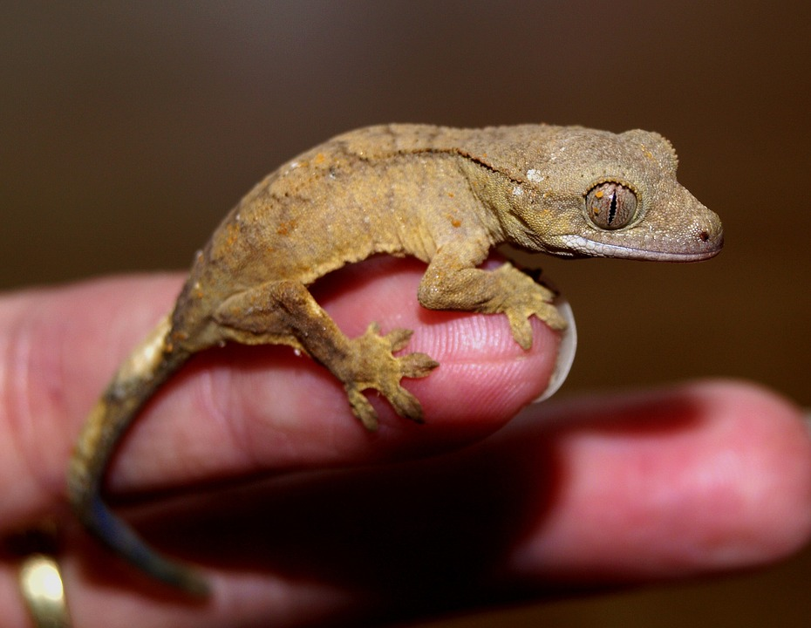
Notes:
Source: https://pixabay.com/en/crown-gecko-reptile-gecko-1302347/

Slide 9
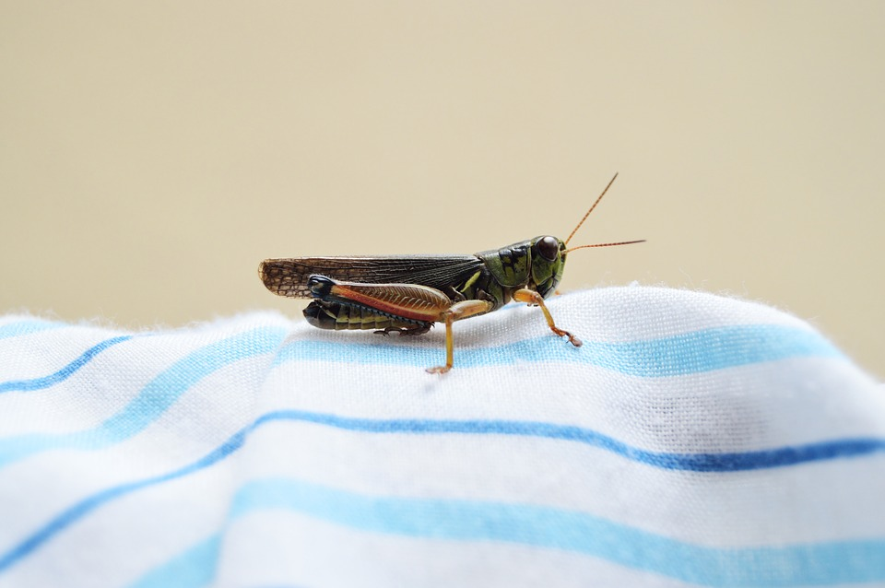
Notes:
Source: https://pixabay.com/en/insect-green-cricket-fabric-nature-1613679/

Slide 10
2
Adriana put 8 crickets in her terrarium for her geckos to eat. Each gecko ate the same number of crickets.
Notes:
What changed? What did we learn from this new information?
How does this compare to the number of crickets you were picturing?
If she puts in 8 crickets, how many geckos do you think are in the terrarium?

Slide 11
2
Adriana put 8 crickets in her terrarium for her 2 geckos to eat. Each gecko ate the same number of crickets.
Notes:
What changed? What did we learn from this new information?
What question could we ask about this situation?

Slide 12
2
Adriana put 8 crickets in her terrarium for her 2 geckos to eat. Each gecko ate the same number of crickets. How many crickets did each gecko eat?
Notes:
Did each gecko eat 8 crickets? How do you know?
How can you use objects, pictures, or numbers to answer this question?

Slide 13
3
Hector is taking some coins to school. He puts the coins into the pockets on his backpack.
Notes:
What are you picturing in your mind when you read this story?
Why do you think Hector is brining coins to school?
Why do you think he wants to put them in the pockets on his backpack?

Slide 14
3
Hector is taking some coins to school. He puts the coins into the 4 pockets on his backpack.
Notes:
What changed? What did we learn from this new information?
What do we still need to find out? What do you think this number could be?
How many coins do you think he is taking to school?

Slide 15
3
Hector is taking 20 coins to school. He puts the coins into the 4 pockets on his backpack.
Notes:
What changed? What did we learn from this new information?
What question could we ask about this situation?

Slide 16
3
Hector is taking 20 coins to school. He puts the coins into the 4 pockets on his backpack. If he puts the same number of coins in each pocket, how many coins will be in each pocket?
Notes:
Can one pocket have 2 coins and another pocket have 5 coins? How do you know?
How can you use objects, pictures, or numbers to answer this question?

Slide 17
4
A baker is packaging some cupcakes to sell at her bakery. She fills some boxes with all of the cupcakes.
Notes:
What are you picturing in your mind when you read this story?
How many cupcakes do you think she has?
What flavor would you like to imagine they are?

Slide 18
4
A baker is packaging 30 cupcakes to sell at her bakery. She fills some boxes with all of the cupcakes.
Notes:
What changed? What did we learn from this new information?
How does this number compare to your estimate? How many boxes do you think she could fill with 30 cupcakes? Why do you think that?

Slide 19
4
A baker is packaging 30 cupcakes to sell at her bakery. She fills 5 boxes with all of the cupcakes.
Notes:
What changed? What did we learn from this new information?
What question could we ask about this situation?

Slide 20
4
A baker is packaging 30 cupcakes to sell at her bakery. She fills 5 boxes with all of the cupcakes. If she puts the same number of cupcakes in each box, how many cupcakes are in one box?
Notes:
Could there be 30 cupcakes in each box? How do you know?
Do you think there’s more than 30 or less than 30 cupcakes in each box? How do you know?
How can you use objects, pictures, or numbers to answer this question?

Slide 21
5
Mrs. Yau is getting ready for art club. She has some markers to put out at the table for the children.
Notes:
What are you picturing in your mind when you read this story?
What do you think the children will be doing at their art club?
What would you create with some markers if you were in art club?

Slide 22
5
Mrs. Yau is getting ready for art club. She has some markers to put out at the table for the 4 children.
Notes:
What changed? What did we learn from this new information?
Are there a lot of children in art club? Why do you say that?
How many markers do you think Mrs. Yau has?

Slide 23
5
Mrs. Yau is getting ready for art club. She has 40 markers to put out at the table for the 4 children.
Notes:
What changed? What did we learn from this new information?
How did this number compare to your guess?
What question could we ask about this situation?

Slide 24
5
Mrs. Yau is getting ready for art club. She has 40 markers to put out at the table for the 4 children. If the markers are shared equally among the children, how many markers will each child get?
Notes:
Does this mean each child will get 40 markers? How do you know?
How can you use objects, pictures, or numbers to answer this question?

Slide 25
6
Mr. Gordon goes to the store to buy some juice boxes for a class party. He buys some packs of juice boxes.
Notes:
What are you picturing in your mind when you read this story?
What flavor juice do you think he is buying?
What kind of party do you think his class is having?

Slide 26
6
Mr. Gordon goes to the store to buy some juice boxes for a class party. He buys 3 packs of juice boxes.
Notes:
What changed? What did we learn from this new information?
If he bought 3 packs, how many juice boxes do you think he got altogether? Why do you say that?
What’s a reasonable number of juice boxes to buy for a class party?
What’s an unreasonable number of juice boxes to buy for a class party?

Slide 27
6
Mr. Gordon goes to the store to buy 24 juice boxes for a class party. He buys 3 packs of juice boxes.
Notes:
What changed? What did we learn from this new information?
How did this compare to our estimates about how many juice boxes he bought?
What questions could we ask about this situation?

Slide 28
6
Mr. Gordon goes to the store to buy 24 juice boxes for a class party. He buys 3 packs of juice boxes. If each pack is the same size, how many juice boxes are in one pack?
Notes:
Let’s estimate. Do you think the answer is closer to 5, 10, or 20? Why do you say that?
How can you use objects, pictures, or numbers to answer this question?

Slide 29
7
Finn bought some chocolate candies from the corner store.
Notes:
What are you picturing in your mind when you read this story?
Do you know what a corner store is?
How many chocolate candies do you think Finn bought?

Slide 30
7
Finn bought 3 chocolate candies from the corner store.
Notes:
What changed? What did we learn from this new information?
How does this compare to your guesses about how many candies he bought?
What other information do you think we might learn about in this story?

Slide 31
7
Finn bought 3 chocolate candies from the corner store. The total cost for all of the candies was 36 cents.
Notes:
What changed? What did we learn from this new information?
What questions could we ask about this situation?

Slide 32
7
Finn bought 3 chocolate candies from the corner store. The total cost for all of the candies was 36 cents. If each candy cost the same amount, what was the price of one chocolate candy?
Notes:
What operation(s) can we use to solve this problem? How do you know?
Let’s estimate. Did each candy cost more than 36 cents or less than 36 cents? How do you know?

Slide 33
8
Your friend brought some pretzels for you both to share at lunch.
Notes:
What are you picturing in your mind when you read this story?
How many pretzels do you think the friend brought?
Are you picturing big pretzels or small pretzels?

Slide 34
8
Your friend brought 18 pretzels for you both to share at lunch.
Notes:
What changed? What did we learn from this new information?
What questions could we ask about this situation?

Slide 35
8
Your friend brought 18 pretzels for you both to share at lunch. If you share the pretzels equally, how many will you get?
Notes:
Will you each get 18 pretzels? How do you know?
How can you solve this problem if there is only one number in the story?
What operation(s) can we use to solve this problem? How do you know?

Slide 36
9
Reggie is making some extra small pepperoni pizzas at a restaurant. He puts the same number of pepperoni slices on each pizza.
Notes:
What are you picturing in your mind when you read this story?
How many pepperoni pizzas do you think he’s making?
How many pieces of pepperoni do you think he puts on an extra small pizza? Why do you say that?

Slide 37
9
Reggie is making 10 extra small pepperoni pizzas at a restaurant. He puts the same number of pepperoni slices on each pizza.
Notes:
What changed? What did we learn from this new information?
What other information could we learn in this story? How would that be helpful?
What questions could we ask about this situation?

Slide 38
9
Reggie is making 10 extra small pepperoni pizzas at a restaurant. He puts the same number of pepperoni slices on each pizza. If he uses a total of 80 pepperoni slices, how many slices did he put on each pizza?
Notes:
Did Reggie put 80 slices of pepperoni on each pizza? How do you know?
What operation(s) can we use to solve this problem? How do you know?

Slide 39
10
Devon bought some packs of Pokemon cards. After opening all the packs he had a lot of new Pokemon cards.
Notes:
What are you picturing in your mind when you read this story?
How many packs of cards do you think he bought?
How do you think he was feeling as he opened all those packs of cards?

Slide 40
10
Devon bought 5 packs of Pokemon cards. After opening all the packs he had a lot of new Pokemon cards.
Notes:
What changed? What did we learn from this new information?
How many new Pokemon cards do you think he has after opening all 5 packs? What’s a reasonable amount? What’s an unreasonable amount?

Slide 41
10
Devon bought 5 packs of Pokemon cards. After opening all the packs he had 50 new Pokemon cards.
Notes:
What changed? What did we learn from this new information?
How does this number of cards compare to your guesses?
What question could we ask about this situation?

Slide 42
10
Devon bought 5 packs of Pokemon cards. After opening all the packs he had 50 new Pokemon cards. If each pack contained the same number of cards, how many cards were in one pack?
Notes:
Does one pack have 50 cards in it? How do you know?
What operation(s) can we use to answer this question? How do you know?

