Slide 1
Week 1

Slide 2
Math Corner-Monday
Discuss: What does it mean to decompose a number?
Today’s Number is:
9
How many ways can you decompose it?
Can you show today’s number using words and a ten frame?
How many more do you need to fill a ten frame? Write a number sentence:
9 and ____ more =10

Slide 3
Math Corner-Tuesday
Today’s Number is:
8
How many ways can you decompose it?
Can you show today’s number using words and a ten frame?
How many more do you need to fill a ten frame? Write a number sentence:
8 and ____ more =10

Slide 4
Math Corner-Wednesday
Today’s Number is:
5
How many ways can you decompose it?
Can you show today’s number using words and a ten frame?
How many more do you need to fill a ten frame? Write a number sentence:
5 and ____ more =10

Slide 5
Math Corner-Thursday
Today’s Number is:
10
How many ways can you decompose it?
Can you show today’s number using words and a ten frame?
How many more do you need to fill a ten frame? Write a number sentence: 10 and ____ more =10

Slide 6
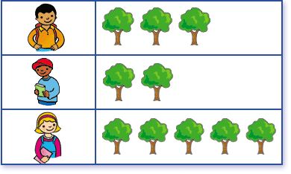
Math Corner-Friday
This graph shows how many trees three friends planted.
How many trees did Matt and Sam plant in all?
Who planted the most trees? Who planted the least number of trees?
How many trees did the three friends plant altogether?
How many more trees would they need to have 16 trees?
Matt
Sam
Kim

Slide 7
Week 2

Slide 8
Math Corner-Monday
Discuss: What does it mean to decompose a number?
Today’s Number is:
12
How many ways can you decompose it?
Can you show today’s number using words and a ten frame?
How many more do you need to fill a double ten frame? Write a number sentence:
12 and ____ more =20

Slide 9
Math Corner-Tuesday
Today’s Number is:
17
How many ways can you decompose it?
Can you show today’s number using words and a ten frame?
How many more do you need to fill a ten frame? Write a number sentence:
19 and ____ more =20

Slide 10
Math Corner-Wednesday
Today’s Number is:
14
How many ways can you decompose it?
Can you show today’s number using words and a ten frame?
How many more do you need to fill a double ten frame? Write a number sentence:
14 and ____ more =20

Slide 11
Math Corner-Thursday
Today’s Number is:
11
How many ways can you decompose it?
Can you show today’s number using words and a ten frame?
How many more do you need to fill a double ten frame? Write a number sentence:
11 and ____ more =20

Slide 12
Math Corner-Friday
This graph shows how many trees three friends planted.
How many trees did Kim and Sam plant in all?
How many trees did Matt and Kim plant in all?
If Sam planted three more trees how many would he have in all?
If Matt wanted TEN trees how many more does he need to plant?
Matt
Sam
Kim

Slide 13
Week 3

Slide 14
Math Corner-Monday
Today’s Number is:
15
How many ways can you decompose it?
Can you show today’s number using words and a ten frame?
How many more do you need to fill a double ten frame? Write a number sentence:
15 and ____ more =20

Slide 15
Math Corner-Tuesday
Today’s Number is:
19
How many ways can you decompose it?
Can you show today’s number using words and a ten frame?
How many more do you need to fill a double ten frame? Write a number sentence:
19 and ____ more =20

Slide 16
Math Corner-Wednesday
Today’s Number is:
16
How many ways can you decompose it?
Can you show today’s number using words and a ten frame?
How many more do you need to fill a double ten frame? Write a number sentence:
16 and ____ more =20

Slide 17
Math Corner-Thursday
Discuss: What does it mean to decompose a number?
Today’s Number is:
18
How many ways can you decompose it?
Can you show today’s number using words and a ten frame?
How many more do you need to fill a double ten frame? Write a number sentence:
18 and ____ more =20

Slide 18
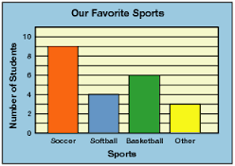
Math Corner-Friday
How many children liked to play soccer?
How many children liked to play softball?
How many children liked to play baseball?
How many children liked to play other sports?
Which sport is closest to 10? How do you know? Explain using numbers and words.

