Slide 1
Waves and Currents

Slide 2
Essential Question:
How are waves and currents created?
Standards:
S6E3d. Explain the causes
of waves, currents, and tides.
Notes:
Instructional Approach(s): The teacher should introduce the essential question and the standard that aligns to the essential question.

Slide 3
Activating Strategy:
Watch the video below then answer the questions.
http://video.disney.com/watch/catching-the-eac-4bb39d25a179ea8833003b15
Where is this event happening?
What causes the condition shown in the video?
What do you think is the importance of the condition shown?
Notes:
Instructional Approach(s): The teacher should show the video clip while the students answer the two questions. The teacher may want to do this as a Think, Pair, Share. The students would “think” and answer the two questions on their own while watching the video. Then the teacher should spend no more than 2-3 minutes doing “Pair and Share”

Slide 4
Use your notes to record important information during the lesson.
Notes:
Instructional Approach(s): The teacher should give each student a copy of the Waves and Currents notes [linked on the resource page] to record important information during the lesson.

Slide 5
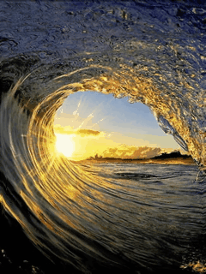
Waves
A wave is a rhythmic movement that carries energy through matter and space. In the ocean, waves move through seawater.
Notes:
Instructional Approach(s): The teacher should present the information on the slide while the students record the important information on their notes.

Slide 6
Causes of Waves
When wind blows across a body of water, wind energy is transferred to the water
If the wind speed is great enough, the water begins to pile up, forming a wave
The height of a wave depends on:
  The speed of the wind
  The distance over which the wind blows
  The length of time the wind blows
Notes:
Instructional Approach(s): The teacher should present the information on the slide while the students record the important information on their notes.

Slide 7
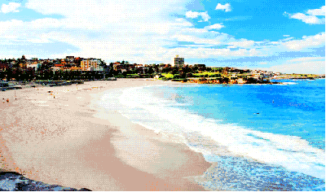
Causes of Waves
Once set in motion, waves continue moving for long distances, even if the wind stops blowing
The waves you see lapping at a beach could have formed halfway around the world
Notes:
Instructional Approach(s): The teacher should present the information on the slide while the students record the important information on their notes.

Slide 8
Ocean Currents
Notes:
Instructional Approach(s): Transition slide to the next concept

Slide 9
Ocean Currents
Ocean currents are a mass flow of ocean water. Remember the “Finding Nemo” clip
There are two main types of currents we will be discussing: Surface Currents and Density Currents
Notes:
Instructional Approach(s): The teacher should present the information on the slide while the students record the important information on their notes.

Slide 10
Ocean Currents:
Surface Currents
Surface currents move water horizontally – parallel to Earth’s surface
Surface currents are powered by wind
The wind forces the ocean to move in huge, circular patterns http://www.livescience.com/19662-animation-reveals-ocean-currents.html
There are warm surface currents and cold surface currents
Notes:
Instructional Approach(s): The teacher should present the information on the slide while the students record the important information on their notes.

Slide 11
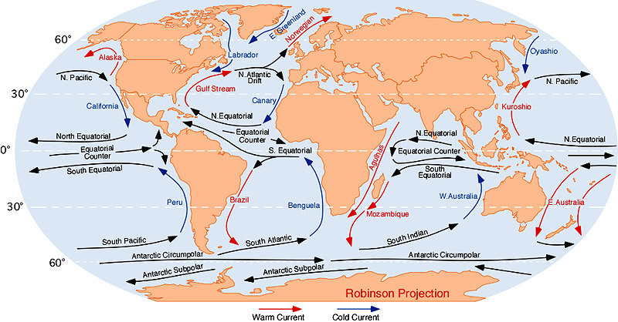
Ocean Currents:
Surface Currents
Notes:
Instructional Approach(s): The teacher should use the diagram to illustrate surface currents.

Slide 12
Ocean Currents:
Surface Currents
Surface winds and surface currents are affected
by the rotation of the Earth (the Coriolis Effect)
http://www.youtube.com/watch?v=dt_XJp77-mk
Because Earth rotates toward the east, winds appear to curve to the right in the northern hemisphere and to the left in the southern hemisphere
So, currents north of the equator turn to the right and currents south of the equator turn to the left
Notes:
Instructional Approach(s): The teacher should present the information on the slide while the students record the important information on their notes.

Slide 13
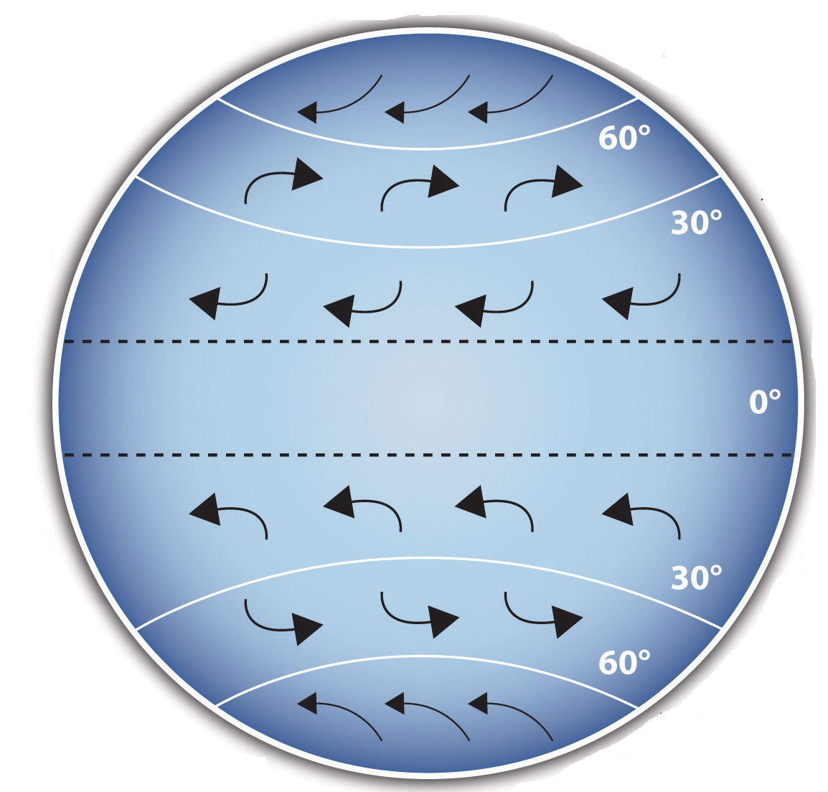
Ocean Currents:
Surface Currents
Curving of surface winds due to the Earth’s rotation
Notes:
Instructional Approach(s): The teacher should present the information on the slide while the students record the important information on their notes.

Slide 14
Ocean Currents: Surface Currents
Surface currents north of the Equator curve to the right due to the Earth’s rotation
Equator
Surface currents south of the Equator curve to the left due to the Earth’s rotation
Notes:
Instructional Approach(s): Watch the slide in slide show view to see the animations. Some are set automatically others you will need to click. If you watch the slide and it has been longer than 1 second, click the mouse and the next animation should occur

Slide 15
Animation of Ocean
Surface Currents
http://www.classzone.com/books/earth_science/terc/content/visualizations/es2401/es2401page01.cfm?chapter_no=visualization
Animation of Coriolis Effect
http://www.classzone.com/books/earth_science/terc/content/visualizations/es1904/es1904page01.cfm
Notes:
Instructional Approach(s): The teacher should show the animations to illustrate the concept of surface currents.

Slide 16
Surface Currents Affect Climate
The ocean absorbs, stores, and moves the sun’s
heat (energy)
Surface currents transport this energy all over the world
Surface currents move warmer water into cooler regions and return cooler water to the warmer
regions (tropics)
Currents can have a cooling effect on an area’s
climate or a warming effect on an area’s climate
As warm water flows from the equator, heat is released into the atmosphere and the air is warmed.
Notes:
Instructional Approach(s): The teacher should present the information on the slide while the students record the important information on their notes.

Slide 17
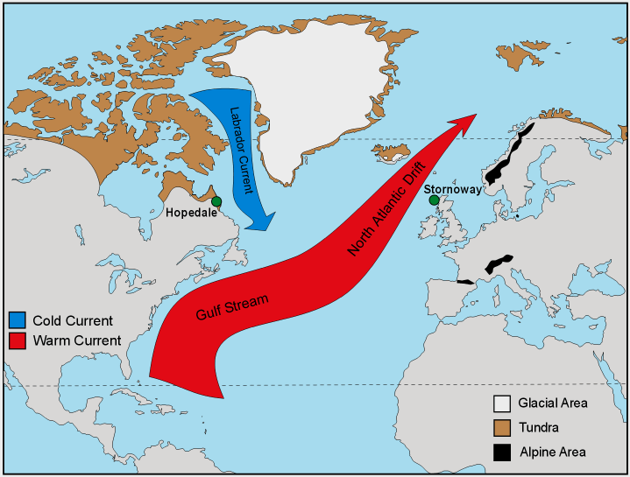
Surface Currents Affect Climate
Think about what you
learned in social studies
about Europe’s climate.
What surface current
makes Europe’s climate temperate (mild)?
The Gulf Stream is a
surface current that
moves warm water from the tropics to the cooler regions around Europe.
Notes:
Instructional Approach(s): The teacher should present the information on the slide while the students record the important information on their notes.

Slide 18
Surface Currents
Notice again the Red arrows and the Blue arrows showing the movement of warm water and the movement of cold water
Notes:
Instructional Approach(s): The teacher should use the diagram to illustrate the concept of surface currents (warm and cold water)

Slide 19
Gulf Stream and Climate
http://www.youtube.com/watch?v=UuGrBhK2c7U
Notes:
Instructional Approach(s): The teacher should show the video describing the Gulf Stream’s affect on climate to lead into the next concepts

Slide 20
The video reminded us that the masses of water are moved by wind, but what did they say was the primary cause of ocean currents?
Different densities are responsible for ocean currents. What factors did we learn influence ocean water’s density?
Temperature and Salinity Affect the Density
of Ocean Water.
Notes:
Instructional Approach(s): The teacher should present the information on the slide.

Slide 21
Temperature, Salinity and Density
Ocean depth
increases
Density
increases
Temperature
increases
Salinity
increases
Salinity
increases
Density
increases
Temperature decreases
Density decreases
Temperature decreases
because cold water is more dense and sinks
Notes:
Instructional Approach(s): The teacher should review the information on the slide while the students record the important information on their notes.

Slide 22
Density Currents
Deep in the ocean, waters circulate not because of wind but because of density differences.
A density current forms when a mass of seawater becomes more dense than the surrounding water.
More dense seawater sinks beneath less dense seawater.
Density currents circulate ocean water slowly.
Notes:
Instructional Approach(s): The teacher should present the information on the slide while the students record the important information on their notes.

Slide 23
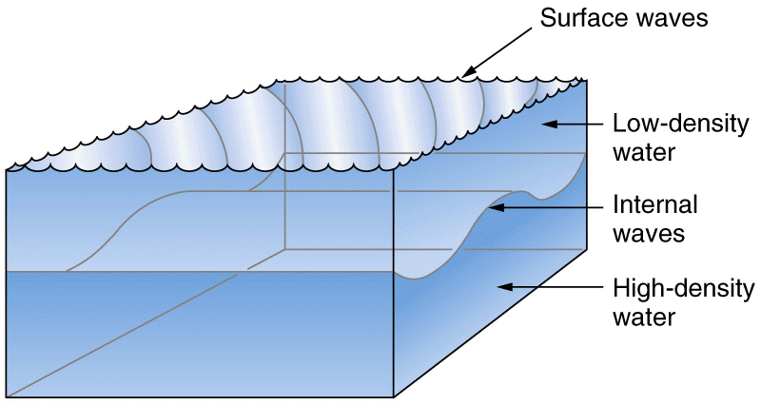
Density Currents
Notes:
Instructional Approach(s): The teacher should present the information on the slide while the students record the important information on their notes.

Slide 24
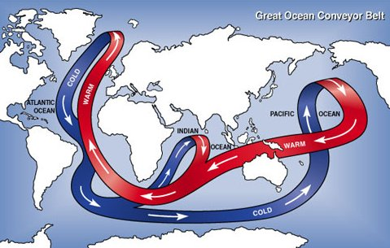
Density Currents
Notes:
Instructional Approach(s): The teacher should use the diagram to illustrate density currents.

Slide 25
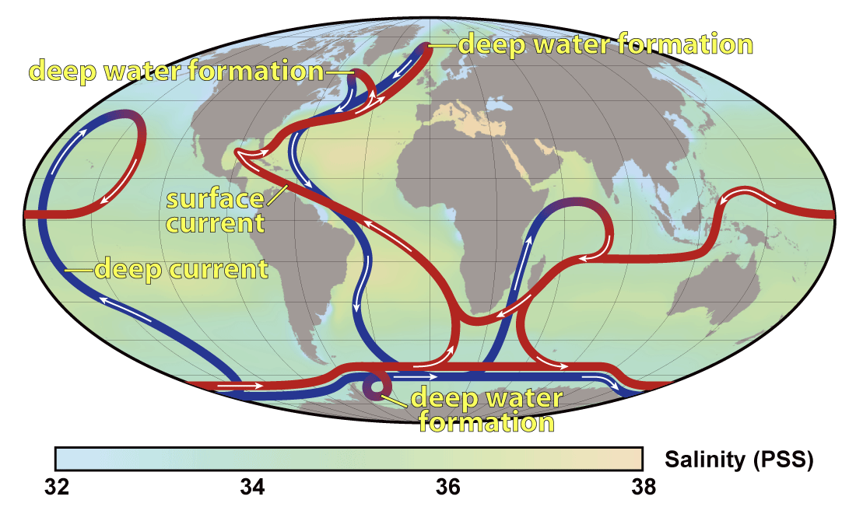
Density Currents
Notes:
Instructional Approach(s): The teacher should use the diagram to illustrate surface currents and density currents.

Slide 26
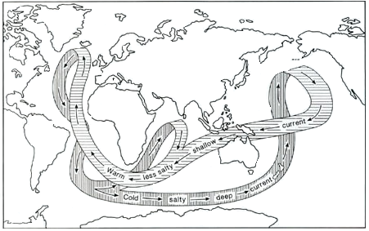
Label on your diagram
Notes:
Instructional Approach(s): The teacher should present the information on the slide while the students record the important information on their notes.

Slide 27
Ocean Currents Song
https://www.youtube.com/watch?v=NsdH_NRM-CU
Notes:
Instructional Approach(s): The teacher should show the ocean current song video to reinforce the concept of ocean currents

Slide 28
Waves & Currents Video
http://studyjams.scholastic.com/studyjams/jams/science/weather-and-climate/waves-and-currents.htm
Notes:
Instructional Approach(s): The teacher should show the video to reinforce the concept of waves and currents

Slide 29
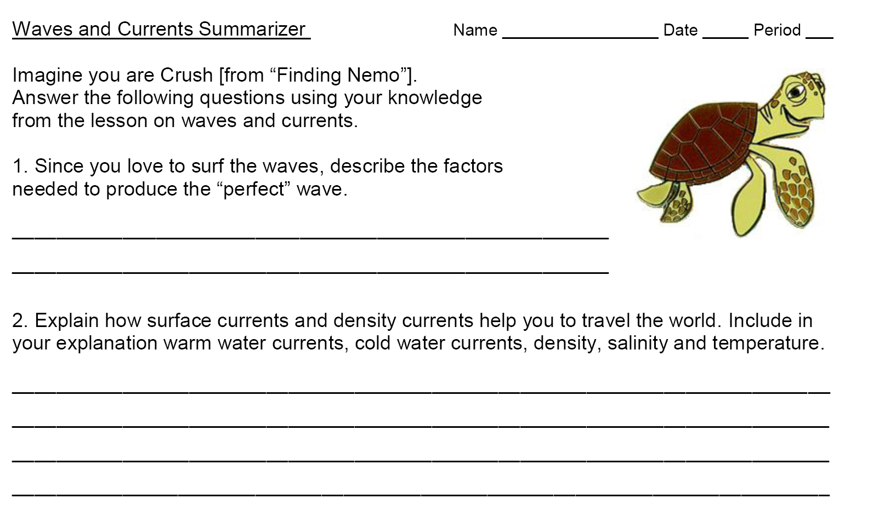
Summarizing Strategy
Notes:
Instructional Approach(s): Each student should complete the summarizer. The teacher should use the summarizer to determine the level of student mastery and if differentiation is needed.

