Slide 1
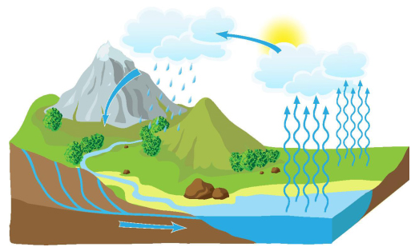
Essential Question:
How does the water cycle explain various atmospheric conditions on the Earth?
Standard:
S6E3b. Relate various atmospheric conditions to stages of the water cycle
Notes:
Instructional Approach(s): The teacher should introduce the essential question and the standard that aligns to the essential question.

Slide 2
Water Cycle Pretest
Notes:
Instructional Approach(s): Each student should complete the Water Cycle Pretest [linked on the resource page]. The teacher should use the pretest to determine if the stages of the water cycle should be reviewed or if the teacher can move forward with atmospheric conditions related to the water cycle. If differentiation is needed, see the curriculum map for possible resources.

Slide 3
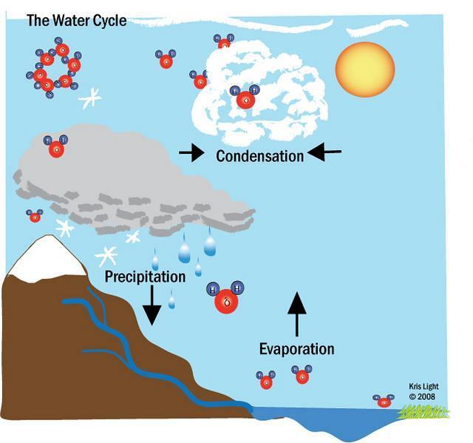
Remembering the Water Cycle
Water
Vapor
Molecules
Notes:
Instructional Approach(s): The teacher should use the diagram to review the main stages of the water cycle.

Slide 4
Stages of the Water Cycle are connected to atmospheric conditions.
Turn to an elbow partner and discuss what is meant by atmospheric condition and possible examples.
Notes:
Instructional Approach(s): The teacher should present the information on the slide and have students partner up to discuss the meaning of atmospheric condition. . Partners can be determined by the students or the teacher can provide more specific directions such as turn to the person directly in front/behind you or to the right/left of you, etc. It may be necessary to have a group of three if you have an uneven number of students. Do not allow more than 30 seconds to 1 minute of discussion time. The teacher should be walking around listening and redirecting discussions as needed. The teacher can briefly discuss student responses. When ready, click to the next slide to discuss the answer.

Slide 5


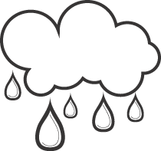
Atmospheric condition refers to the state of the atmosphere in terms of temperature and wind and clouds and precipitation.
Notes:
Instructional Approach(s): The teacher should present the information on the slide.

Slide 6
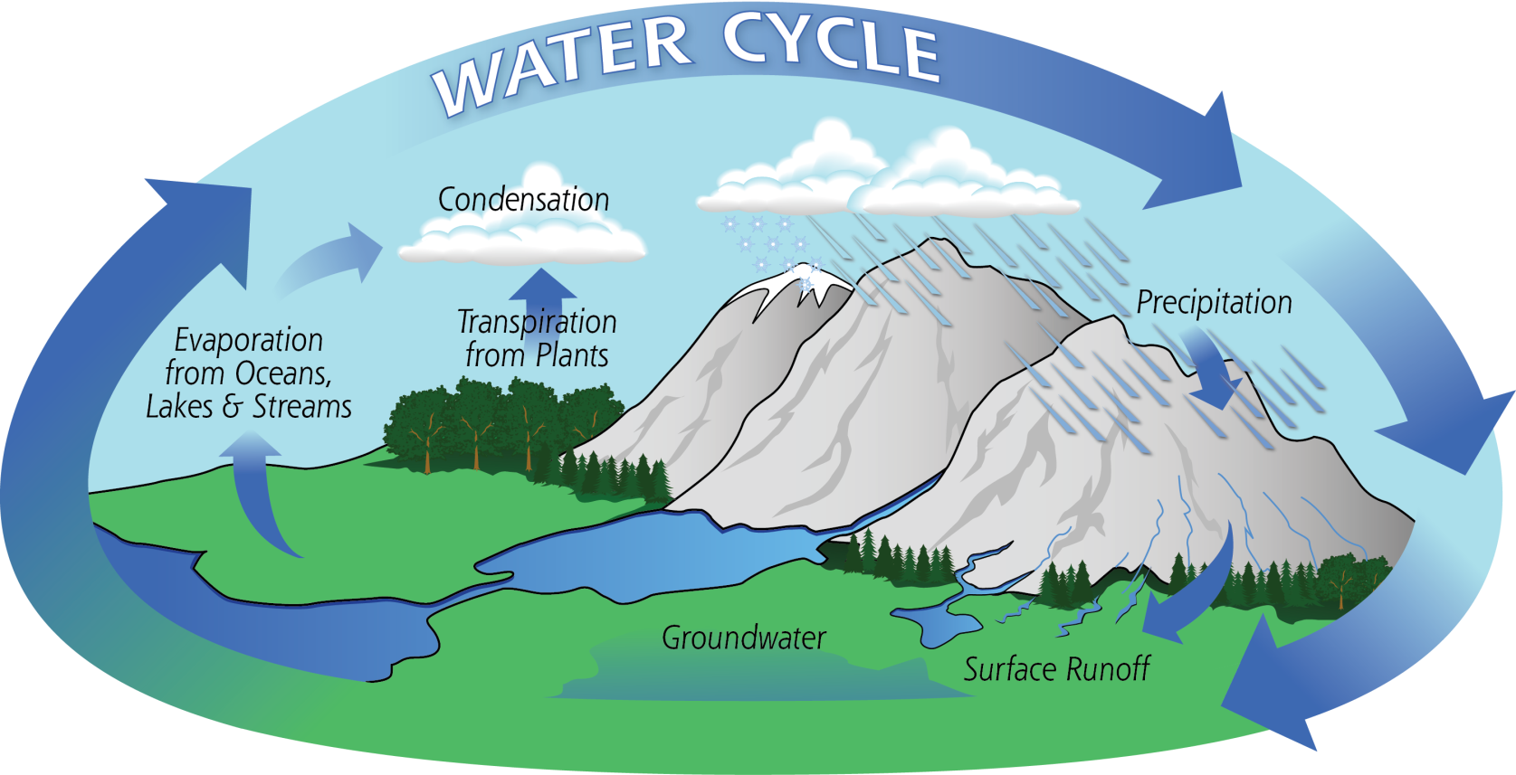
In this lesson, we are going to look at some of the atmospheric conditions that are related to various stages of the Water Cycle.
Notes:
Instructional Approach(s): The teacher should present the information on the slide.

Slide 7
Use your graphic organizer to record important information during the lesson.
Notes:
Instructional Approach(s): The teacher should give each student a copy of the Water Cycle & Atmospheric Conditions Graphic Organizer [linked on the resource page] to record important information during the lesson.

Slide 8
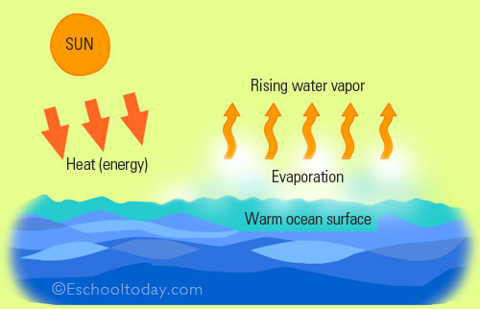
Evaporation
Notes:
Instructional Approach(s): The teacher should use the slide to introduce evaporation.

Slide 9
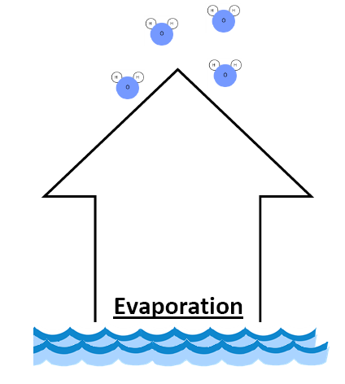
Heat evaporates water into water vapor
(gaseous state). Water vapor molecules fit into spaces among the molecules that make up air.
Water Vapor
Molecules
Notes:
Instructional Approach(s): The teacher should present the information on the slide while the students record the important information on their graphic organizer.

Slide 10
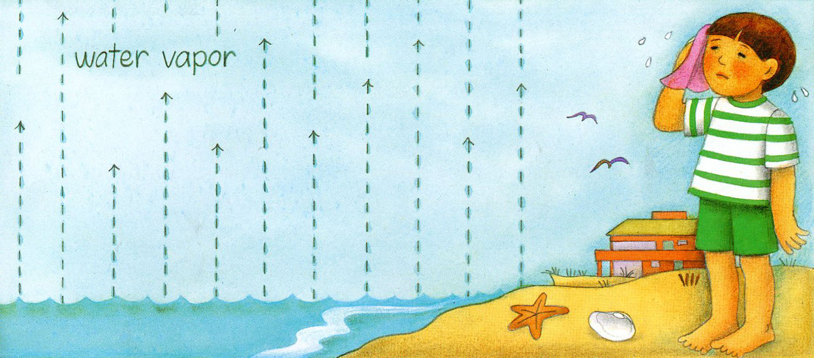
Humidity is the amount of water vapor present in the air.
Notes:
Instructional Approach(s): The teacher should present the information on the slide. Humidity will be covered more in depth in the next unit with weather. However, the teacher may want to have the students add humidity to their graphic organizer (near the water vapor molecules).

Slide 11
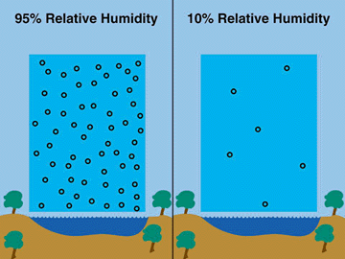
Notes:
Instructional Approach(s): The teacher should use the slide to illustrate that humidity represents the amount of water vapor in the air and that higher humidity means there are more water vapor molecules in the air. In relation, it means the temperature is warmer because in warmer temperatures, the particles move faster and don’t easily come together. Do not focus on the term relative humidity.

Slide 12
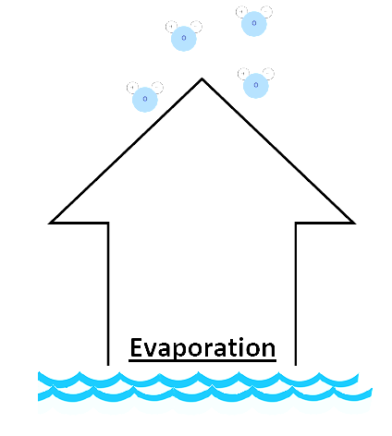
Higher temperatures mean more evaporation. More evaporation means more water vapor in the air
(higher humidity).
How does temperature affect evaporation?
What atmospheric condition occurs
due to evaporation?
Notes:
Instructional Approach(s): The teacher should present the information on the slide while the students record the important information on their graphic organizer.

Slide 13
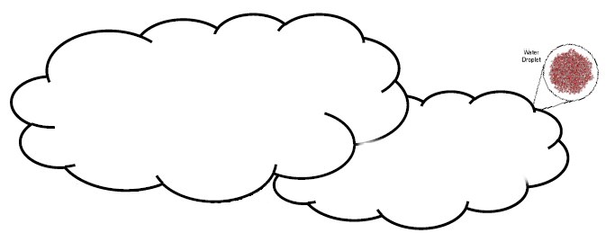

At cooler temperatures water vapor molecules slow down and form droplets of liquid water.
The air is saturated (holding as much water vapor as it can).
Notes:
Instructional Approach(s): The teacher should present the information on the slide.

Slide 14

Clouds form when water vapor condenses in tiny droplets around small particles such as dust and salt.
Notes:
Instructional Approach(s):The teacher should present the information on the slide while the students record the important information on their graphic organizer.

Slide 15
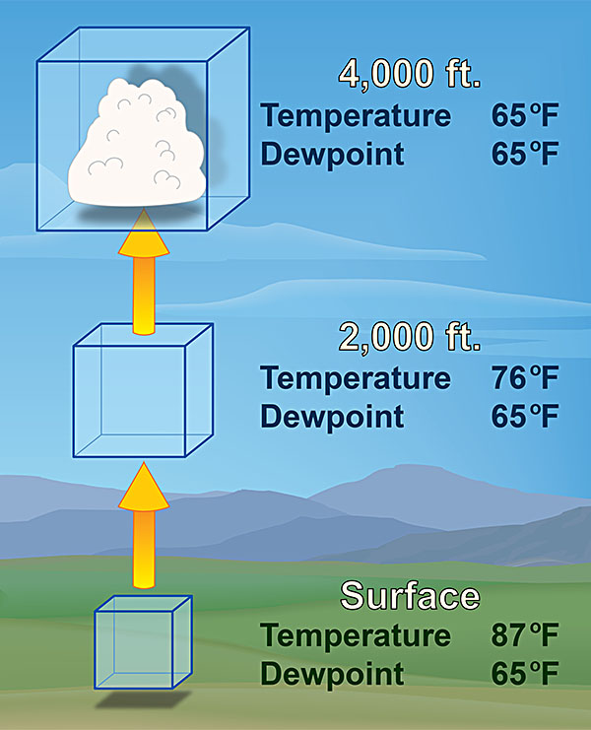
Dew Point is the temperature at which air is saturated and condensation forms.
Notes:
Instructional Approach(s): The teacher should present the information on the slide. The teacher should not focus on the term “dew point”. Use the slide to illustrate that as the water vapor molecules move further up into the atmosphere they begin to cool until they slow down enough to condense.

Slide 16
Other Forms of
Condensation
Condensation can occur whenever air becomes saturated (holding as much water vapor as it can).
Notes:
Instructional Approach(s): The teacher should present the information on the slide.

Slide 17

Other Forms of
Condensation
When water vapor molecules suspended in the atmosphere
at or near the earth's surface
cool and condense, fog can
occur (a cloud next to
the surface)
Notes:
Instructional Approach(s): The teacher should present the information on the slide while the students record the important information on their graphic organizer.

Slide 18
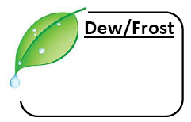
Other Forms of
Condensation
Dew forms when
water droplets condense
from the air, usually at night,
onto cool surfaces near the
ground. Frost may form when
temperatures are near 0°C.
Notes:
Instructional Approach(s): The teacher should present the information on the slide while the students record the important information on their graphic organizer.

Slide 19
Lab/Demonstration of
Condensation
Notes:
Instructional Approach(s): Use 1-2 of the condensation labs/demonstrations [linked on the curriculum map] to reinforce the concept of condensation.

Slide 20
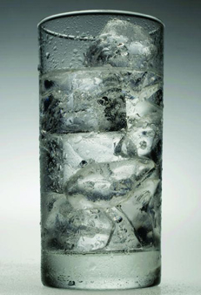
Think, Pair, Share:
Using your knowledge, explain why condensation occurs on the glass shown below.
Notes:
Instructional Approach(s): Have students turn to a partner and discuss the question on the slide. Partners can be determined by the students or the teacher can provide more specific directions such as turn to the person directly in front/behind you or to the right/left of you, etc. It may be necessary to have a group of three if you have an uneven number of students. Do not allow more than 30 seconds to 1 minute of discussion time. The teacher should be walking around listening and redirecting discussions as needed. The teacher can briefly discuss student responses. *Answer: the ice water in the glass cools the warmer air surrounding it to its “dew point” so the water vapor molecules around the glass condense (change from gas to liquid) on the glass.

Slide 21
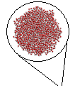


When liquid water droplets combine and grow too large for the atmosphere to support their weight, the droplets fall.
Condensation
Precipitation
Notes:
Instructional Approach(s): The teacher should present the information on the slide.

Slide 22


Condensation
Precipitation
Air temperature determines which form
of Precipitation occurs
Rain
Sleet
Snow
Hail
Water
falling in temperatures above freezing
Falling water passes through a layer of freezing air near earth’s surface
Water falling in air temperature so cold that water vapor changes to
a solid
Water
freezes inside a cloud before it falls
http://www.atmosedu.com/meteor/Animations/51_Sleet/51.html
Notes:
Instructional Approach(s): The teacher should present the information on the slide while the students record the important information on their graphic organizer. Show the animation at the bottom of the slide to illustrate the formation of rain, sleet, and snow.

Slide 23

Condensation
Precipitation
Temperature
The atmospheric condition that affects each stage of the water cycle
Notes:
Instructional Approach(s): The teacher should present the information on the slide while the students record the important information on their graphic organizer.

Slide 24
Turn to an elbow partner and discuss how temperature affects each stage of the water cycle.
The atmospheric condition that affects each stage of the water cycle
Temperature
Notes:
Instructional Approach(s): Students should partner up to discuss how temperature affects each stage of the water cycle. Partners can be determined by the students or the teacher can provide more specific directions such as turn to the person directly in front/behind you or to the right/left of you, etc. It may be necessary to have a group of three if you have an uneven number of students. Do not allow more than 30 seconds to 1 minute of discussion time. The teacher should be walking around listening and redirecting discussions as needed. The teacher can briefly discuss student responses.

Slide 25
http://commons.wikimedia.org/w/index.php?title=File%3AThe_Water_Cycle_Watering_the_Land.ogv
Notes:
Instructional Approach(s): The teacher should use the linked animation to illustrate the concepts of the lesson.

Slide 26
Summarizer
Notes:
Instructional Approach(s): Each student should complete the summarizer. The teacher should use the summarizer to determine the level of student mastery and if differentiation is needed.

