Slide 1
Essential Question: How does the temperature and salinity of water affect density?
Standard:
S6E3c. Describe the composition, location, and subsurface topography of the world’s oceans.
S6E3d. Explain the causes of waves, currents, and tides.
Notes:
Instructional Approach(s): The teacher should introduce the essential question and the standards that align to the essential question

Slide 2
Activating Strategy
With a seat partner, write a short definition for the following terms: temperature, salinity, and density
Temperature: the degree of hotness or coldness of an object
Salinity: the dissolved salt content of a body of water
Density: the amount of mass in a given space
Notes:
Instructional Approach(s): Have students turn to a partner and define the terms on the slide. Partners can be determined by the students or the teacher can provide more specific directions such as turn to the person directly in front/behind you or to the right/left of you, etc. It may be necessary to have a group of three if you have an uneven number of students. Do not allow more than 2-3 minutes of discussion time. The teacher should be walking around listening and redirecting discussions as needed. The teacher can briefly discuss student responses. When ready, the teacher can click the mouse to reveal short definitions for the three terms.

Slide 3
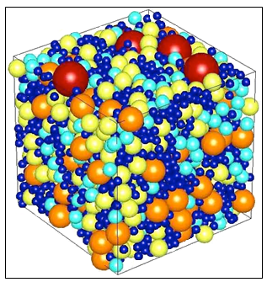
Activating Strategy
The diagram to the right illustrates an object that has a lot of density.
How do you think temperature affects density? What about salinity?
Temperature: the degree of hotness or coldness of an object
Salinity: the dissolved salt content of a body of water
Notes:
Instructional Approach(s): The teacher should continue to activate student’s prior knowledge by posing the questions on the slide to the class. Ask for volunteers or call on specific students to respond to the questions. If the students are not able to come up with possible answers, explain that by the end of the lesson they should be able to discuss how temperature and salinity affect density.

Slide 4
Look at the diagram below. What does it illustrate?
Notes:
Instructional Approach(s): The teacher should pose the question on the slide to the class. Ask for a few responses. When ready, click to the next slide to reveal the answer.

Slide 5
Everything is made up of Matter.
Matter can be broken down into smaller particles such as atoms and molecules.
Atoms
Molecule
Matter
Notes:
Instructional Approach(s): The teacher should present the information on the slide providing the answers to the previous slide.

Slide 6
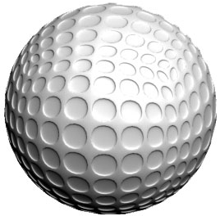
What is Density?
Density is the amount of matter (mass) in a given space (volume)
For example, a golf ball and a table-tennis ball have similar volumes. But a golf ball has more mass than a table-tennis ball does. So, the golf ball has a greater density.
Notes:
Instructional Approach(s): The teacher should present the information on the slide. The concept of Density is difficult for students, but it is important that the students understand the concept of density. Density will show up again when teaching currents and wind. Additionally, the concept of particles moving from high density to low density is important in Life Science and in Physical Science. 6th grade science needs to lay the foundations for these concepts by teaching density.

Slide 7
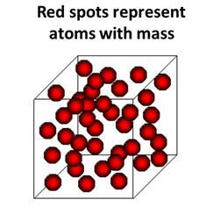
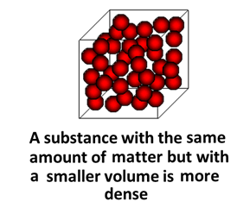
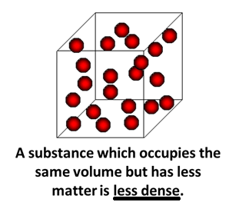
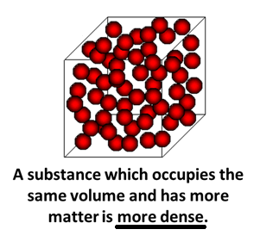
Notes:
Instructional Approach(s): The teacher should present the animated slide to illustrate the concepts of less dense and more dense.

Slide 8
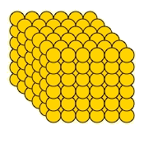
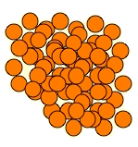
Which one has greater density?
Notes:
Instructional Approach(s): The teacher should pose the question to the class or call on a specific student. Be sure to ask the student(s) why? Or what makes them think it is more dense than the other. The yellow picture is more dense. The molecules are packed close together.

Slide 9
Density of Liquids Activity [see resources]
Let’s apply the concept of Density to Liquids
If you cannot do the activity, see the next slide
Notes:
Instructional Approach(s): The students can conduct the Density of Liquids Activity or the Comparing the Density of Two Liquids [linked on the resource page] to examine the density of liquids

Slide 10
Density of Liquids
Like all substances, liquids have different densities
It is easy to see the differences in the density of liquids because more dense liquids will sink and less dense liquids will rise. The same is true for objects in liquids.
If you pour together liquids that don’t mix and have different densities, they will form liquid layers.
Making Liquid Layers: http://www.youtube.com/watch?v=-CDkJuo_LYs
Notes:
Instructional Approach(s):

Slide 11
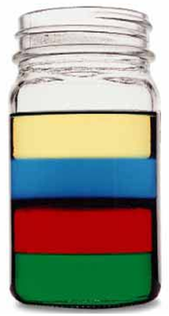
Density of Liquids
Check out this picture. Which layer has the highest density?
Which layer has the lowest density?
Imagine that the liquids have the following densities:
10g/cm³ 3g/cm³
6g/cm³ 5g/cm³
Which number would go with which layer?
Notes:
Instructional Approach(s): The teacher should work through each question with the class in preparation for students to do similar questions on the next slide. Question 1 Answer: Green; Question 2: Beige or Gold; Question 3: Beige 3, Blue 5, Red 6 and Green 10

Slide 12
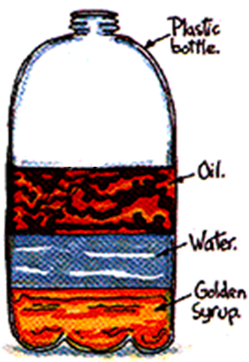
Density of Liquids
Try with your neighbor!
Which liquid has the highest density?
Which liquid has the lowest density?
Which liquid has the middle density?
Notes:
Instructional Approach(s): Have students turn to a partner and discuss the questions on the slide. Partners can be determined by the students or the teacher can provide more specific directions such as turn to the person directly in front/behind you or to the right/left of you, etc. It may be necessary to have a group of three if you have an uneven number of students. Do not allow more than 1-2 minutes of discussion time. The teacher should be walking around listening and redirecting discussions as needed. The teacher can briefly discuss student responses.

Slide 13
Density: Float or Sink
http://www.youtube.com/watch?v=dcQR6vV1Sqo
Notes:
Instructional Approach(s): Have students write quick notes on the video. Or have them listen for buzz words to keep them focused on the content. Objects that sink are ____ dense?? Objects that float are ____ dense. Answers:more;less

Slide 14
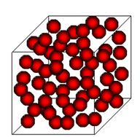
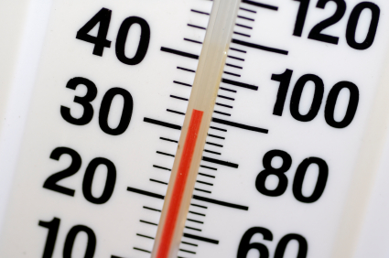
Relationship between Density & Temperature
Notes:
Instructional Approach(s): Transition slide to next concept

Slide 15
What is temperature?
Temperature is the degree of hotness or coldness of an object.
For this lesson, we are going to look at temperature more closely.
Notes:
Instructional Approach(s): The teacher should present the information on the slide.

Slide 16
The temperature of a substance is related to the speed of the substance’s particles.
http://www.bgfl.org/bgfl/custom/resources_ftp/client_ftp/ks3/science/changing_matter/changingmatter.swf
What happens to the particles in an object or substance when its temperature is increased?
As the temperature of a liquid increases, the particles in the liquid move faster.
As the temperature of a liquid decreases, the particles in the liquid move slower.
Notes:
Instructional Approach(s): The teacher should present the information on the slide while the students record the important information on their notes.

Slide 17
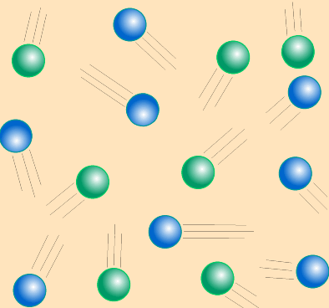
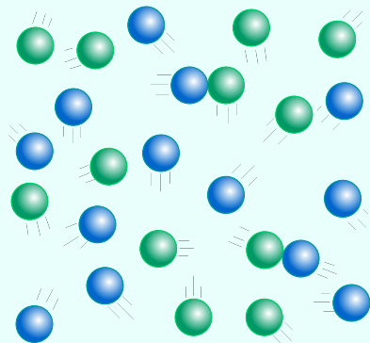
When an object or substance is warmer, its particles move faster and get further apart
(Tip for remembering: they are warmer and want to get cooler by moving away from one another)
When an object or substance is cooler, its particles move slower and are closer together
(Tip for remembering: they are cold and want to get warm by getting closer together)
Notes:
Instructional Approach(s): The teacher should present the information on the slide while the students record the important information on their notes.

Slide 18
Relationship between Temperature and Density
http://www.youtube.com/watch?v=1dx-Tx5dPKk
Ice Cube Demonstration:
http://www.youtube.com/watch?v=I8kToTROCHA
Notes:
Instructional Approach(s): The teacher should use the videos to reinforce the relationship between temperature and density

Slide 19
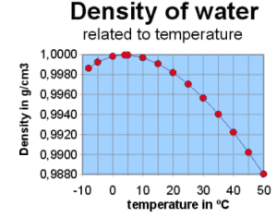
Relationship between Temperature and Density
As temperature increases, density decreases.
Notes:
Instructional Approach(s): The teacher should present the information on the slide while the students record the important information on their notes.

Slide 20
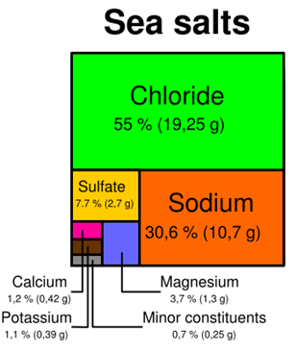
Relationship between Density & Salinity
Notes:
Instructional Approach(s): Transition slide to next concept

Slide 21
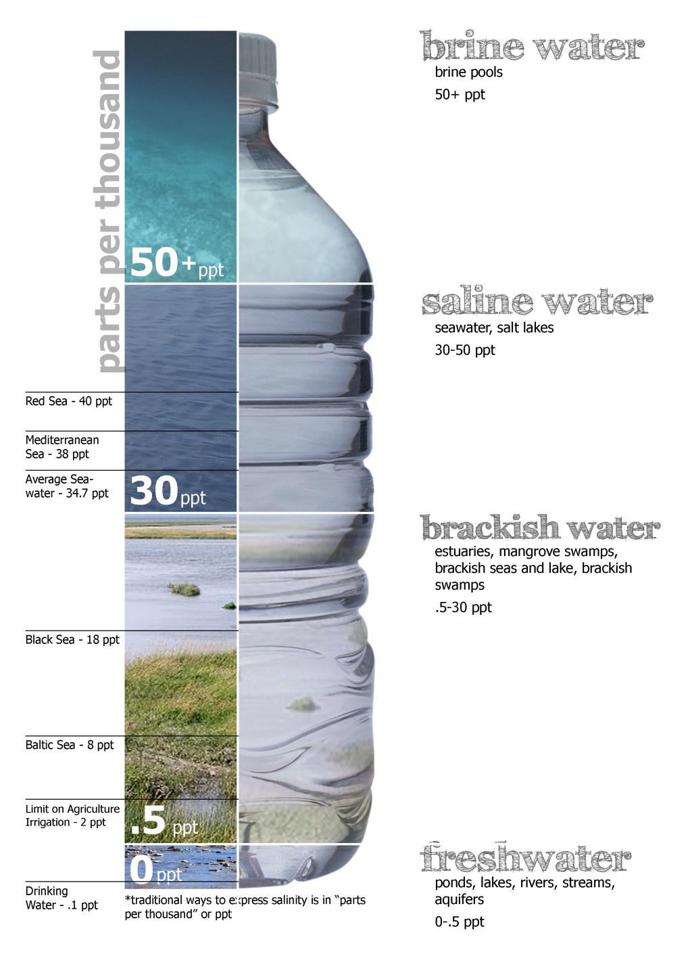
What is salinity?
Salinity is the dissolved salt content of a body of water
Look at the diagram to the right showing the varying degrees of salinity in water
Notes:
Instructional Approach(s): The teacher should present the information on the slide while the students record the important information on their notes.

Slide 22
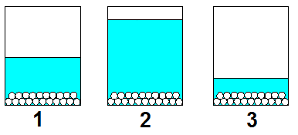
Salinity
Look at the three diagrams below. Which one do you think has the highest salinity? Why?
Notes:
Instructional Approach(s): The teacher should pose the question to the class. The teacher may want to have students get with a partner to answer the question or call on students. When ready, click on the next slide to reveal the answer.

Slide 23
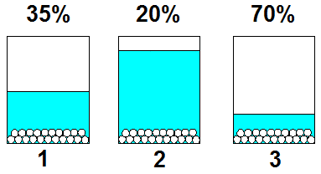
Salinity
Number 3 has the highest Salinity because it has more salt particles than water particles per unit.
Notes:
Instructional Approach(s): The teacher should present the answers on the slide from the previous slide. For simplicity, dissolved salts are shown concentrated in the bottom of the container; in reality they are evenly distributed throughout the water. The left diagram illustrates water of normal salinity (35 ‰). The middle sketch shows seawater that has been diluted by fresh water, as might occur near a river; this water is brackish (20 ‰ salinity). The last diagram represents seawater that has been evaporated to about one-half of its original volume; the salinity is doubled (70‰)

Slide 24
Density and Salinity
As Salinity [the amount of salts in the water] increases, Density increases.
Salinity can increase [increasing density] from the freezing of polar ice. Why?
Salinity can increase [increasing density] from evaporation. Why?
Salinity can decrease [decreasing density] from the melting of polar ice. Why?
Salinity can decrease [decreasing density] with the addition of freshwater.
Notes:
Instructional Approach(s): The teacher should present the information on the slide while the students record the important information on their notes.

Slide 25
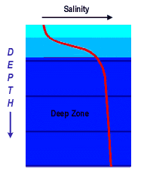
Look at the graph to the right. What does it tell us about Salinity and depth of the ocean?
Salinity increases as ocean depth increases.
What happens to temperature as ocean depth increases? Why?
Notes:
Instructional Approach(s): The teacher should pose the question to the class. Students should conclude that as depth of the ocean increases, salinity increases.

Slide 26
Temperature, Salinity and Density
Ocean depth increases
Density increases
Temperature increases
Salinity increases
Salinity increases
Density increases
Temperature decreases
Density decreases
Temperature decreases
because cold water is more dense and sinks
Notes:
Instructional Approach(s): The teacher should present the animated slide while the students record the information on their notes.

Slide 27
Summarizing Strategy: Answer the lesson essential question How does the temperature and salinity of water affect density?
Notes:
Instructional Approach(s): Each student should complete the summarizer. The teacher should use the summarizer to determine the level of student mastery and if differentiation is needed. Answer: As temperature increases, density decreases. As temperature decreases, density increases. As Salinity increases, density increases. As salinity decreases, density decreases.

