Slide 1
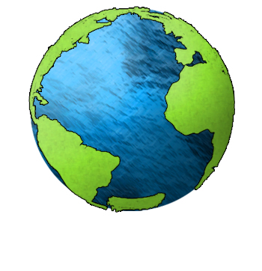
Essential Question:
What is the composition
of the Earth’s
oceans and
where are
they located?
Standard:
S6E3c. Describe the composition, location, and subsurface topography of the world’s oceans.
Notes:
Instructional Approach(s): The teacher should introduce the essential question for the lesson and the standard that aligns to the essential question.

Slide 2
Use your notes to record important information
during the lesson
Notes:
Instructional Approach(s): The teacher should give each student a copy of the Composition and Location of Oceans Notes [linked on the resource page] to record important information during the lesson.

Slide 3
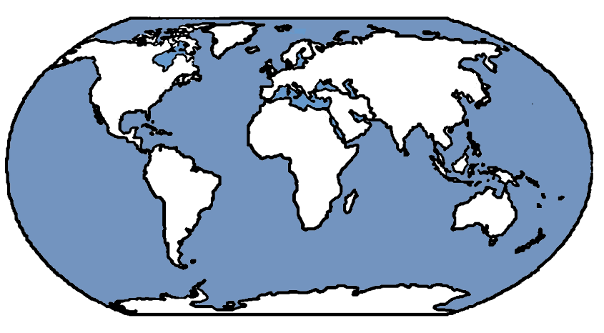
Location of the
Earth’s Oceans
Arctic Ocean
North
America
Europe
Asia
Atlantic
Ocean
Let’s Start with the Continents
Now the
Oceans
Pacific
Ocean
Africa
Pacific
Ocean
South
America
Indian
Ocean
Australia
Southern Ocean
Antarctica
Notes:
Instructional Approach(s): The teacher should ask students to first label the continents on the map in their notes. When ready, click the mouse to go over the continents when ready. The teacher can ask for volunteers or call on specific students to identify the name of the continent prior to showing the answer. The order when clicked: North America, South America, Africa, Europe, Asia, Australia, Antarctica. Once the continents have been labeled, the students should do the oceans. Follow the same strategy. When clicked, the order of the Oceans is as follows: Pacific Ocean, Atlantic Ocean, Arctic Ocean, Indian Ocean, Pacific Ocean again, and the Southern Ocean. The teacher should walk around and make sure that all students have identified both continents and oceans on their notes.

Slide 4
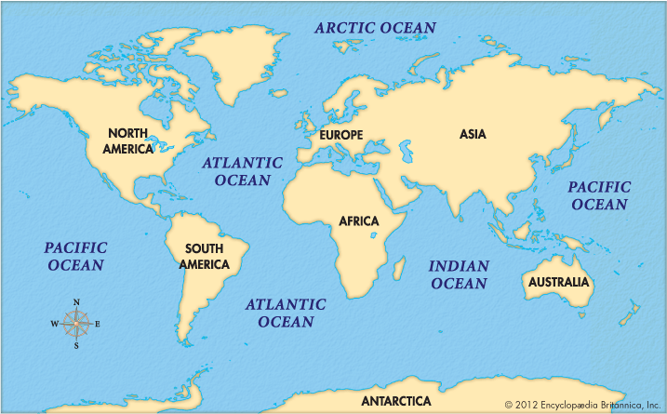
Location of the
Earth’s Oceans
Notes:
Instructional Approach(s): The teacher should use the slide to ensure that students have the correct answers identified on their notes. *Note: the Southern Ocean is not identified on this map

Slide 5
Review Location of the Oceans
[see resources]
Use sheet protectors with maps and either do formative assessment led by the teacher or have students work with partners to quiz each other
Location of Oceans and Continents Worksheet
QR Codes: Reviewing the Location of the Oceans
Play Kahoot: https://play.kahoot.it/#/k/783b7b97-4964-41aa-ab10-2b4a91368d20 [free Web 2.0 tool where students use their cell phone to answer questions and get points]
Notes:
Instructional Approach(s): The teacher should use the review activities identified on the slide and linked on the resource page to reinforce the location of the oceans

Slide 6
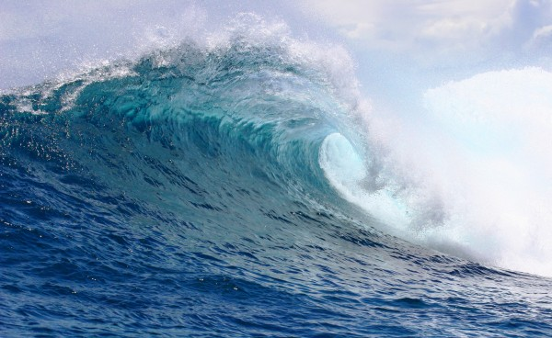
Chemical Composition of Ocean Water
Notes:
Instructional Approach(s): The teacher should use the slide as a transition into the next part of the lesson, the chemical composition of ocean water

Slide 7
What does the word composition mean?
What are some synonyms?
Structure
Make-up
Parts
Pieces
Content
Components
Notes:
Instructional Approach(s): The teacher should pose the question on the slide to the class. The teacher can either ask for volunteers or call on specific students to answer the question. When ready, click the mouse to reveal some synonyms for composition.

Slide 8


With a partner, select one of the following foods and describe its composition:
Notes:
Instructional Approach(s): Have students turn to a partner and discuss the question on the slide. Partners can be determined by the students or the teacher can provide more specific directions such as turn to the person directly in front/behind you or to the right/left of you, etc. It may be necessary to have a group of three if you have an uneven number of students. Do not allow more than 30 seconds to 1 minute of discussion time. The teacher should be walking around listening and redirecting discussions as needed. The teacher can briefly discuss student responses.

Slide 9
What percent of ocean water is salt?
Notes:
Instructional Approach(s): The teacher should pose the question to the class and gather a few student responses

Slide 10
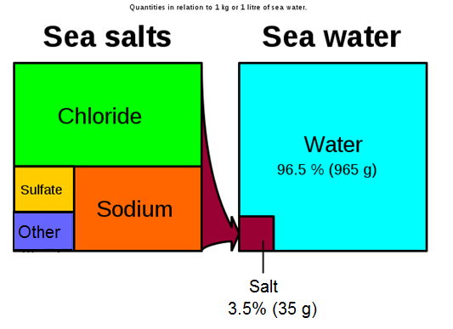
Chemical Composition of Ocean Water
Notes:
Instructional Approach(s): The teacher should present the information on the slide while the students record the information on their notes.

Slide 11

By some estimates, if the salt in the ocean could be removed and spread evenly over the Earth's land surface it would form a layer more than 500 feet (166 meters) thick, about the height of a 40-story office building (NOAA).
But, where did all this salt come from?
Notes:
Instructional Approach(s): The teacher should present the information on the slide.

Slide 12
From precipitation to the land to the rivers to the sea…
The rain that falls on the land contains some dissolved carbon dioxide from the surrounding air. This causes the rainwater to be slightly acidic.
The rain physically breaks down the rock and the acids chemically break down the rocks. Rain then carries the dissolved salts and minerals along as it flows. The salts in the runoff are carried to the streams and rivers and then to the ocean. http://www.classzone.com/books/earth_science/terc/content/visualizations/es1303/es1303page01.cfm?chapter_no=visualization
Many of the dissolved salts are used by organisms in the ocean and are removed from the water. Others are not used up and are left for long periods of time where their concentrations increase over time.
Notes:
Instructional Approach(s): The teacher should present the information on the slide while the students record the important information on their notes.

Slide 13
Salt from below…
Hydrothermal vents are recently-discovered features on the ocean seafloor that contribute dissolved minerals to the oceans.
These vents are the “exit points” on the ocean floor from which sea water that has seeped into the rocks of the oceanic crust has become hotter, has dissolved some of the minerals from the crust, and then flows back into the ocean.
http://www.youtube.com/watch?v=D69hGvCsWgA&list=PL88CB33C02CCF3D39&index=1
Notes:
Instructional Approach(s): The teacher should present the information on the slide while the students record the important information on their notes.

Slide 14
Eruption of Volcanoes Underwater…
Similar to the previous process, during an underwater volcano eruption, seawater reacts with hot rock and some minerals are dissolved into the sea water.
http://www.youtube.com/watch?v=U51cY6iod3U&index=5&list=PL88CB33C02CCF3D39
Notes:
Instructional Approach(s): The teacher should present the information on the slide while the students record the important information on their notes.

Slide 15
Journey to the Ocean Activity
Notes:
Instructional Approach(s): The teacher should give each student a “Journey to the Ocean” handout [linked on the resource page]. The writing assignment may be used as a formative assessment task.

Slide 16
Summarizing Strategy:
Notes:
Instructional Approach(s): Each student should complete the summarizer. The teacher should use the summarizer to determine the level of student mastery and if differentiation is needed.

