Slide 1
The Chemistry of Life
Day 1

Slide 2
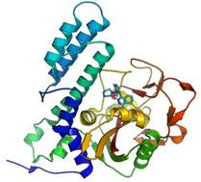
What is biochemistry?
Biochemistry is the study of structure, composition (what things are made up of), and chemical reactions that occur in living things.
Living things (biotic factors) depend on chemistry for life…so biology and chemistry are closely related!

Slide 3
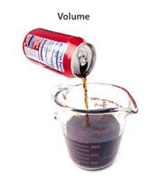
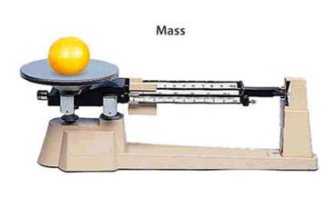
Composition of Matter
Matter – everything in the universe is composed of matter.
  Matter is anything that occupies space or has mass.
    Mass is the quantity of matter an object has.
    Weight is the pull of gravity on an object.

Slide 4
States of Matter
States of Matter

Slide 5
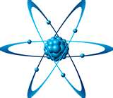
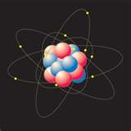
Atoms
The simplest particle of an element that retains all the properties of that element.
  All atoms consist of 3 types of smaller particles:
    Proton = has a + charge
    Neutron = has no charge
    Electron = has a - charge
Properties of atoms determine the structure and properties of the matter they compose.
Our understanding of the structure of atoms is based on scientific models, not actual observation.

Slide 6
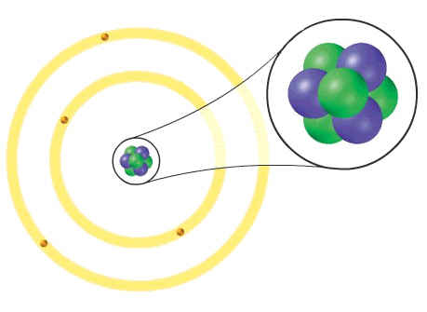
The Nucleus
Central core
Consists of positive charged protons and neutral neutrons
Positively charged
Contains most of the mass of the atom

Slide 7
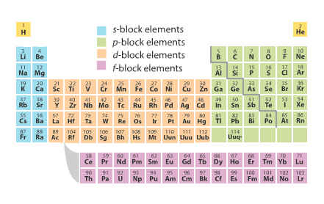
Elements
Pure substances that cannot be broken down chemically into simpler kinds of matter.
  Made of only 1 type of atom
A group of atoms of the “same” type.
More than 100 elements (91 are naturally occurring)

Slide 8
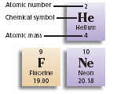
More on Elements
96 % of the mass of an organism is composed of 4 elements (oxygen, carbon, hydrogen, and nitrogen)
Each element has a unique chemical symbol:
  Consists of 1-2 letters
  First letter is always capitalized

Slide 9
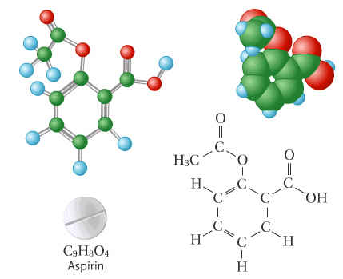
Compounds
Is a substance made of atoms of different elements bonded together in a certain ratio.
  Examples: H₂O and CO₂
Most elements do not exist by themselves
Readily combine with other elements in a predictable fashion

Slide 10
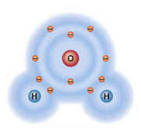
More on Compounds
A compound is a pure substance made up of atoms of two or more elements.
  The proportion of atoms are always fixed.
Chemical formulas show the kind and proportion of atoms of each element that occurs in a particular compound.

Slide 11
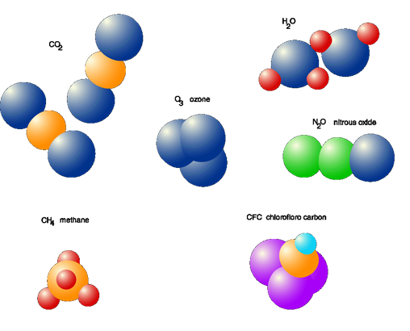
Molecules
Is two or more atoms held together by covalent bonds.
Are the simplest part of a substance that retains all of the properties of the substance and exists in a free state.
Some molecules are large and complex.

Slide 12
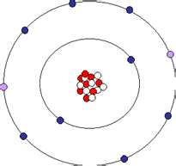
Ions form when atoms gain or lose electrons
Ion is an atom that has gained or lost one or more electron.
It forms because an atom is more stable when its outermost energy level is full.
  The gain or loss of electrons results in a full outermost level.
An atom becomes an ion when its number of electrons change and it gains an electrical charge.
Can be positively or negatively charged.

Slide 13
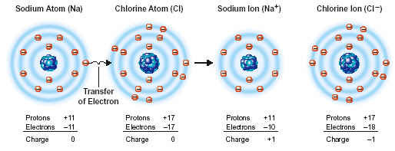
Ionic Bond
Some atoms become stable by losing or gaining electrons.
Atoms that lose electrons are called positive ions.
Atoms that gain electrons are called negative ions.
Because positive and negative electrical charges attract each other ionic bonds form.

Slide 14
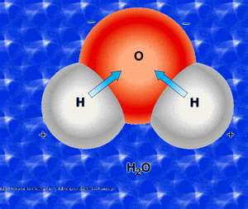
Atoms share pairs of electrons in covalent bonds.
Not all atoms gain or lose electrons easily.
Some atoms “share” pairs of electrons.
Shared pairs of electrons fill the outermost energy levels of the bonded atoms.
  A covalent bond is formed when atoms share a pair of electrons.
  This type of bond is very strong.

Slide 15
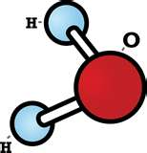
Properties of the Water Molecule
Water molecule (H₂O) is made up of three atoms – one oxygen and two hydrogen
The oxygen atom attracts more than its “fair share” of electrons.
Oxygen end “acts” negative
Hydrogen end “acts” positive
Causes the water to be polar
  Think of it as two magnets attracted to one another.
Water is neutral (equal number of electrons and protons)
  Zero net charge

Slide 16
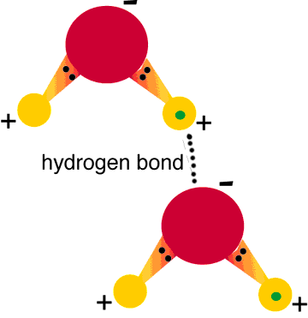
Life depends on hydrogen bonds in water
Polar water molecules act like magnets and attract each other
Hydrogen bonds –
  Is an attraction between a slightly positive hydrogen atom and a slightly negative atom, often oxygen or nitrogen.
They are strong bonds that form between molecules like CO₂ and H₂O

Slide 17
Bonding Animation
Bonding Relationships

Slide 18
Homeostasis
Ability to maintain a steady state despite changing conditions
Water is important to this process because:
  Makes a good insulator
  Resists temperature change
  Universal solvent
  Coolant
  Ice protects against temperature extremes (insulates frozen lakes)

Slide 19
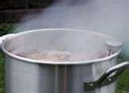
Properties Related to Hydrogen Bonds
High specific heat:
  Water resists changes in temperature.
  Must absorb more heat energy to increase temperature
  Helps regulate cell temperatures

Slide 20
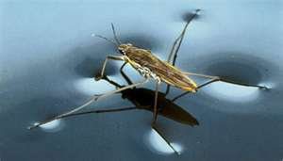
Properties Related to Hydrogen Bonds
Cohesion –
  Attraction among molecules of the same substance
  Makes water molecules stick to each other
  Produces surface tension, makes kind of skin on water

Slide 21
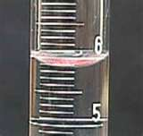
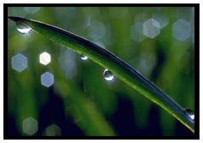
Properties Related to Hydrogen Bonds
Adhesion
  Attraction among molecules of different substances
  Water molecules stick to things
  Responsible for the upward curve on the surface of the water in a test tube
  Helps plants transport water from their roots to their leaves

Slide 22
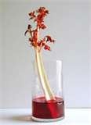
Properties Related to Hydrogen Bonds
Capillary action
  Allowing water to travel upwards against gravity

Slide 23
Solutions - Review
Solutions Animation

Slide 24
BrainPop - Review
BrainPop Acids and Bases

Slide 25
Ticket Out the Door
What is biochemistry?
What is matter?
List the charges for protons, neutrons, and electrons.
What is the difference between an element and a compound?
Describe the difference between ionic and covalent bonds.
On the pH scale where do acids AND bases fall?

Slide 26
The Chemistry of Life
Day 2

Slide 27
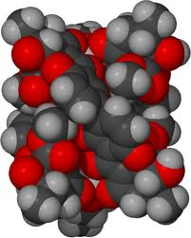
What is a macromolecule?
These are organic compounds that contain carbon, and are considered to be “giant molecules”.
A process called polymerization combines smaller molecules together to form these larger macromolecules.
These compounds are the building blocks of living things…in other words without them there would be no you!

Slide 28
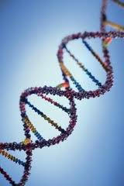
Examples of Macromolecules
There are four groups of macromolecules that make up living things:
  Carbohydrates
  Lipids
  Proteins
  Nucleic acids

Slide 29
Six Major Elements associated with making up these macromolecules
These 6 elements make up your body, and they are also important in creating these organic compounds.
So what are these 6 major elements important to life:
The Big Six -> CHONPS
          Carbon (C) ●Hydrogen (H)
          Oxygen (O) ●Nitrogen (N)
          Phosphorus (P) ●Sulfur (S)

Slide 30

So how are these the building blocks of living things?
The macromolecules are the LARGER MOLECULES…so like a house, you need “bricks” to build/make them!
  Monomer – smallest unit of a large molecule (building blocks of things)
  Polymer – the large molecule; formed by joining monomers (the product/the thing made = this is the macromolecule!)
2 or more monomers make a polymer!

Slide 31
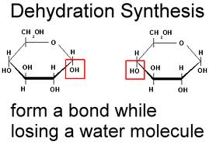
Formation of Macromolecules
Monomers are connected by a reaction in which 2 molecules are bonded to each other through the loss of a water molecule.
  Called a condensation reaction or dehydration reaction because a water molecule is lost.

Slide 32
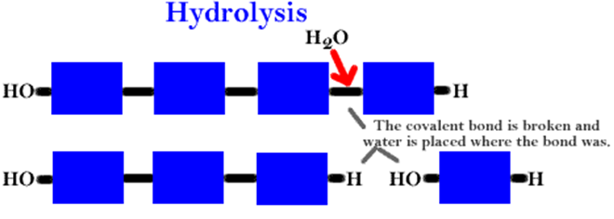
Formation of Macromolecules cont.
Polymers are disassembled (broken up) into monomers by hydrolysis, a process that is essentially the reverse of the dehydration reaction.
  Hydrolysis means “to break with water”. Bonds between monomers are broken by the addition of water molecules.

Slide 33
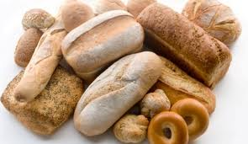
Four Major Classes of Organic Molecules
1. Carbohydrates
  Main source of energy for living things
  Plants and some animals use carbohydrates for structural purposes
  Made up of sugars
    Monosaccharide (monomer) = 1 single
    Disaccharide = 2 sugars
    Polysaccharide = many/more than 2 sugars

Slide 34
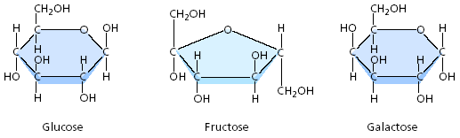
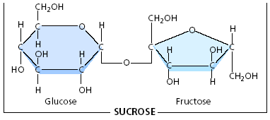

Organic Compounds: Carbohydrates
The elements that make them up → C, H, & O
Glycosidic bonds attach the sugar monomers together
3 types –
(1) Monosaccharides
(C₆H₁₂O₆ = glucose,
galactose, & fructose)
(2) Disaccharides (2 monosaccharides joined; ex: sucrose)
(3) Polysaccharides
(long chain of monosaccharides; ex: starch)

Slide 35
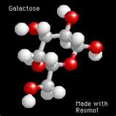
Glucose, Fructose, and Galactose
(Monosaccharides)
Glucose:
  Made during photosynthesis
  Main source of energy for plants and animals
Fructose:
  Found naturally in fruits
  Is the sweetest of monosaccharides
Galactose:
  Found in milk
  Is usually in association with glucose or fructose

Slide 36
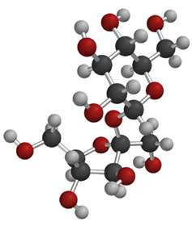
Disaccharide
Disaccharide – two monosaccharide bonded together
  Table sugar (sucrose) = made up of glucose + fructose bonded together
  Milk sugar (lactose) = made up of glucose + galactose bonded together

Slide 37
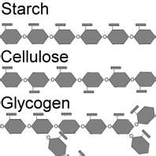
Polysaccharide
Polysaccharide = more than two monosaccharide bonded together by glycosidic bonds
  Serve as storage material or building material
    Storage (examples: starch, glycogen)
    Structural (examples: cellulose, chitin)
A complex carbohydrate is a polysaccharide with 12 or more monosaccharide units.
  Pasta and starches are polysaccharides
    Potatoes are a starch

Slide 38
Carbohydrate Animation
Carbohydrate Animation

Slide 39
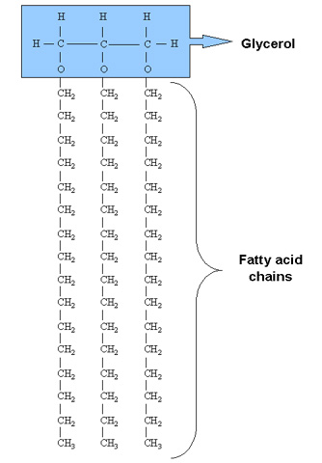
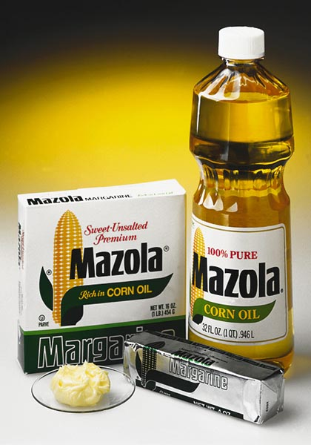
4 Classes of Organic Cmpds cont’d…
Lipids
  Used to store energy (for the long term)
  Important in making your cell membranes & waterproofing the certain coverings in the body
    Example: Cell Membranes
  Insulates/ protects your bodies organs (like a cushion)
  Examples → Fats, Oils,
  and Waxes

Slide 40
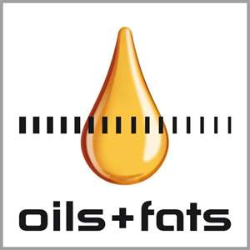
Organic Compounds: Lipids
The elements that make them up → C, H, & O
Nonpolar (NOT soluble / will not mix with water - Hydrophobic)
The building block for lipids includes 1 glycerol molecule and 3 fatty acid molecules.
There two ways lipids can be represented in the body:
  Saturated Fat – fatty acids are “full” of Hydrogens; all carbon bonds are single (animal products)
  Unsaturated Fat – at least 1 double bond between carbons (plant products)

Slide 41
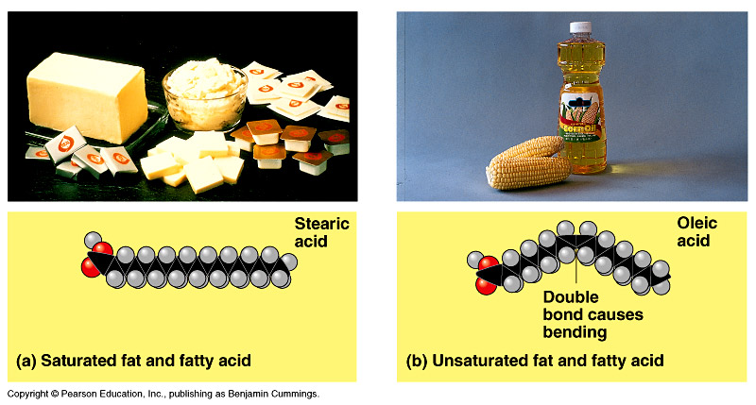
At room temperature, the molecules of a saturated fat are packed closely together, forming a solid.
At room temperature, the molecules of an unsaturated fat cannot pack together closely enough to solidify because of the kinks in their fatty acid tails.

Slide 42
Ticket Out the Door
What is a macromolecule?
List the 4 major groups of macromolecules.
What are the 6 major groups of elements found in macromolecules?
What is the difference between a monomer and a polymer?
What are carbohydrates used for?
What lipids used for?
What is the difference between a saturated and unsaturated fat?

Slide 43
The Chemistry of Life
Day 3

Slide 44
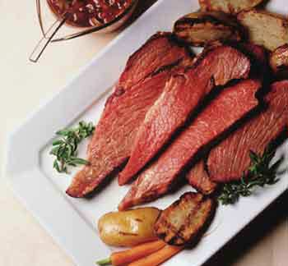
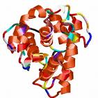
More on the 4 Classes of Organic Compounds …
Proteins
  The majority of the processes that take place in the body occur because of proteins!!!
  The elements that make up proteins are C, H, O, & N
  Amino Acids (aa) are the monomers of proteins

Slide 45
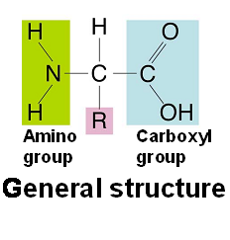
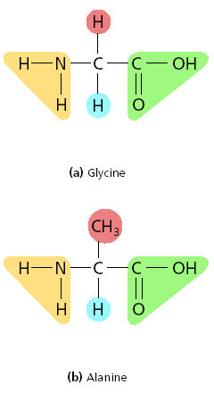
Organic Compounds:
Proteins
There are 20 different amino acids
found in nature
Amino Acids are made up of
3 functional groups:
  An AMINO GROUP (-NH₂)
  An R GROUP
  (different per amino acid)
  A CARBOXYL GROUP (-COOH)

Slide 46
What are some functions of proteins?
4 Types of Proteins & their function in the body:
  Regulatory (ex: Enzymes)
    Controls the rate of reactions in your body
  Transport (ex: Hemoglobin transports O₂)
    Sending nutrients to different parts of the body
  Structural (ex: collagen, found in skin and bones)
    Forms/ makes up different parts of the body
  Protective (ex: antibodies protect against disease)
    Makes cells that act as fighters for the body

Slide 47
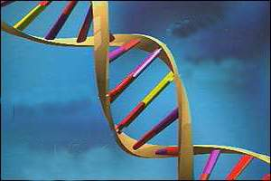
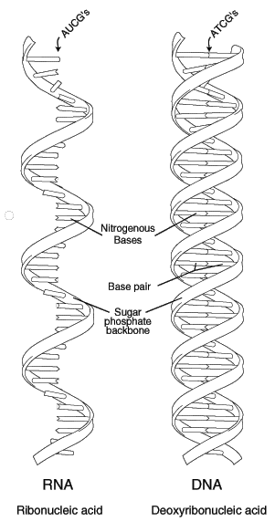
Finally…
Nucleic Acids
  The function of nucleic acids is to store and transmit genetic info
  The elements that make up nucleic acids are…
  C, H, O, N, & P
  Two types:
    DNA (Deoxyribonucleic Acid)
    RNA (Ribonucleic Acid)
DNA

Slide 48
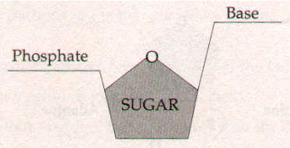
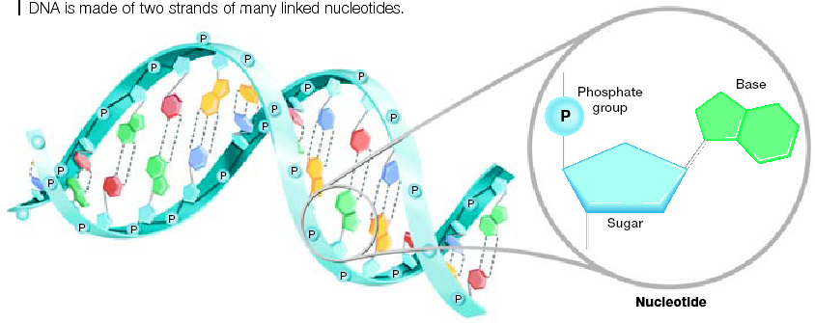
Organic Compounds: Nucleic Acids
The monomers of nucleic acids are nucleotides
Each nucleotide
is made up of:
  A 5-carbon sugar
  A phosphate group
  A nitrogenous base

Slide 49
Monomer + Monomer, etc. = Polymer
MONOMERS (or building blocks) | POLYMERS
Monosaccharides | Carbohydrates (polysaccharides)
Glycerol and fatty acids (building block) | Lipids
Nucleotides | Nucleic Acids
Amino Acids | Proteins

Slide 50
Carbon Macromolecules
Compounds
include
Carbohydrates
Lipids
Nucleic acids
Proteins
that consist of
that consist of
that consist of
that consist of
Sugars and
starches
Fats and oils
Nucleotides
Amino Acids
which contain
which contain
which contain
which contain
Carbon,
hydrogen,
oxygen
Carbon,
hydrogen,
oxygen
Carbon,hydrogen,
oxygen, nitrogen,
phosphorus
Carbon,
hydrogen,oxygen,
nitrogen,

Slide 51
Ticket Out the Door
What are the monomers of (building blocks) of proteins?
What are the 3 basic parts of an amino acid?
What do proteins do for organisms?
What do nucleic acids do?
What are the 2 types of nucleic acids?
What are the monomers of nucleic acids?
What are the parts of a nucleotide?

Slide 52
The Chemistry of Life
Day 4

Slide 53
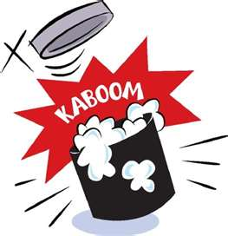
What is a Chemical Reaction?
Everything that happens inside of an organism is based on chemical reactions – Examples:
  Growth
  Its interaction with the environment
  Reproduction
  Movement
Chemical reaction – a process that changes one set of chemicals into another
Chemical reactions always involve the breaking of bonds and the formation of new bonds!

Slide 54
Chemical Reaction Breakdown
There are 2 parts to every chemical reaction:
CO₂ + H₂O → C₆H₁₂O₆ + O₂
Reactants represent what is being used/what enters into a reaction
  Always found before the arrow!
Products represent what is made/what exits a reaction
  Always found after the arrow!
Reactants
Products

Slide 55
Do we need energy to complete all of these reactions?
YES!!! Energy is a big factor in completing these reactions.
Some chemical reactions release energy and some absorb energy
  Chemical reactions that release energy are called EXERGONIC REACTIONS
    These often occur spontaneously – such as
    Cellular Respiration
  Chemical reactions that absorb energy are called ENDERGONIC REACTIONS
    These will not occur without a source of energy – such as Photosynthesis (the original energy comes from the sun!!!)

Slide 56
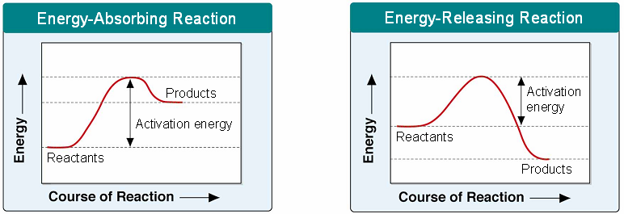
Chemical Reactions (cont’d)
Photosynthesis
Cell Respiration

Slide 57
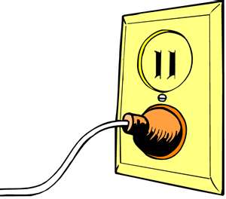
But not all reactions are spontaneous…some STILL require a little energy!
Energy needed to get a reaction started is called activation energy.
This “start energy” is important, because it can determine whether you release or absorb energy.
It is important to every organism that they maintain a certain amount of energy…the amount of energy you use in the beginning can make a big difference on whether or not you complete an important reaction!

Slide 58
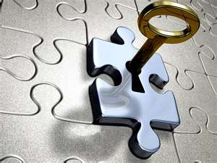
However… there is a PROBLEM!
Some chemical reactions that make life possible are too slow or have activation energies that are too high to make them practical for living tissue…(in other words they take TOO LONG)
Solution → Your body has a protein that lowers the amount of energy needed at the beginning of a reaction, so you have more energy to complete your metabolic processes needed to live your life!

Slide 59
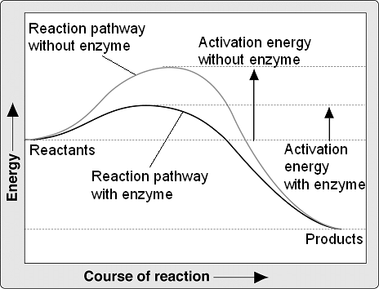
These proteins are called… Enzymes!!!
Enzymes are proteins that act as biological catalysts
  Catalysts:
    Substance that speed up the rate of a reaction, without using a large amount of energy.
Most enzymes end in
the letters – ase.
  Ex: your saliva/ spit is called AMYLASE

Slide 60
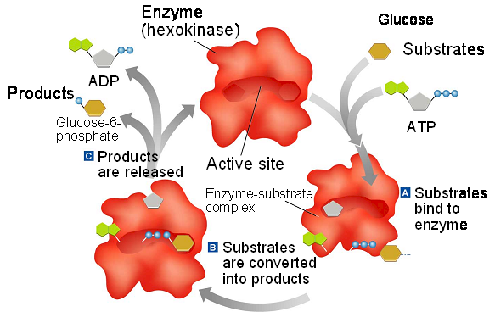
Enzymes
Enzymes speed up a reaction by lowering the activation energy of a reaction
Enzymes act as a site of a reaction and are not used up

Slide 61
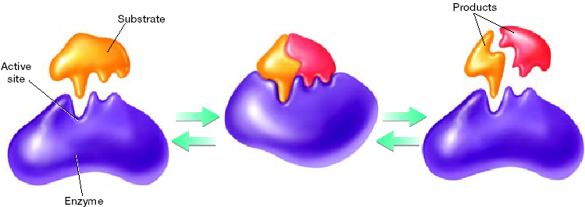
Scientists use a model to represent the way enzymes carry out chemical reactions
The Enzyme-Substrate Complex →
“Lock & Key” Model
  Enzymes have very specific Active Sites, where only certain reactants can bind to reduce activation energy (E_{A}).
  These reactants are called “substrates.”
  Enzymes release products after a reaction and can start the same process over again.

Slide 62

Remember…
Enzymes are a type of PROTEIN!!!
There job is to regulate the body’s activities WITHOUT using too much energy.
When you damage a protein, so it no longer works it becomes DENATURED.

Slide 63

Denaturation and Re-naturation of a Protein
There are many things that can affect the way an enzyme works:
  Extreme Temperatures→ Both hot or cold can damage an enzyme
  pH changes → Mixing proteins with Strong Acids or Bases
  Cell Activators → Things that may turn on an enzyme
  Cell Inhibitors → Things that may turn off certain cell activities

