Slide 1
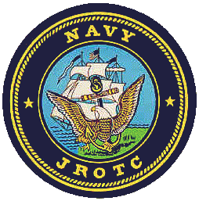
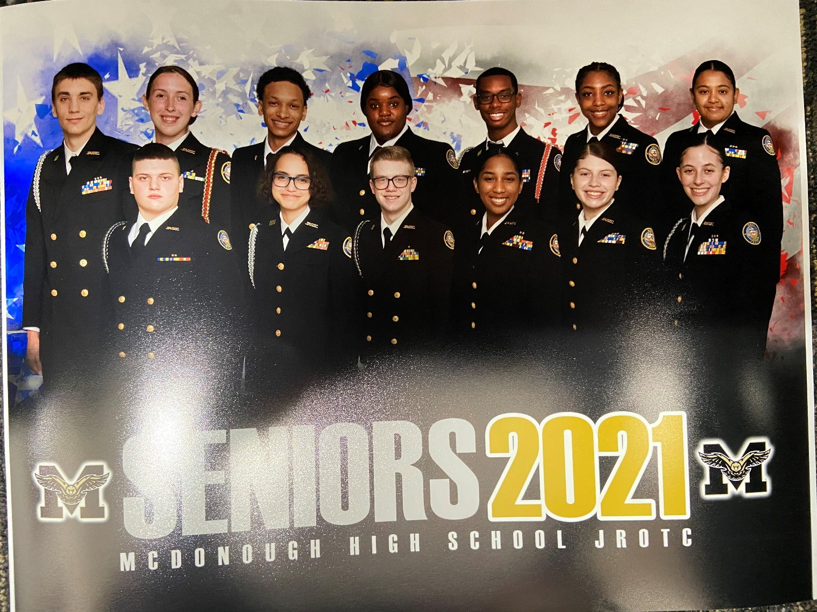
Warhawk Battalion Welcome Aboard!!!

Slide 2
Mission and Vision
Navy JROTC Mission:
Our program mission is to instill in students in United States secondary educational institutions the values of citizenship, service to the United States, personal responsibility and a sense of accomplishment.
McDonough HS Warhawk Battalion Mission:
Create motivated leaders that uphold Warhawk standards, are involved in their community and value learning to become the best citizens they can.

Slide 3
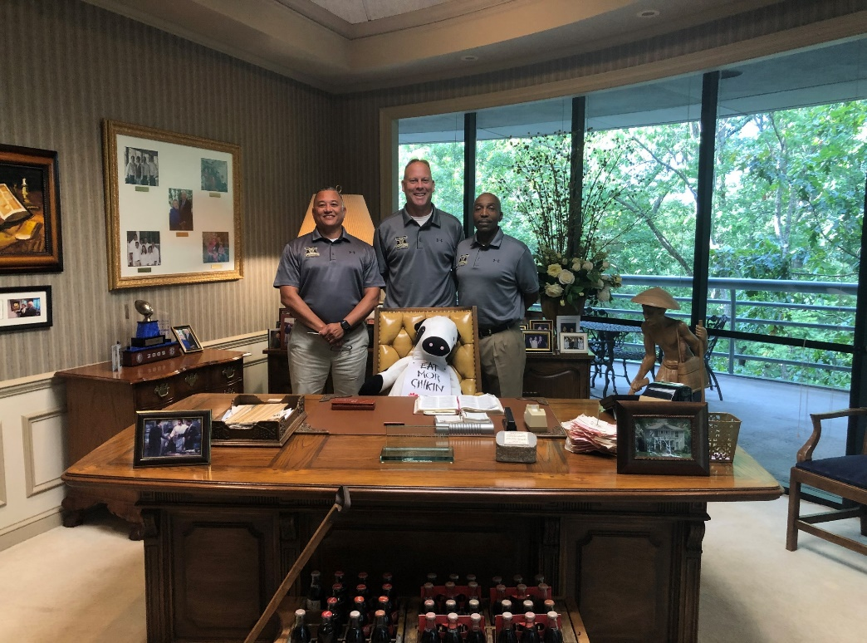
Instructors
Major Clint A. Houchins, United States Marine Corps (Ret.)
Senior Chief David Moss, United States Navy (Ret.)
Chief Tim Welch, United States Navy (Ret.)

Slide 4
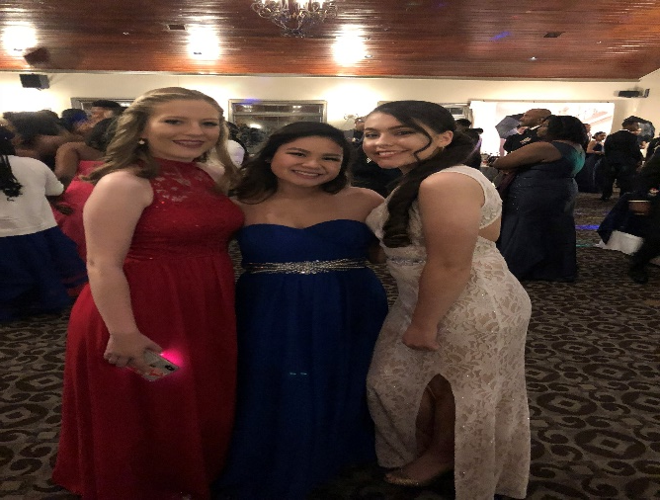
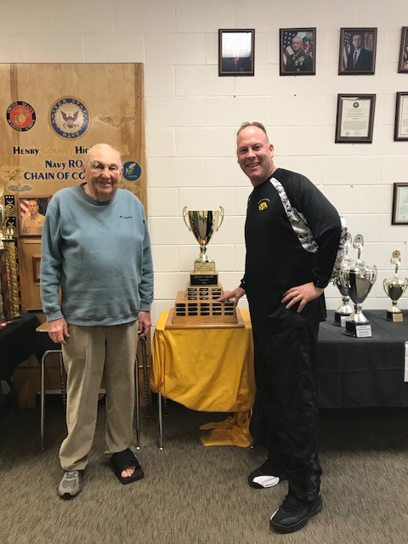
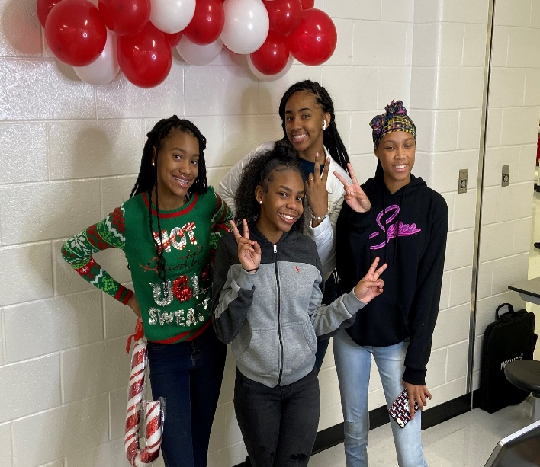
History
Established in 1986 at Henry County HS along with Stockbridge HS
Part of US Navy NJROTC – Area-12 (Georgia / Jacksonville, FL)
1 of 5 Navy JROTC units in Henry County along with Stockbridge, Luella, Union Grove and Eagle’s Landing (Dutchtown and Ola = USAF)
20 years straight of U.S. Navy Distinguished Unit
2015 began partnership w/Academy for Advanced Studies

Slide 5
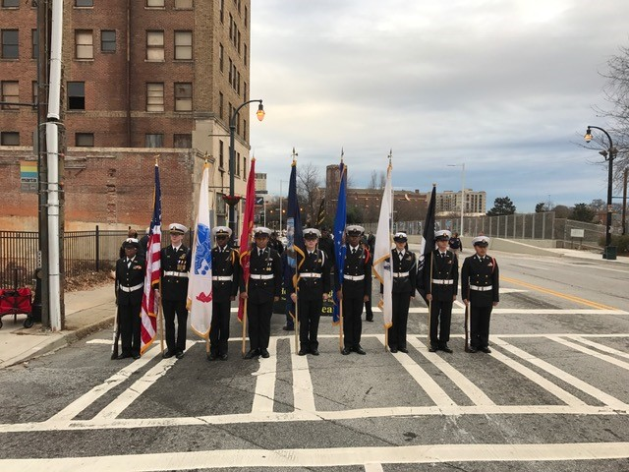
General Schedule
Monday and Tuesday: Academics
NS-1 Senior Chief Moss
NS-2/4 Major Houchins
NS-3 Chief Welch
Wednesday: Uniform Inspection
Thursday: Drill
Friday: Physical Training

Slide 6
Extra-Curricular Activities - Teams
Orienteering- Mix of Land Navigation and Cross Country. We are 6-time National Champions
Coach: Senior Chief Moss
Rifle- 3-PAR Teams compete in both Area-12 Matches and a GHSA schedule
Coach: Chief Welch
Drill- A combination of events including Close Order Drill, Uniform Inspection and Athletic Events
Coach: Major Houchins
Academic Team- Compete in Brain Brawls against other schools within Area-12
Chief Welch
Drone Team- Inaugural season – Fly and navigate drones with speed through obstacles and various courses
Coach: Major Houchins
Color Guard (non-competitive): Events at City Hall, State Capitol, SunTrust Park, etc.

Slide 7
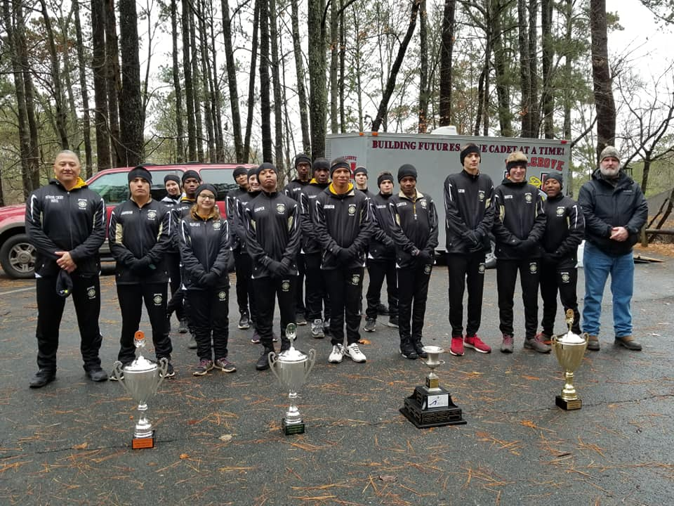
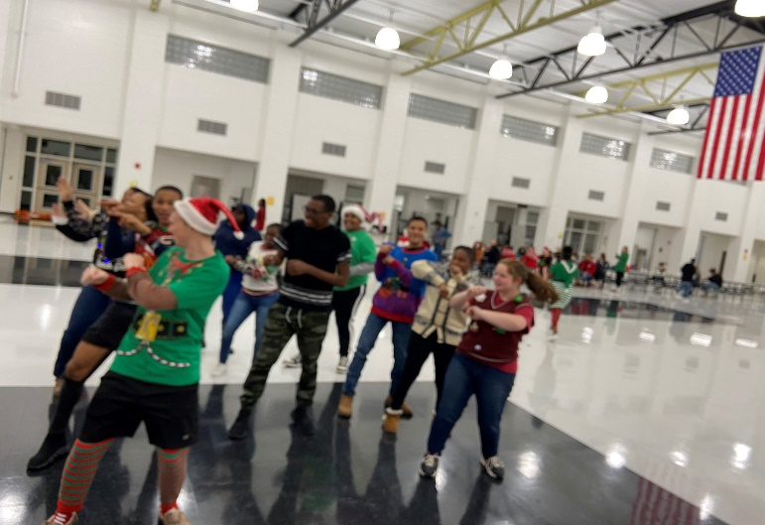
Major Events
August: Unit Welcome Cook-out / Mini Boot Camp
September: Warhawk Classic Drill Meet
October: Jolly Roger O-Meet
Oct/Nov: US Navy Birthday Ball (Formal)
Oct/Nov: Area Manager’s Inspection
December: Unit Holiday Party
January: Warhawk Open Rifle Meet
February: Navy Nationals O-Meet
March: US Nationals O-Meet
April: Unit Awards Night
May: Senior Breakfast / Graduation

Slide 8
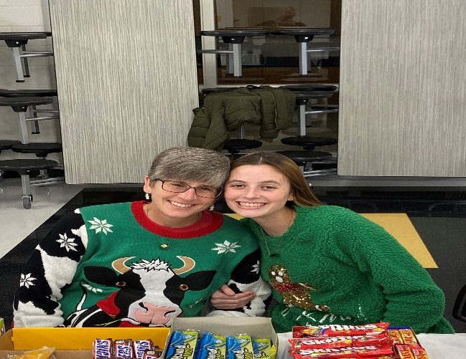
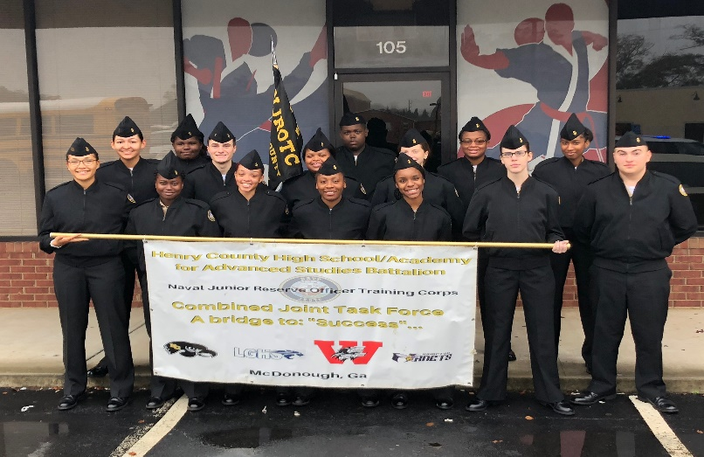
Cadet Parent Organization
Local Booster Club
Used to support events such as Unit cook-out, Mini Bootcamp, Military Ball, Drill Meet, Senior Breakfast, Awards Night
Open to all parents/Cadets
Monthly Meetings at School (via Zoom)
Offices: President, Vice President, Secretary and Treasurer

Slide 9
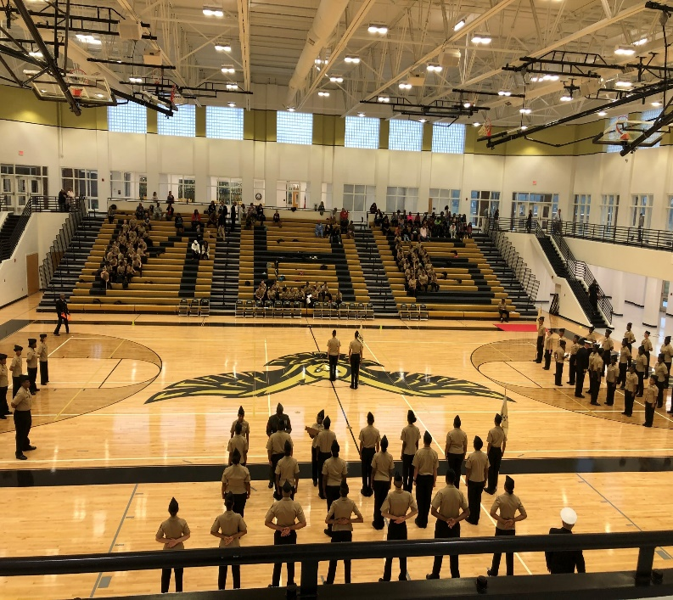
So the….why???
Our graduation rate is 100%....period!
Recent Alumni have:
Obtained ROTC scholarships to Morehouse, Spelman, GA Military College, Tuskegee, Savannah State
Been accepted to colleges all over the nation including: Yale, Iowa State, North Greenville, Alabama State, GA Southern, Univ of GA
Appointments to US Naval Academy and US Military Academy at West Point
Joined all branches of service, meritoriously promoted, Sailor/Marine of the Quarter

Slide 10
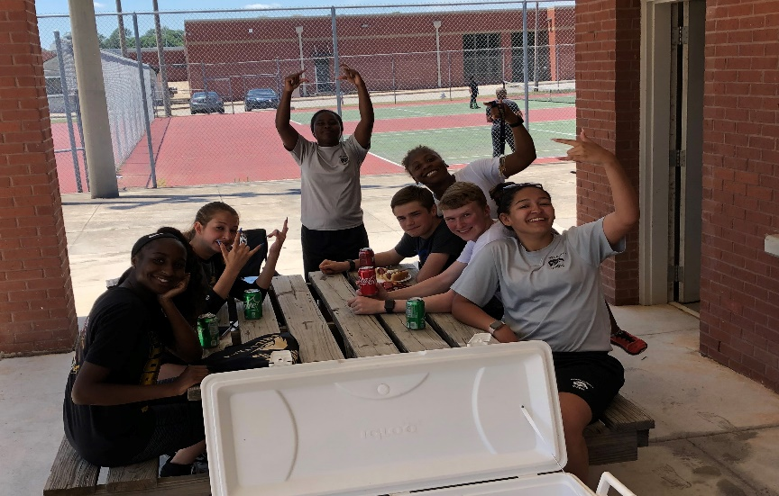
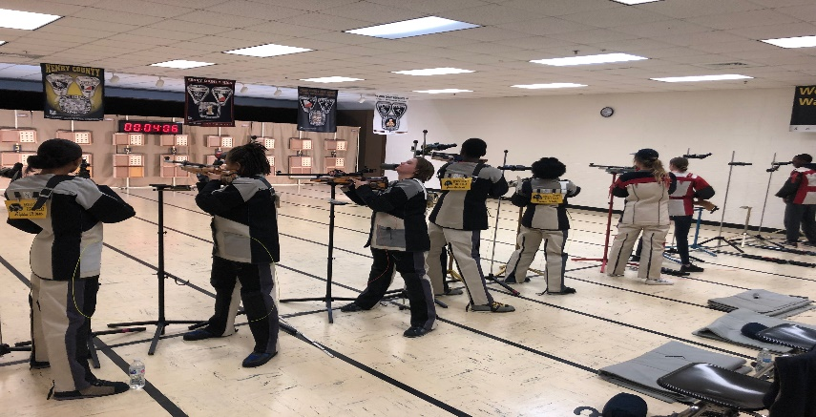
In closing….
We are not “recruiters”
If you’re child is undisciplined we are NOT the quick fix.
If you’re child (and/or you) do not buy in to the program…i.e. wear their uniform, maintain grooming standards, etc….they will fail.
If your child will work hard, commit to a team and maintain top grades they WILL be successful….we guarantee it!!!
Follow us: on Facebook @ McDonough High School [NJROTC]

