Slide 1


Prepare for the PSAT™ 8/9

Slide 2
Contents
01
What Is the PSAT 8/9?
02
When Is the PSAT 8/9?
03
Skills Tested on the PSAT 8/9
04
How to Prepare for the PSAT 8/9
05
Resources

Slide 3
What Is the PSAT 8/9?
1

Slide 4
Key Facts
The PSAT 8/9 is offered to 8th‐ and 9th‐grade students, testing the same knowledge and skills as the SAT®, PSAT/NMSQT®, and PSAT™ 10 in a way that makes sense for the student’s grade level.
The PSAT 8/9 establishes a baseline of college readiness to help educators and students figure out what students need to work on most so they are ready for college when graduating from high school.
Scores for the SAT Suite of Assessments (SAT, PSAT/NMSQT, PSAT 10, and PSAT 8/9) are reported on a common vertical scale, allowing educators and students to measure progress.
Test length: 2 hours and 25 minutes.
There’s no penalty for guessing or blank responses, also known as “rights-only scoring.”

Slide 5

Benefits of the PSAT 8/9
Establishes a baseline measurement of college and career readiness.
Gives students comprehensive feedback on test performance and which academic skills they should work to improve.
Tests the same skills and knowledge as the SAT, PSAT/NMSQT, and PSAT 10—in a way that makes sense for each grade level.
Information on majors and career exploration with College Board and Roadtrip Nation®

Slide 6
When Is the PSAT 8/9?
2

Slide 7
PSAT 8/9 Test Dates
For upcoming PSAT 8/9 administration dates, as well as information on key deadlines and timelines, please visit
collegereadiness.collegeboard.org/psat-8-9/k12-educators/dates

Slide 8
Skills Tested on the PSAT 8/9
3

Slide 9
Skills Tested
Each test assesses the academic skills that students have developed primarily through their coursework.
These skills are considered essential for high school, college, and career success.
Reading Test
Writing and Language Test
Math Test

Slide 10
Reading Test
Quick Facts
All questions are multiple choice and based on passages.
Some passages are paired with other passages or informational graphics such as graphs and tables.
No mathematical computation is required.
Topic-specific prior knowledge is never tested.
The Reading Test is part of the Evidence-Based Reading and Writing section.
5 passages
42 passage-based questions;
55 minutes

Slide 11
Reading Test
What to Expect
In the Reading Test, students will encounter questions like those asked in a lively, thoughtful, evidence-based discussion.

Slide 12
Writing and Language Test
Quick Facts
All questions are multiple choice and based on passages.
Some passages are paired with informational graphics such as graphs and tables.
No mathematical computation is required.
Topic-specific prior knowledge is never tested.
The Writing and Language Test is part of the Evidence-Based Reading and Writing section.
4 passages
40 passage-based questions;
30 minutes

Slide 13
Writing and Language Test
What to Expect
The Writing and Language Test puts students in the active role of an editor who is improving a written passage. Most questions ask students to decide which, if any, of the alternatives to an underlined portion of a passage most improves it.

Slide 14
Math Test
Quick Facts
Most math questions will
be multiple choice, but
some will be student-produced responses.
The Math Test is divided into 2 portions:
Math Test – No Calculator and Math Test – Calculator.
Some parts of the test
will present a scenario and then ask several questions about it.
2 test sections; 60 minutes
38 questions (31 multiple choice,
7 student-produced responses)

Slide 15
Math Test
What to Expect
The Math Test focuses on the math that matters most for college and career readiness. To succeed on the Math Test, students will need to demonstrate mathematical practices, such as problem solving and using appropriate tools strategically.

Slide 16
Math Section
Math Test — Calculator
Students: Know Your Calculator
A scientific or graphing calculator is recommended.
Students should bring a familiar calculator. Test day is not the time to figure out how to use a new calculator.

Slide 17
Math Section
Math Test — Calculator
Additional Calculator Tips for Students
Don’t try to use your calculator on every question—no question requires one.
Decide how to solve each problem; then decide whether to
use a calculator.
Make sure your calculator is in good working order with fresh batteries.
Students will not be permitted to use laptops or other computers, tablets, cell phones or smartphones, etc. Please reference the student guide for a complete list of prohibited items.

Slide 18
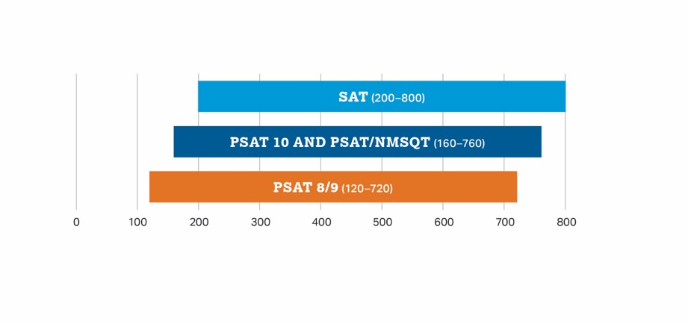
How Does the PSAT 8/9 Connect to the PSAT 10, PSAT/NMSQT, and SAT?
Content and Domain Alignment
Scoring
All tests in the SAT Suite are aligned to the same research backbone and focus on the same domain of knowledge and skills.
All tests in the SAT Suite are on a common score scale that provides consistent feedback, enabling teachers to adjust instruction to better support students who are ahead or behind.

Slide 19
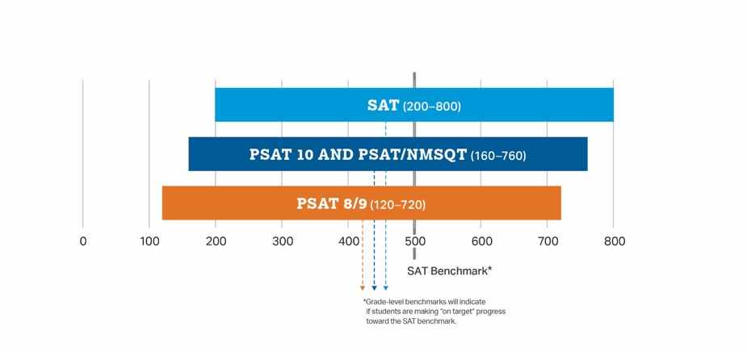
How Does the PSAT 8/9 Connect to the PSAT 10, PSAT/NMSQT, and SAT?
The score students get on the PSAT 8/9 is the same score they would have gotten on the PSAT 10, PSAT/NMSQT, or SAT if they’d taken it on the same day.

Slide 20
How to Prepare for the PSAT 8/9
4

Slide 21
Know How the PSAT 8/9
Is Scored
Rights-Only Scoring
1 point for each correct answer
No points deducted for incorrect answers or unanswered questions
Math Student-Produced Responses
Enter answers as (reduced) fractions or decimals.
If rounding a decimal, make sure to enter as many characters as are allowed.
Scale
120–720 for each test section
240–1440 for the total score

Slide 22
Personalized Skills Information
The PSAT 8/9 Score Report
Contains information to help students improve
academic skills.
Lists skills that students have the best chance of improving with additional work.

Slide 23
Preparation Starts in School
Read
Continuous reading improves vocabulary and develops essential skills.
Take Challenging Courses
This help students develop and strengthen their critical thinking skills.

Slide 24
Take the 2021-22 PSAT 8/9
How to Sign Up:
Test Day/Date:
Time:
Location:
_______________________
_______________________
_______________________
_______________________
Make sure you bring:
Two No. 2 pencils
Calculator (optional)

Slide 25
Resources
6

Slide 26
Resources
For general information about the PSAT 8/9, please visit psat.org/8-9

Slide 27
Good luck!

