Slide 1

Fundamentals of the FFA

Slide 2
STANDARD
The student becomes oriented to the comprehensive program of agricultural education, learns to work safely in the agriculture lab and work sites, demonstrates selected competencies in leadership through the FFA and agricultural industry organizations, and develops plans for a SAE.

Slide 3
Essential Question & Bell Work
What are the benefits of the unique relationship between agriculture education and FFA?
Grab a FFA Handbook

Slide 4
Objectives for the DAY
  Explain the benefits of agriculture classes.
  Explain the benefit of the FFA.
  Help students understand how they can become a part of FFA.

Slide 5
What is Agriscience?
3 Parts
  Classroom/Laboratory
    In the classroom or school day learning
  FFA
    Member of a national organization of over 500,000 FFA members
    Outside of the school day learning
  SAE
    Supervised Agricultural Experience
    Hands-on learning outside of class
    Fun & Research based

Slide 6
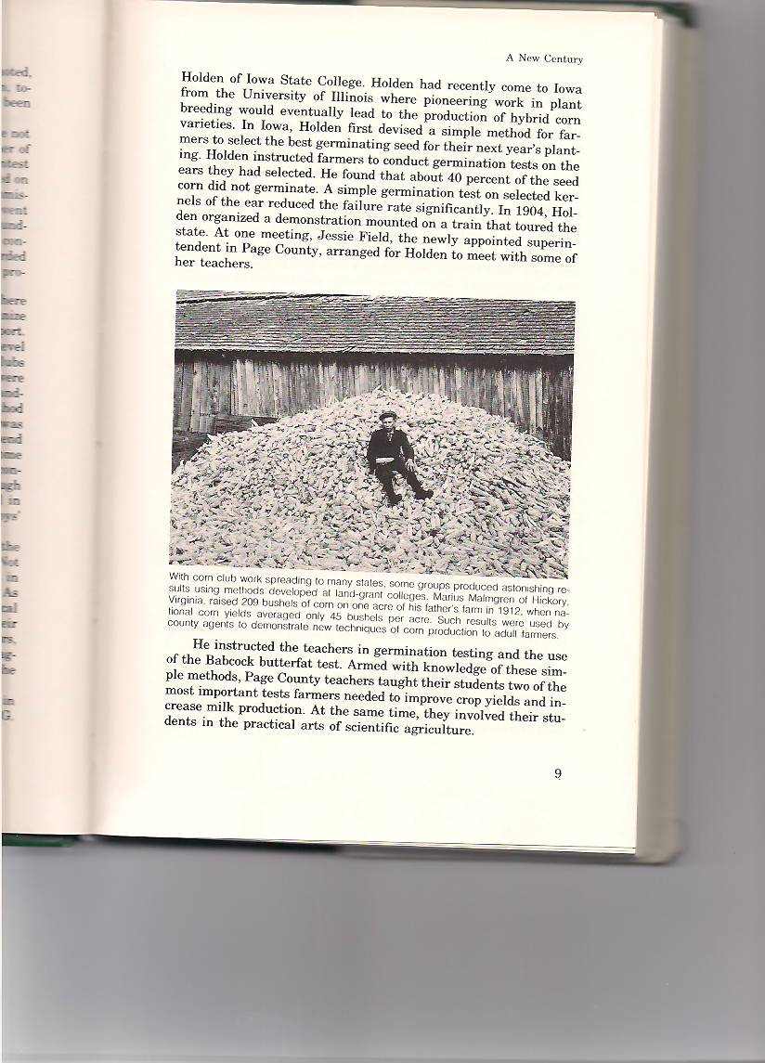
What is FFA?
Dynamic youth organization within agricultural education.
Structure of FFA-3 layers
  Local
  Officer Team
  State
    Officer Team
  National
  Officer Team

Slide 7

Symbols of the FFA Emblem
The FFA emblem was designed with much thought and meaning.
It is made up of six symbols.
Notes:
The FFA emblem represents the history, goals, and future of the FFA. It is comprised of:
1. A cross-section of an ear of corn which signifies common agricultural interest.
2. A rising sun which symbolizes progress in agriculture.
3. A plow , the symbol of labor and tillage of the soil.
4. An owl, the symbol of wisdom and knowledge.
5. An eagle which represents the national scope of the FFA.
6. The words: Agricultural Education/FFA which signify that FFA is an important part of the agricultural/agribusiness program.

Slide 8
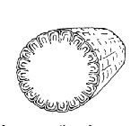
Symbols of the FFA Emblem
A cross-section of an ear of corn. The symbol of corn represents our common agricultural interests, is native to America, and is grown in every state.
Officer: Secretary

Slide 9

Symbols of the FFA Emblem
The rising sun. It symbolizes progress in agriculture and the confidence that FFA members have in the future.
Officer: President

Slide 10

Symbols of the FFA Emblem
The plow. It is a symbol of labor and tillage of the soil.
Officer: Vice President

Slide 11
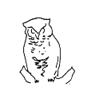
Symbols of the FFA Emblem
The owl. It symbolizes wisdom and knowledge.
Officer: Advisor

Slide 12

Symbols of the FFA Emblem
The eagle. This is symbolic of the national scope of the FFA.
Officer: Reporter

Slide 13

Symbols of the FFA Emblem
The words “Agricultural Education“ surround the letters “FFA.” This tells us that FFA is an important part of agriculture and agribusiness programs.

Slide 14
FFA: The Creed
I believe in the future of agriculture……………
I believe that to live and work…………
I believe in leadership…………
I believe in less dependence……….
I believe that American agriculture……….
The Creed was written by E.M. Tiffany and adopted at the 3rd National Convention.

Slide 15
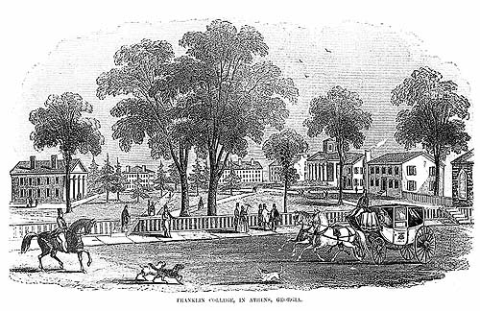
FFA History 101
1917- the Smith-Hughes National Vocational Education Act.
  Smith & Hughes were both congress men from Georgia
  Established Vocational Agricultural Classes
1925-Virginia Tech Agriculture Teacher organized the Future Farmers of Virginia
  FFA is modeled from FFV

Slide 16
History 101
1928- FFA established
  Location of establishment: Kansas City, Mo
1930- FFA Creed adopted
1933-Blue Corduroy Jacket adopted as official dress
1965- New Farmers of America merge with FFA
1969- Membership opens to girls
Another important part of History for FFA
Morrill Act of 1862

Slide 17
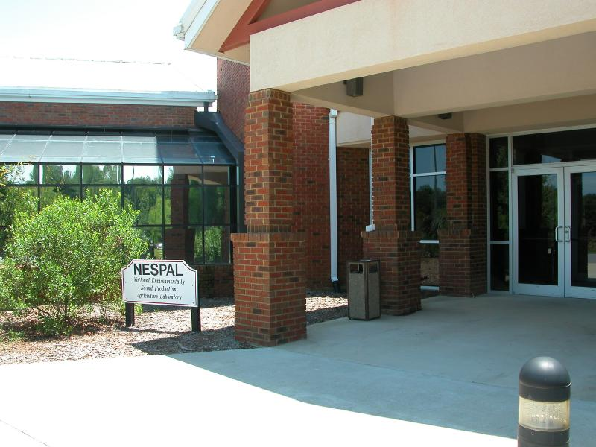
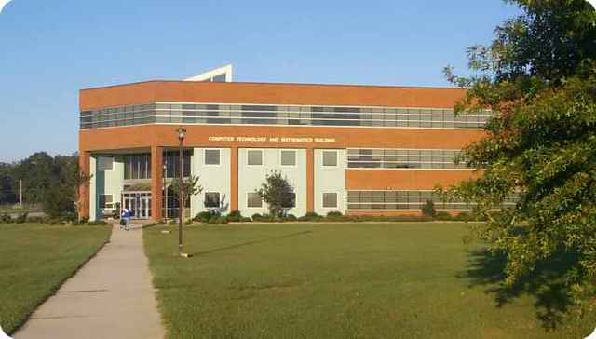
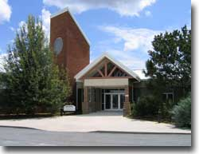
What are our Land-Grant Universities?
Notes:
Each state has at least one land-grant university
Georgia has two: The University of Georgia (1860’s) and Fort Valley State University (1890’s)
The University of Georgia is also a Sea-Grant University.

Slide 18
What is a Land Grant University?
UGA is a land grant university
Land Grant Universities were started by the Morrill Acts….
In 1862, legislation granted 30,000 acres per senator and congressman to establish land grant colleges as public universities.
Required to have the 3 following areas:
  Military tactics
  Engineering
  Agriculture
Notes:
Each state has a land-grant university.
Before land-grants, college was for the privileged; mostly white males.
Passage of the First Morrill Act (1862) reflected a growing demand for agricultural and technical education in the United States. While a number of institutions had begun to expand upon the traditional classical curriculum, higher education was still widely unavailable to many agricultural and industrial workers. The Morrill Act was intended to provide a broad segment of the population with a practical education that had direct relevance to their daily lives.

Slide 19
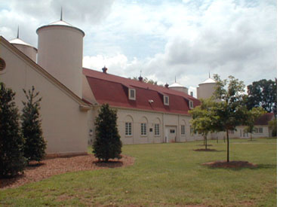
Land-Grant Benefits
Allowed for the financing of the Georgia State College of Agriculture and Mechanical Arts
Based on pillars:
    Teaching
    Research
    Extension

Slide 20
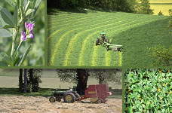
What do you think are the benefits of a land grant school for a state?
Notes:
Mix of academics (science and liberal arts)
Education for the “common people”
Research to better the lives of people in the state

Slide 21

Make up of Local Chapter
Any school in the nation can have a FFA chapter as long as they have Agriscience
Each chapter has:
  An Advisor
  Chapter Officer Team
  Chapter Advisory Committee
  School Administration

Slide 22
FFA Mission Statement
FFA makes a positive difference in the lives of students by developing their potential for premier leadership, personal growth, and career success.
Premier Leadership: leadership is influence-the ability to obtain followers
Personal Growth: the positive evolution of the whole person
Career Success: success in a chosen profession while effectively contributing to society.

Slide 23
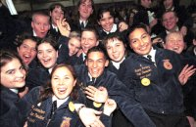
FFA Colors
National Blue & Corn Gold

Slide 24
FFA Salute
The Pledge of Allegiance

Slide 25
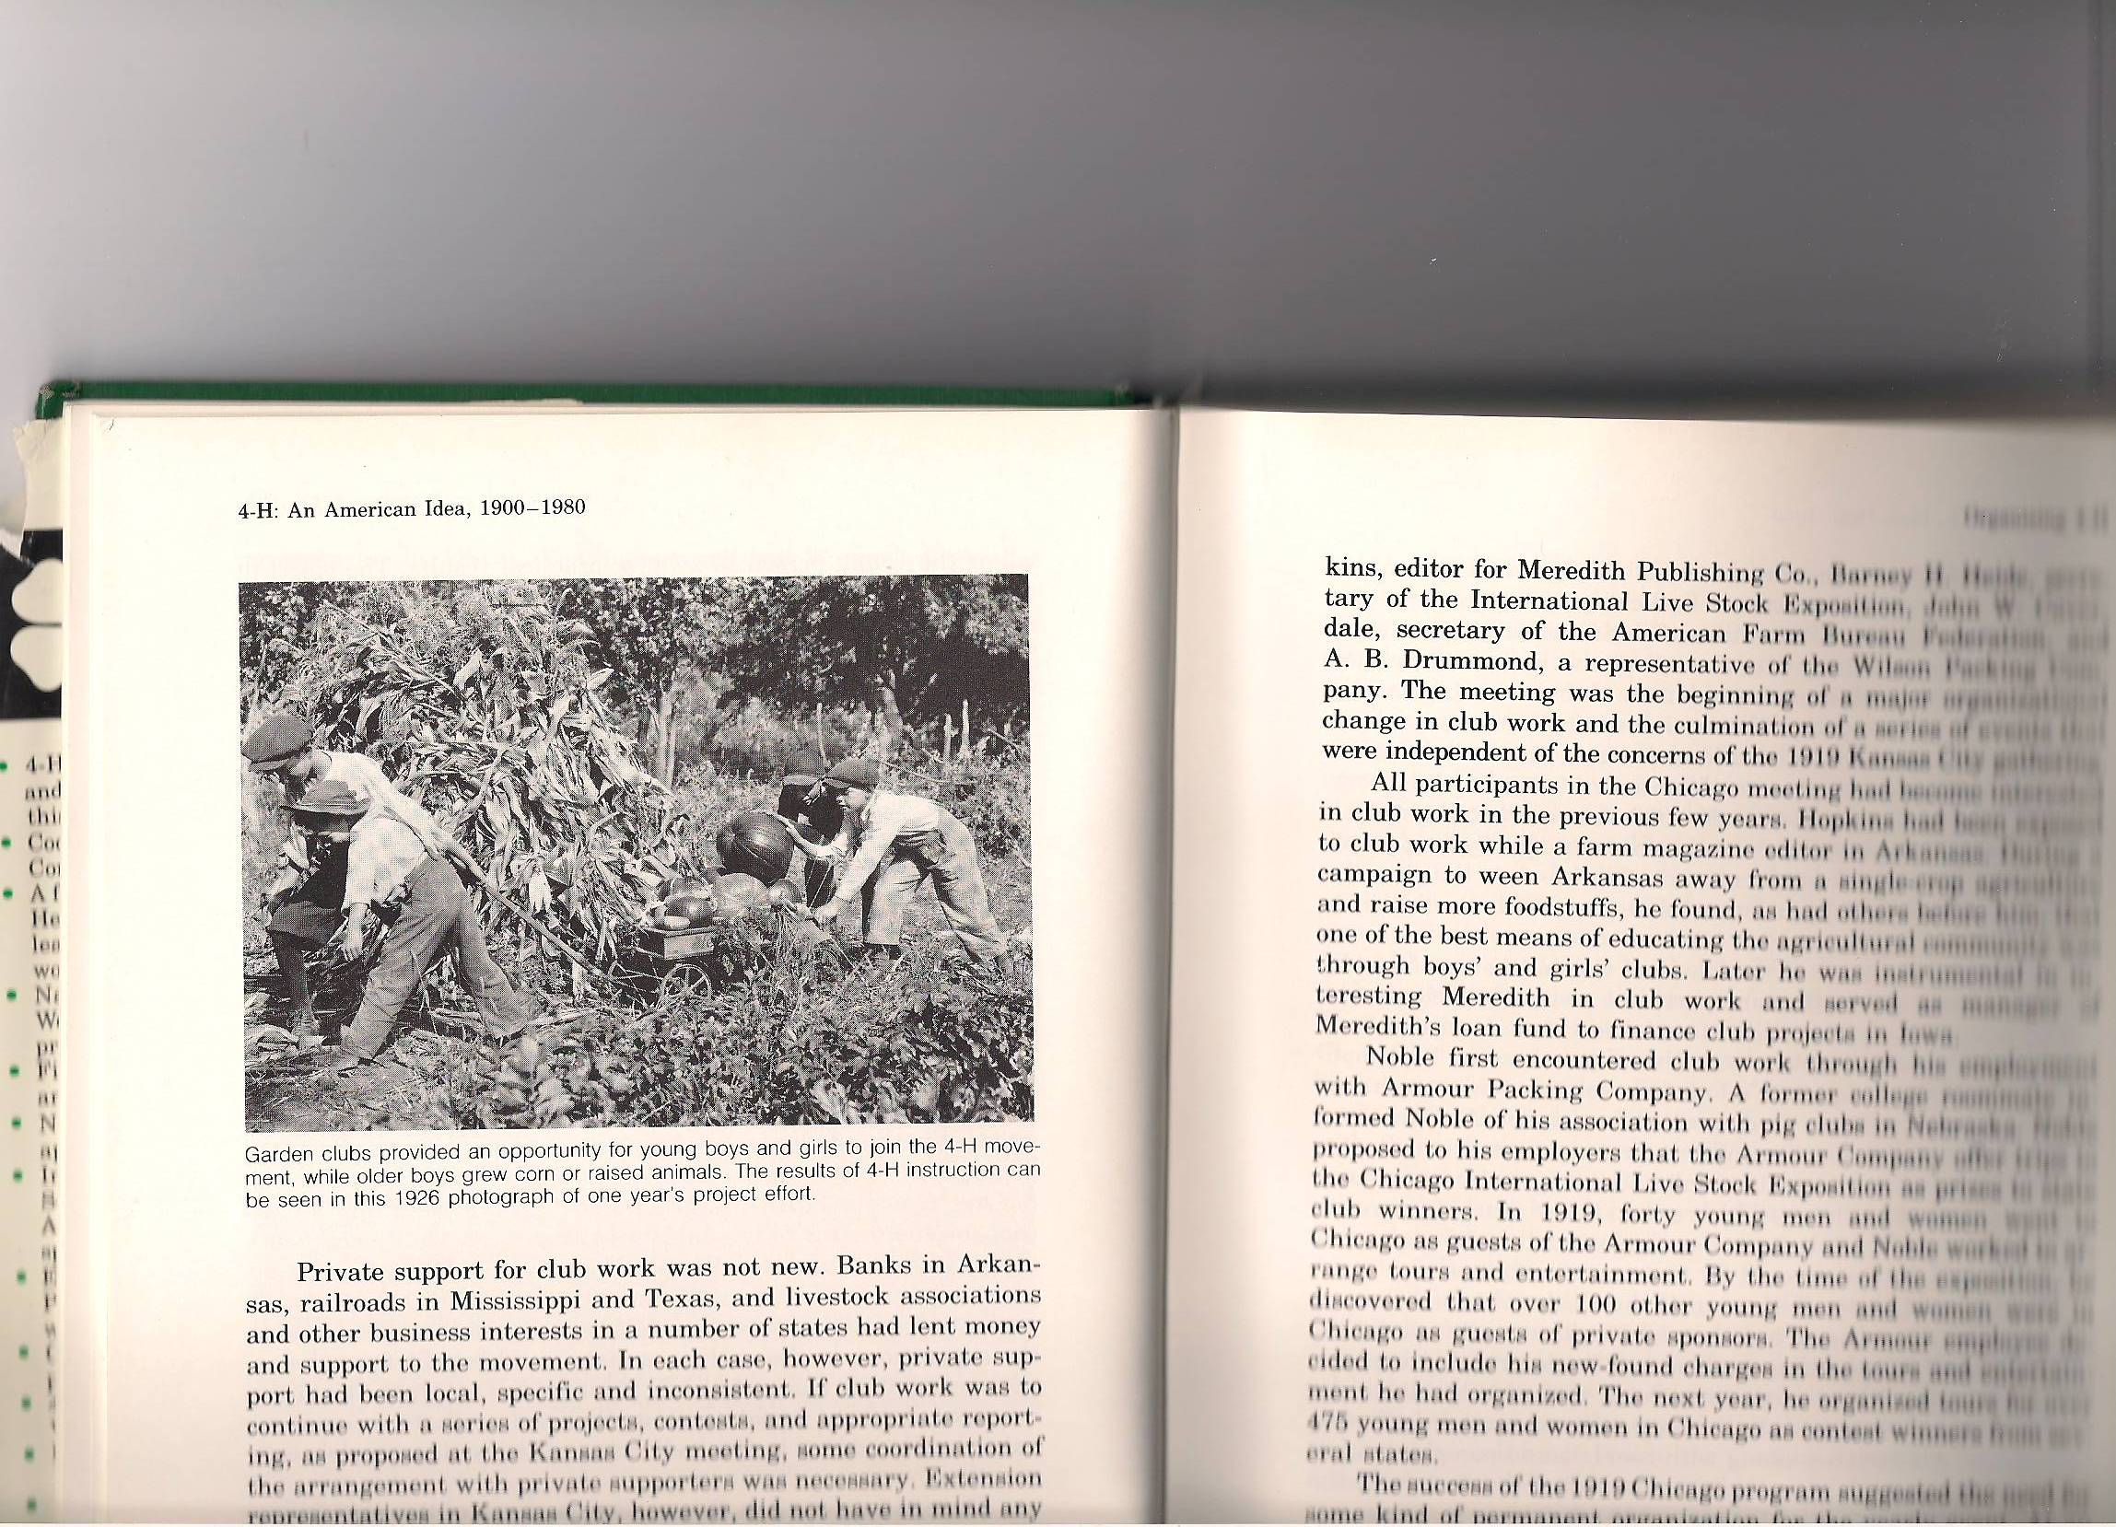
FFA Motto
LEARNING TO DO, DOING TO LEARN,
EARNING TO LIVE, LIVING TO SERVE

Slide 26
FFA Code of Ethics
FFA members conduct themselves at all times to be a credit to their organization, chapter, school, community, and family. As an FFA member, I pledge to:
Develop my potential for premier leadership, personal growth, and career success.
Make a positive difference in the lives of others.
Dress neatly and appropriately for the occasion.
Respect the rights of others and their property.

Slide 27
FFA Code of Ethics
FFA members conduct themselves at all times to be a credit to their organization, chapter, school, community, and family. As an FFA member, I pledge to:
Be courteous, honest and fair with others.
Communicate in an appropriate, purposeful and positive manner.
Demonstrate good sportsmanship by being modest in winning and generous in defeat.
Make myself aware of FFA programs and activities and be an active particpant.

Slide 28
FFA Code of Ethics
FFA members conduct themselves at all times to be a credit to their organization, chapter, school, community, and family. As an FFA member, I pledge to:
Conduct and value a supervised agricultural experience program.
Strive to establish and enhance my skills through agricultural education in order to enter a successful career.
Appreciate and promote diversity in our organization.

Slide 29
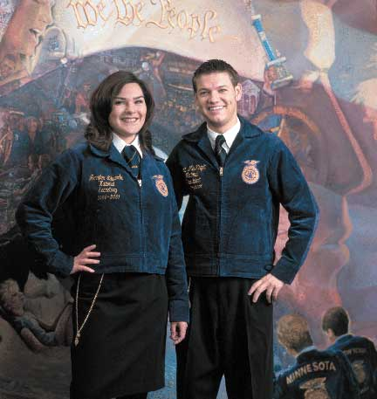
Why Official Dress?
Official Dress is the uniform worn by FFA members at local, state, and national functions.
Provides identity and gives a distinctive and recognizable image to the organization and its members.
Has been worn since 1933.

Slide 31
FFA Official Dress-Ladies
Black Skirt
White Collared Blouse
Official FFA Blue Scarf
Black Dress shoes
Black hosiery
Official Jacket zipped to top

Slide 32
FFA Official Dress-Guys
Black Slacks
White Collared shirt
Official FFA tie
Black Dress shoes
Black socks
Official Jacket zipped to top

Slide 33
Types of FFA Membership
Honorary: member is conferred on by individuals within organization.
Alumni: membership is open to former active members.
Collegiate: membership at the postsecondary level.
Active: membership is open to all students enrolled in an agriculture education class
    Pay dues
    Show and interest in FFA
    Display the ideals and purposes of FFA

Slide 34
FFA Degrees
4 Different Degrees
Discovery FFA Degree
Greenhand FFA Degree
Chapter FFA Degree: highest degree the chapter can give
State FFA Degree: highest degree the state can give
American FFA Degree: highest degree that can be obtained

Slide 35
What is a POA?
The “Road Map” for planning activities and accomplishing goals at the local level.
3 Parts
  Student Developent
    Promote personal & group activities
  Chapter Development
    Encourage students to work together
  Community Development
    Work with community so everyone works together

Slide 36
What is a CDE?
Career Development Event
The competition branch of FFA
  Leadership Opportunities
  Money
  Scholarship Opportunities
  Lots & Lots of traveling

Slide 37
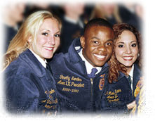
Some Fun CDE’s
Floral Design
Tractor Driving
Livestock Judging
Wildlife Judging
Public Speaking
Parliamentary Procedure
Land Judging
Natural Resource Management

Slide 38
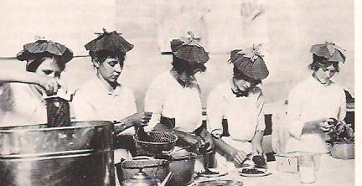
Some more CDE’s
Quiz Bowls
  Horse
  Dairy
  Poultry
  FFA
  Tree

Slide 39

Travel Options in FFA
State FFA Convention
  Macon, Georgia
National FFA Convention
  Indianapolis, Indiana
Trips all over the state with CDE’s
  University of Georgia
  North Georgia
  South Georgia
National Fair
  Perry, Georgia

Slide 40
FFA Camp
FUN-FILLED WEEK
  Summer months
  Ride horses
  Go swimming
  High ropes
  Make Friends from all over the state
  Ride a jet-ski and water ski
  Get muddy!!!

Slide 41

Chapter Activites
National FFA Week
Chapter Banquet
Fundraising
Awards
Retreats & Conferences
State & National Conventions

Slide 42
Chapter Meetings
These are meetings held by the local chapter
  Business is conducted here
  Food is usually provided here
  Fun and engaging activities happen at meetings
  Great leadership opportunties

Slide 43
Chapter Membership
Pay $15.00 by August 31 $20 after!
What you get:
  FFA New Horizon Magazine Every month
  Opportunity to participate in CDE’s
  Limitless opportunities to meet people
  National & State Dues covered
  Monthly chapter meetings with food

Slide 44
What is an SAEP?
Supervised Agricultural Experience Program
(Learning by Doing)
8 primary types of SAE programs
  Entrepreneurship
  Placement
  Agriscience Research
  Agricultural Service Learning
  Exploratory
  Improvement
  Supplemental
  Directed School Laboratory

Slide 45
Official FFA Ceremonies
Opening & Closing
Degree
Induction of Officers

Slide 46
Essentials for a Successful Chapter
FFA Knowledge
Diversity of Membeship
Members share responsibilities
Capable officers
Challenging POA
Workable constitution & bylaws
Proper equipment & records
Well-planned, regularly-held chapter meetings
Adequate financing
School & community support

Slide 47
Chapter Officer Team
President
Vice President
Secretary
Treasurer
Reporter
Sentinel
Advisor
Historian
Parliamentarian

Slide 48

Parliamentary Procedure or Parliamentary Law/Robert’s Rules of Order
All FFA meetings practice this!!!
  Makes meetings more efficient & orderly
Goal is to maintain 4 things:
  Focus on one thing at a time
  Extend courtesy to everyone
  Observe the rule of the majority
  Ensure the rights of the minority

Slide 49
Use of the Gavel
Used to maintain order in a meeting
One tap
  Follows the announcement of adjournment
  Follows the completion of a business item
  Tells members to be seated
Two taps
  Call the meeting to order

Slide 50
More Gavel Info
Three taps
  Signal for all members to stand
Series of sharp taps
  Used to restore order at a meeting

Slide 51
Voting
Four common methods of voting:
  Voice vote, by saying “aye” or “no.”
  Rising vote, either by standing or by a show of hands.
  Secret ballot, a written vote
  Roll call, with each member speaking their vote when the secretary calls their name.
**A quorum must be present before voting can take place.
(at least half of the members must be present)

Slide 52
Other voting procedures
Simple majority:
  Majority is simply based on the # voting
  At least half of the voters plus one voter must be in favor for a vote to pass
Two-thirds vote:
  This must happen when a motion limits the rights of a member or members

Slide 53
Motions
These are the main tools of parliamentary procedure
Four Types:
Privileged- motions concerned with the rights of members; take precedence over all other motions.
Incidental- motions that arise out of the business being conducted.
Subsidary- motions which help dispose of a main motion.
Unclassified- motions that bring a question before an assembly again.

Slide 54
Main Motions
Used to get a group to approve a new project or some other action.
The member would rise and say, “I move to……”
Following the motion, it would need a second, another member says, “I second the motion”

Slide 55
More Parli Pro
If no second occurs, the presiding officer would say, “the motion dies from lack of a second.”
If it receives a second, the presiding officer would say, “what the motion was and then as the members is their any discussion.”
When discussion is over, the presiding officer calls for a vote.
  Presiding Officer: “All those in favor of the motion to……….signfy by saying aye.” “All opposed, say no.”
  “The motion is carried/defeated.” Then taps gavel once.

Slide 56

Amendments
Members can make an amendment to a motion.
Reason to make an amendment is to maybe clean up the wording.
Members can amend in 3 ways:
  By addition
  By substitution
  By striking out

Slide 57
Delaying Action
Maybe members want to go home and think about it!!!
Many Ways:
  Postpone definetly
      Allows for research of the motion to take place and a time would be set up to bring it up again.
        “I move to postpone action on this motion until our next regular meeting.”
  Lay on the Table
      Different because you are not setting a time to come back to it
        “I move to lay this motion on the table.”
  Refer to committee
      May want to refer something for a group of people to research
        “I move to refer this motion to a committee to report at our next meeting.”

Slide 58
Returning a Meeting to Order
Point or Order
  This is done if you ever think parliamentary law is not being followed properly
    “I rise to a point of order.”
    Presiding says, “State your point.”
    You continue, “……………….
    Presiding says, “Either point was taken or not.”

Slide 59

Ending a Meeting
Motion to Adjourn
  Someone says, “I move to adjourn.”
    Second must occur, then a vote.

Slide 60
Meeting Responsibilities
(officers have responsibilities during a meeting)
President- called the chair, presides but does not direct, only votes in a tie, cannot bring business up
Vice President- non-voting member, assumes President position if President is absent
Secretary- prepares agenda and keeps accurate record
Treasurer- prepares financial report
Reporter- obtain publicity
Sentinel- prepares meeting room

