Slide 1
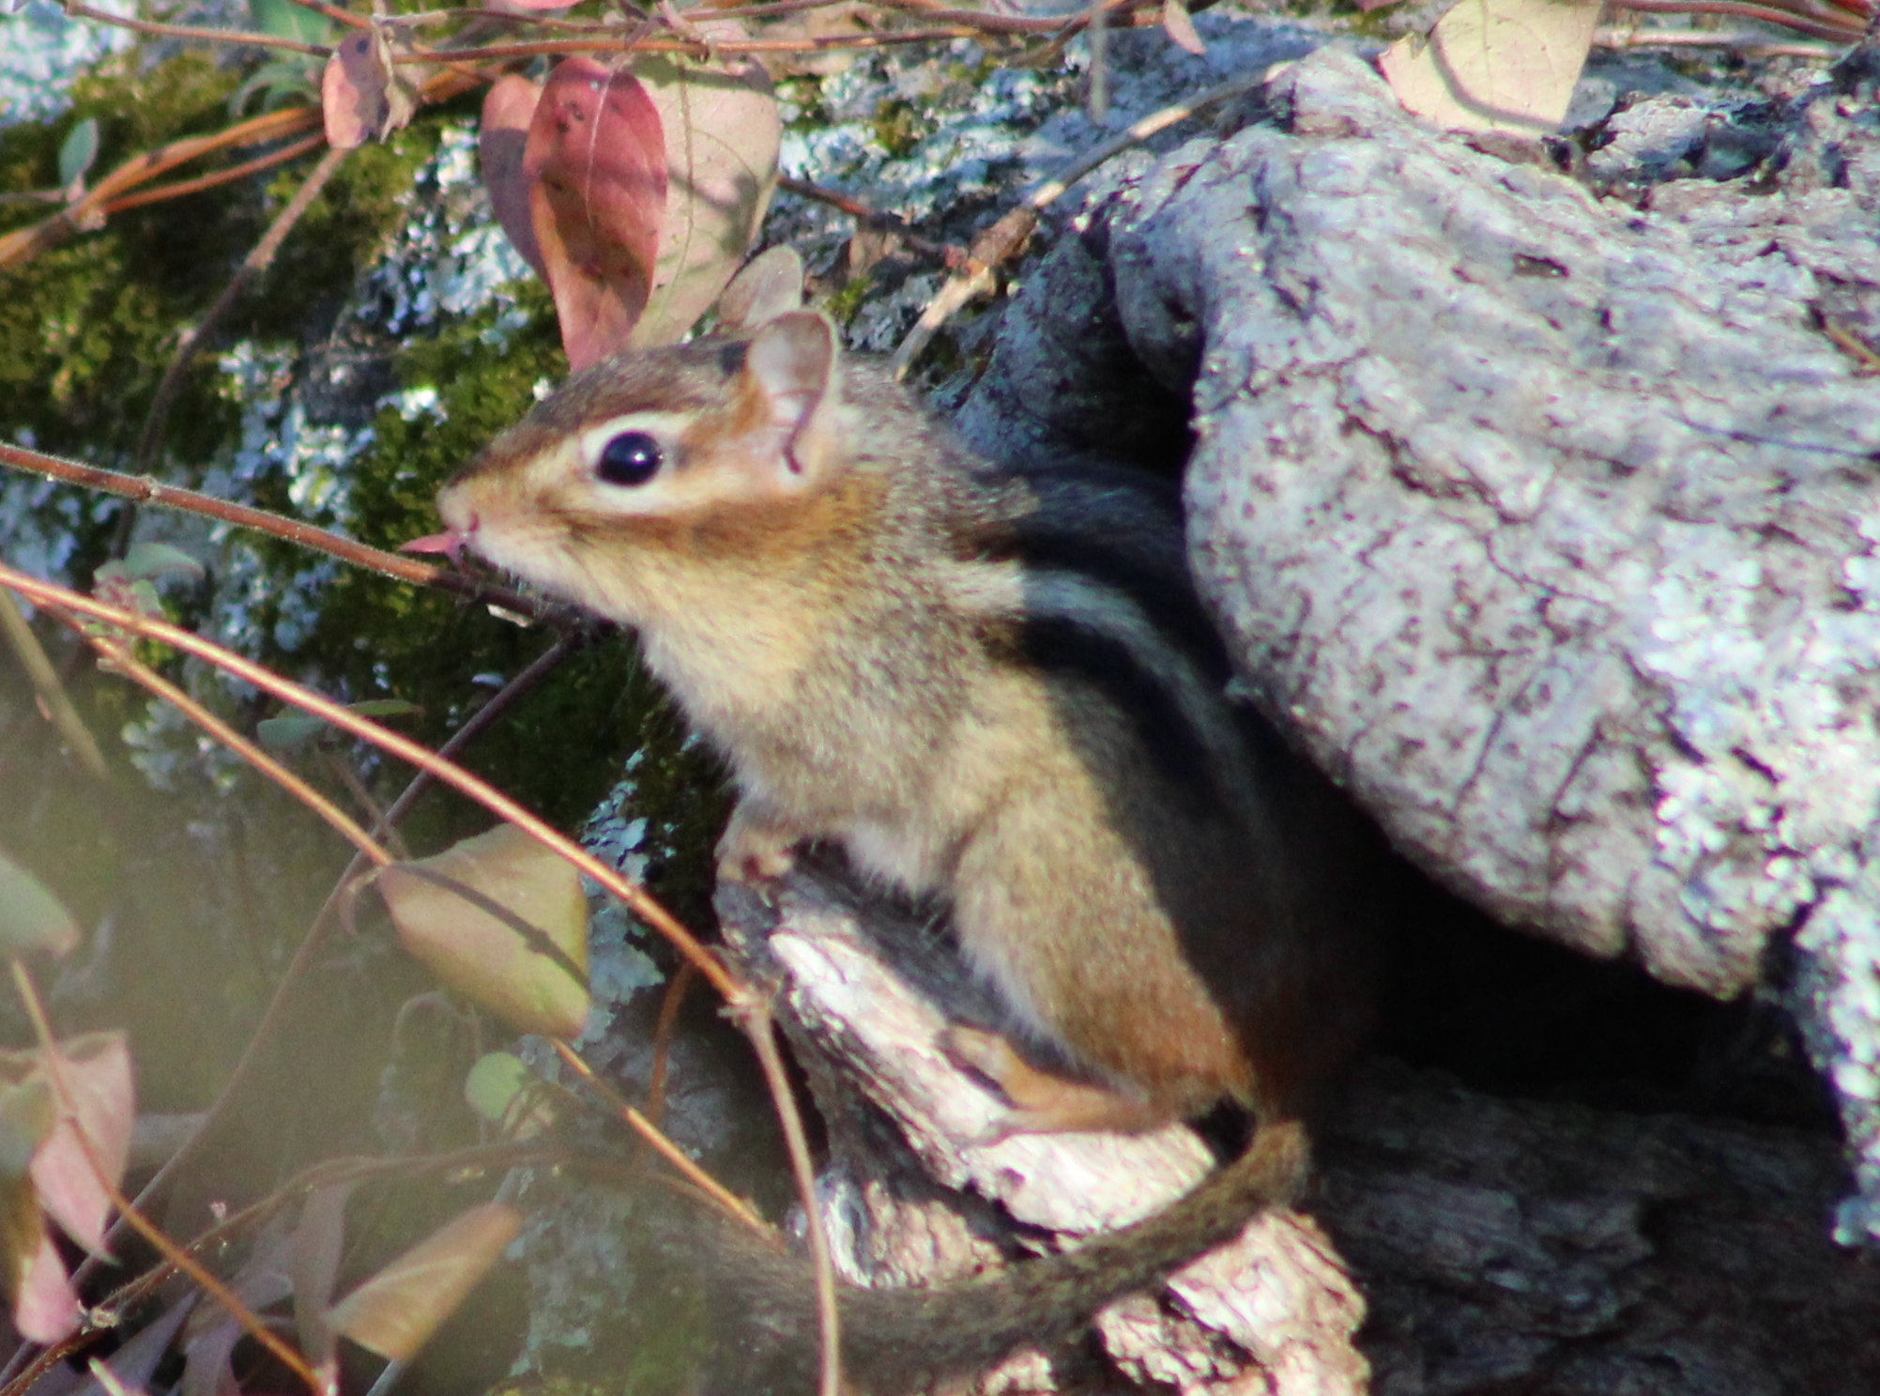
Author’s Point of View

Slide 2
What is point of view?
In expository text, the author’s point of view or perspective shows how the author feels about the topic.

Slide 3
Words to describe point of view
Neutral
Objective

Slide 4
Words to describe point of view
Writing that is “neutral” or “objective” sticks to mostly facts

Slide 5
Neutral point of view
Chipmunks are omnivores and eat a wide variety of plants, seeds, and insects.

Slide 6
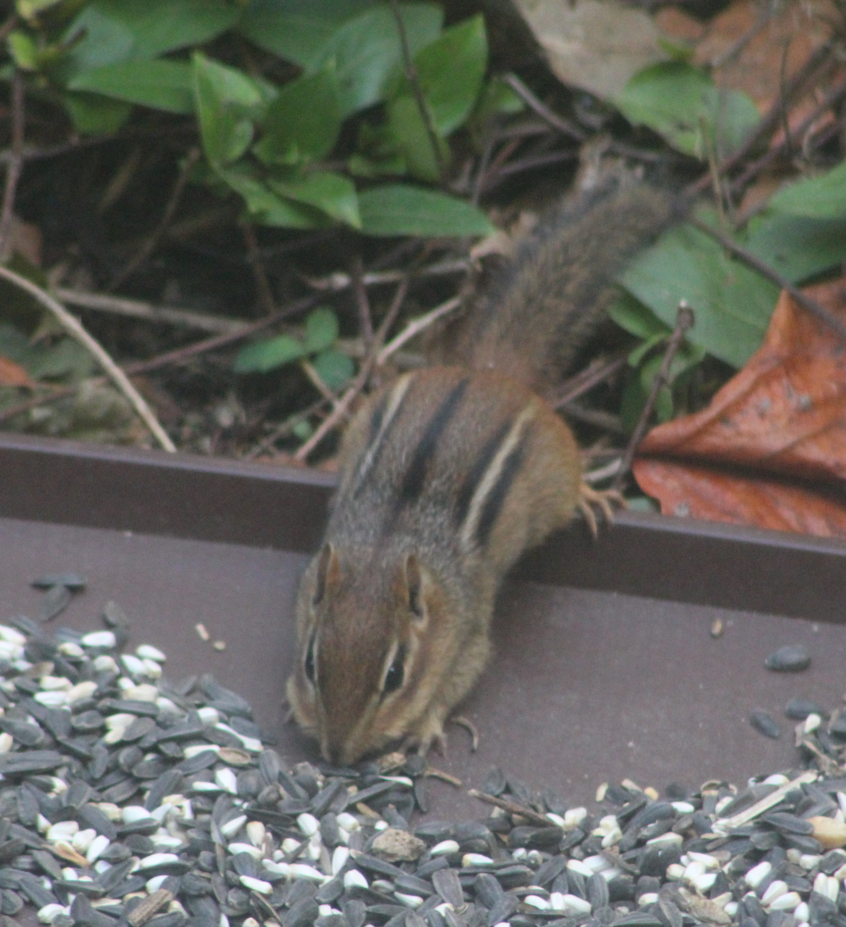
Positive point of view
Helpful chipmunks play an important role in seed dispersal.

Slide 7
Positive point of view
Helpful chipmunks play an important role in seed dispersal.

Slide 8
Negative point of view
Because they eat seeds, chipmunks can be nuisances at birdfeeders.

Slide 9
Negative point of view
Because they eat seeds, chipmunks can be nuisances at birdfeeders.

Slide 10
Looking for author’s point of view
On a wet fall day, lucky hikers might be able to see beautiful fall fungus.
negative neutral positive

Slide 11
Looking for author’s point of view
On a wet fall day, lucky hikers might be able to see beautiful fall fungus.
negative neutral positive

Slide 12
Looking for author’s point of view
On a wet fall day, lucky hikers might be able to see beautiful fall fungus.
negative neutral positive

Slide 13
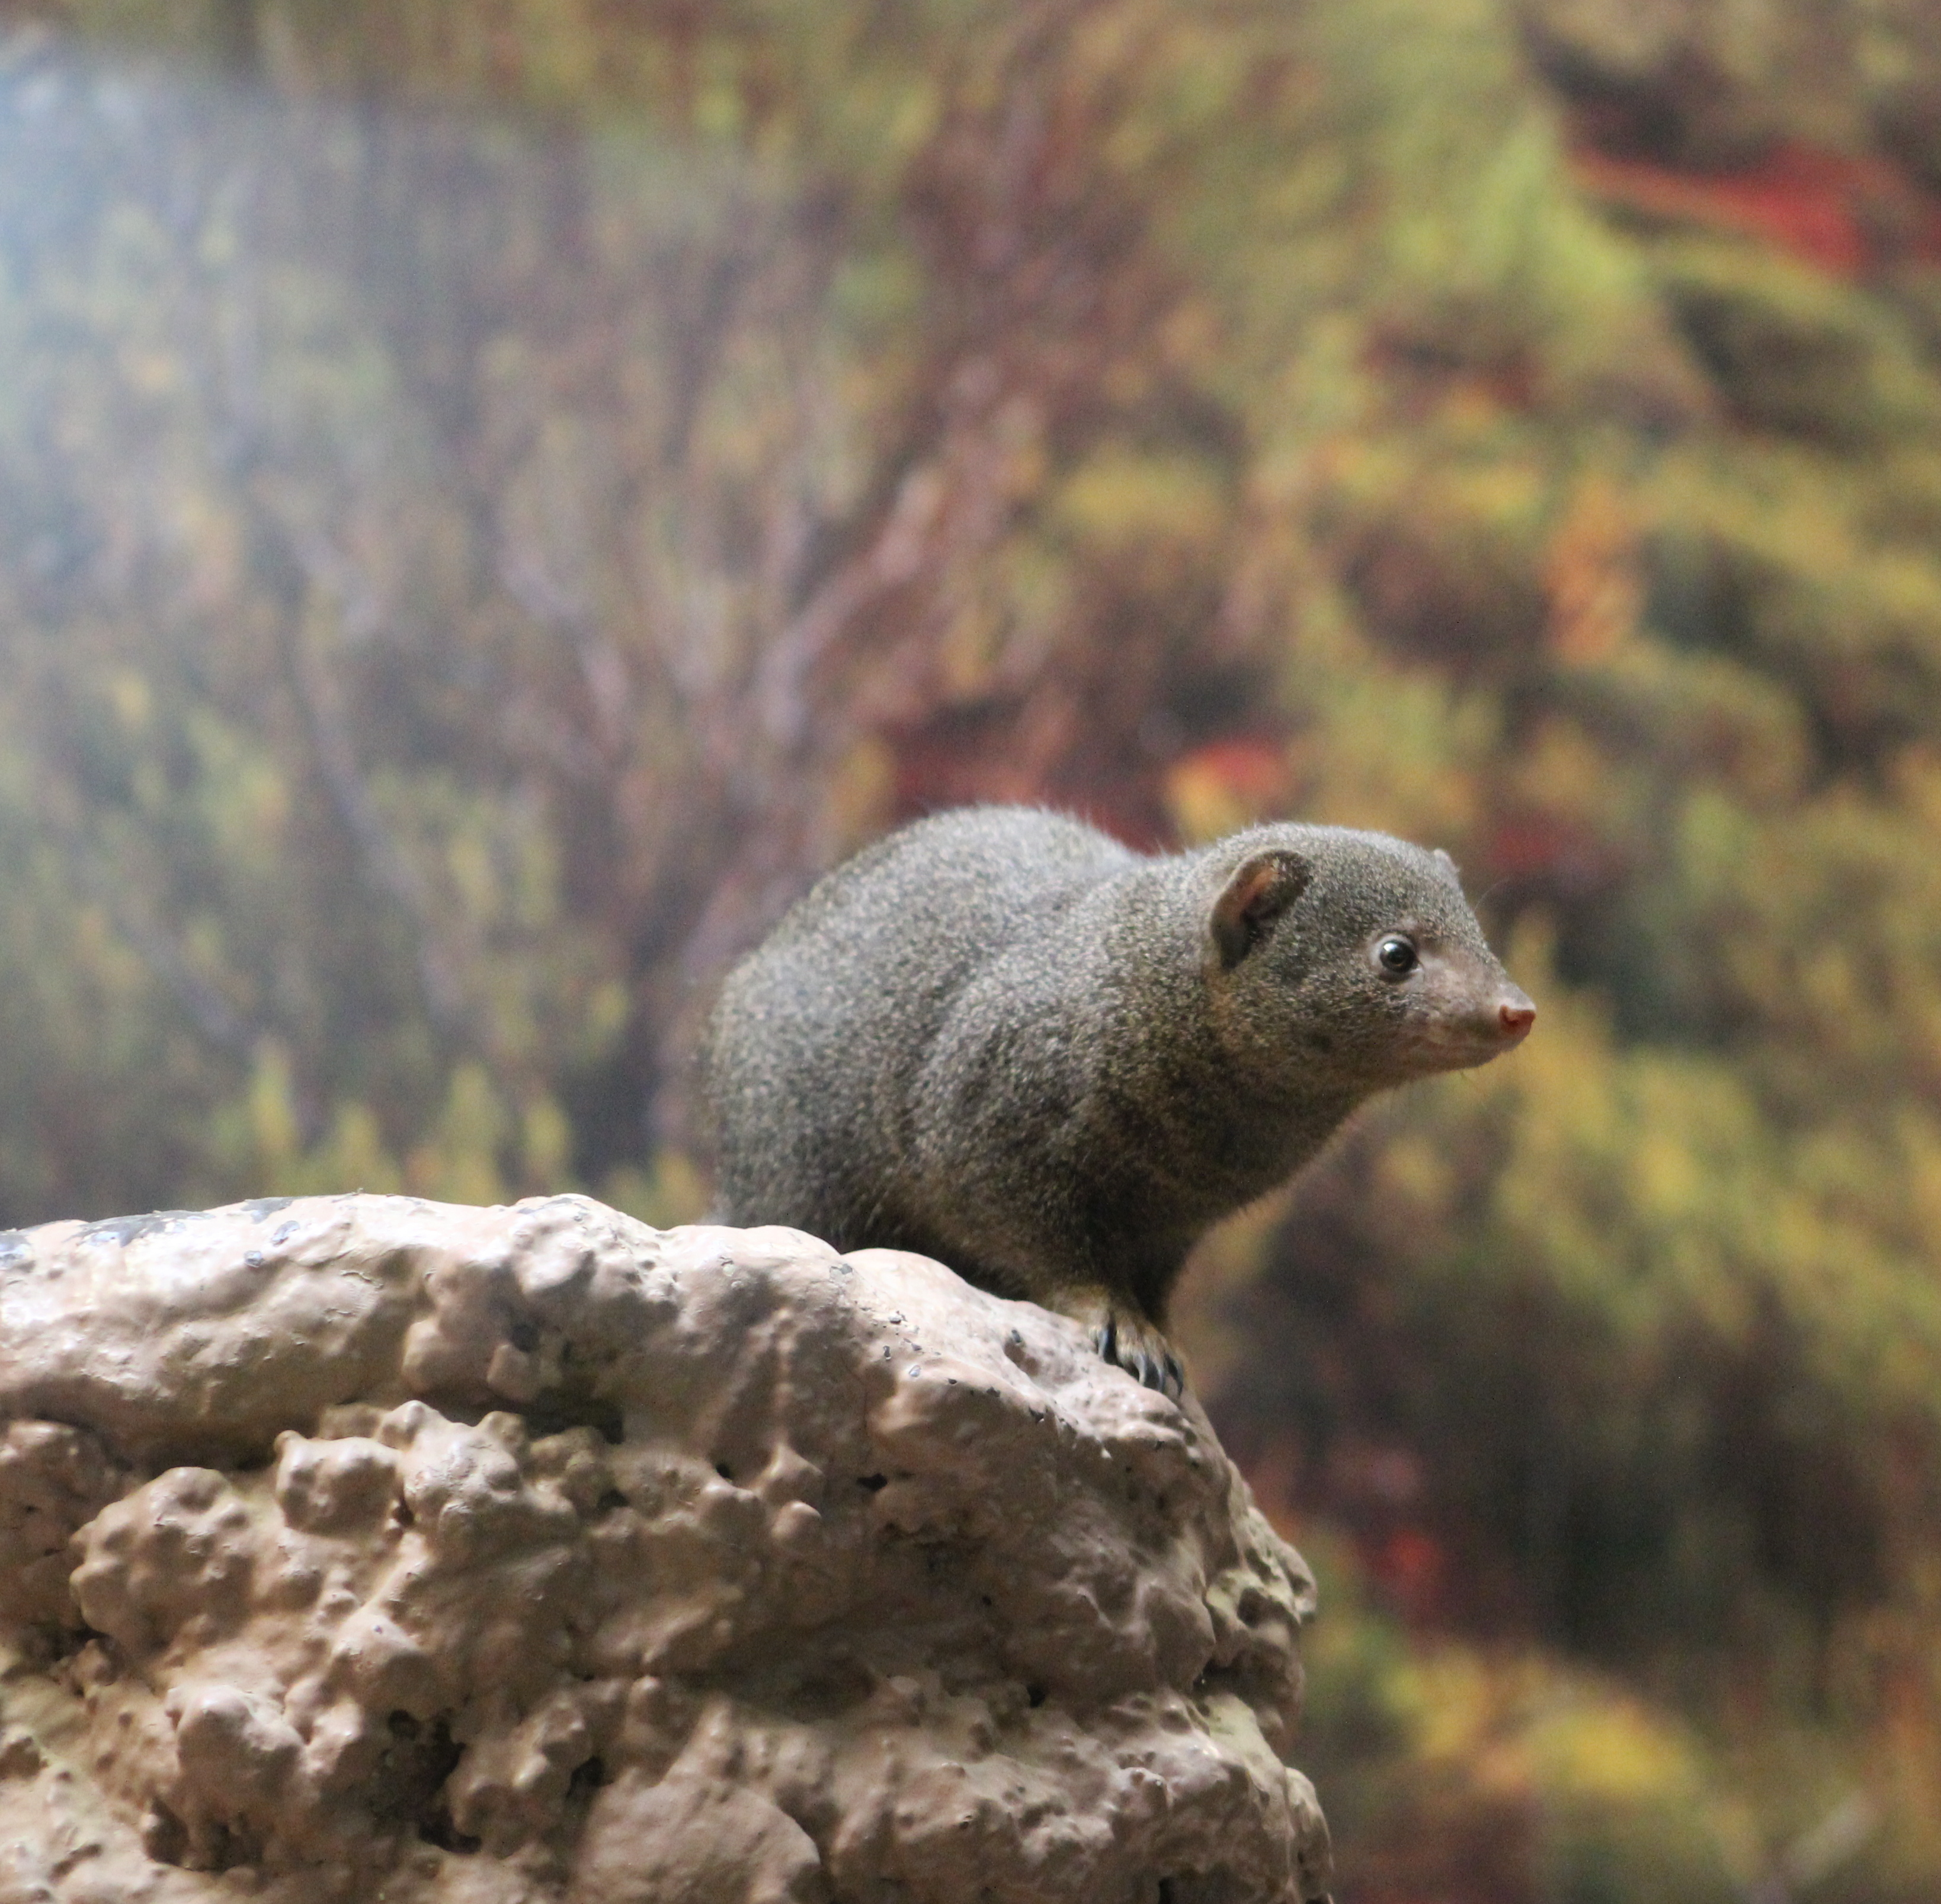
Looking for author’s point of view
Dwarf mongooses live in dry grasslands and open forests across central Africa.
negative neutral positive

Slide 14
Looking for author’s point of view
Dwarf mongooses live in dry grasslands and open forests across central Africa.
negative neutral positive

Slide 15
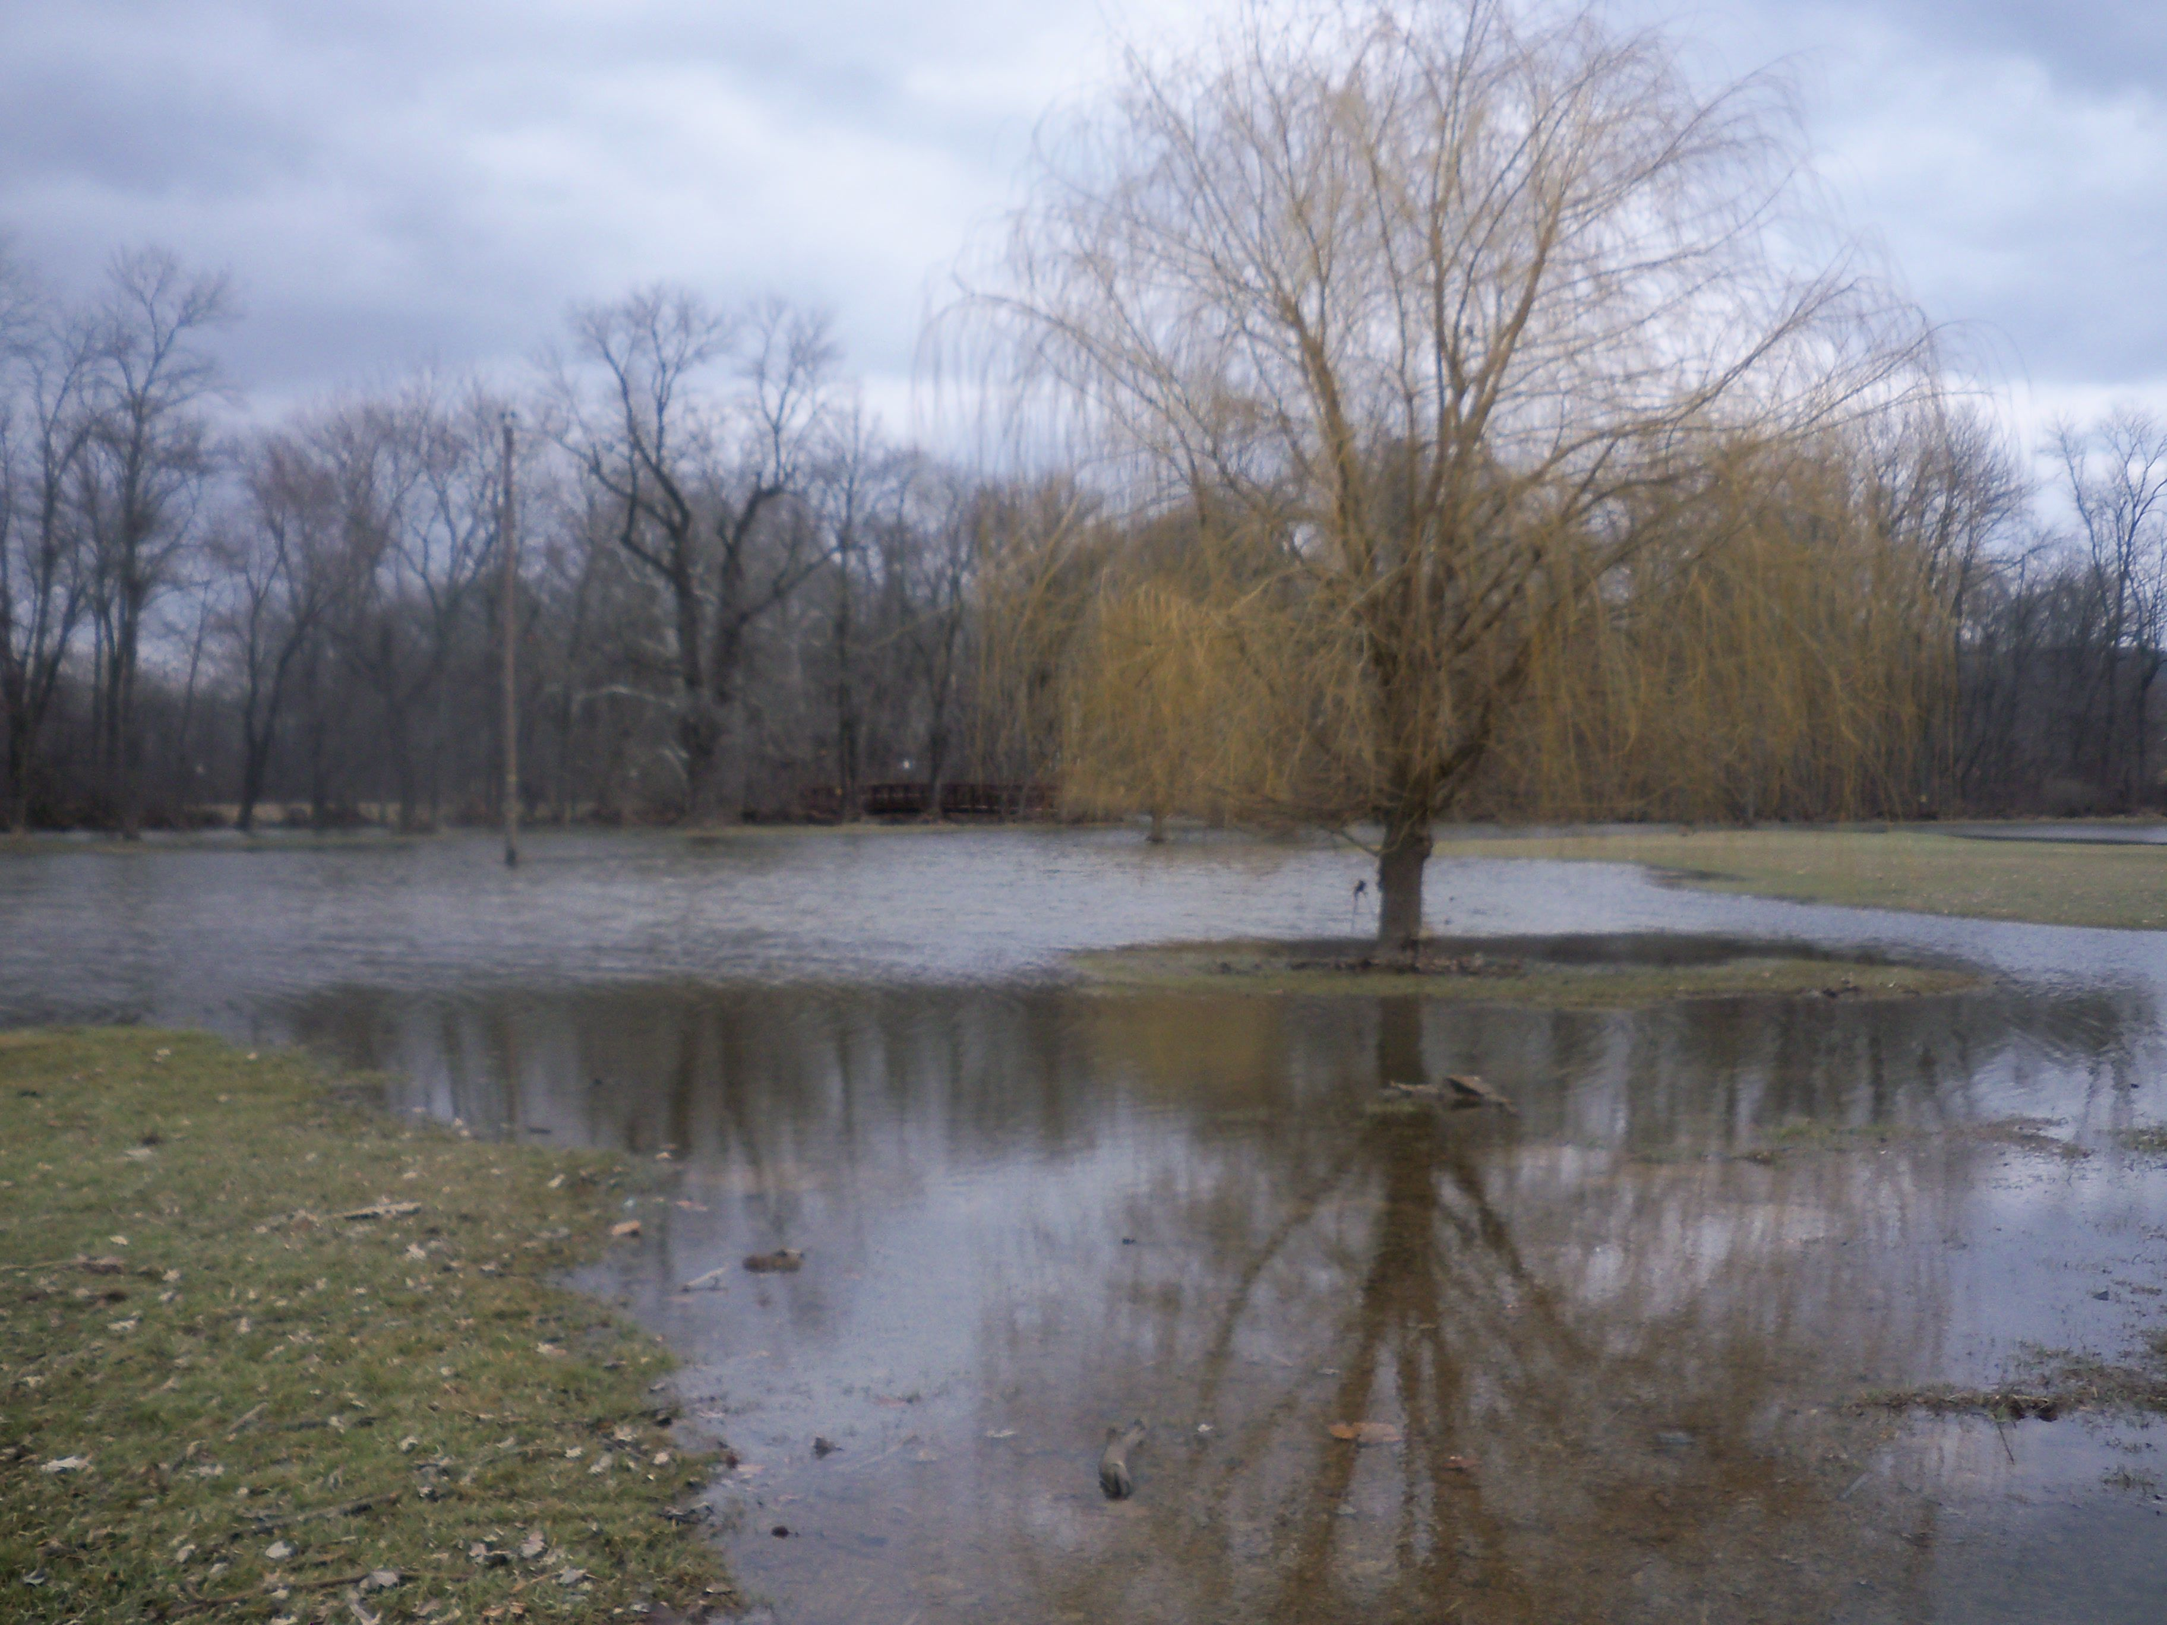
Looking for author’s point of view
Floods can have many terrible consequences for people in the path of rushing water.
negative neutral positive

Slide 16
Looking for author’s point of view
Floods can have many terrible consequences for people in the path of rushing water.
negative neutral positive

Slide 17
Looking for author’s point of view
Floods can have many terrible consequences for people in the path of rushing water.
negative neutral positive

Slide 18
Is point of view a problem?
Sometimes authors try to keep their writing completely neutral and objective.

Slide 19
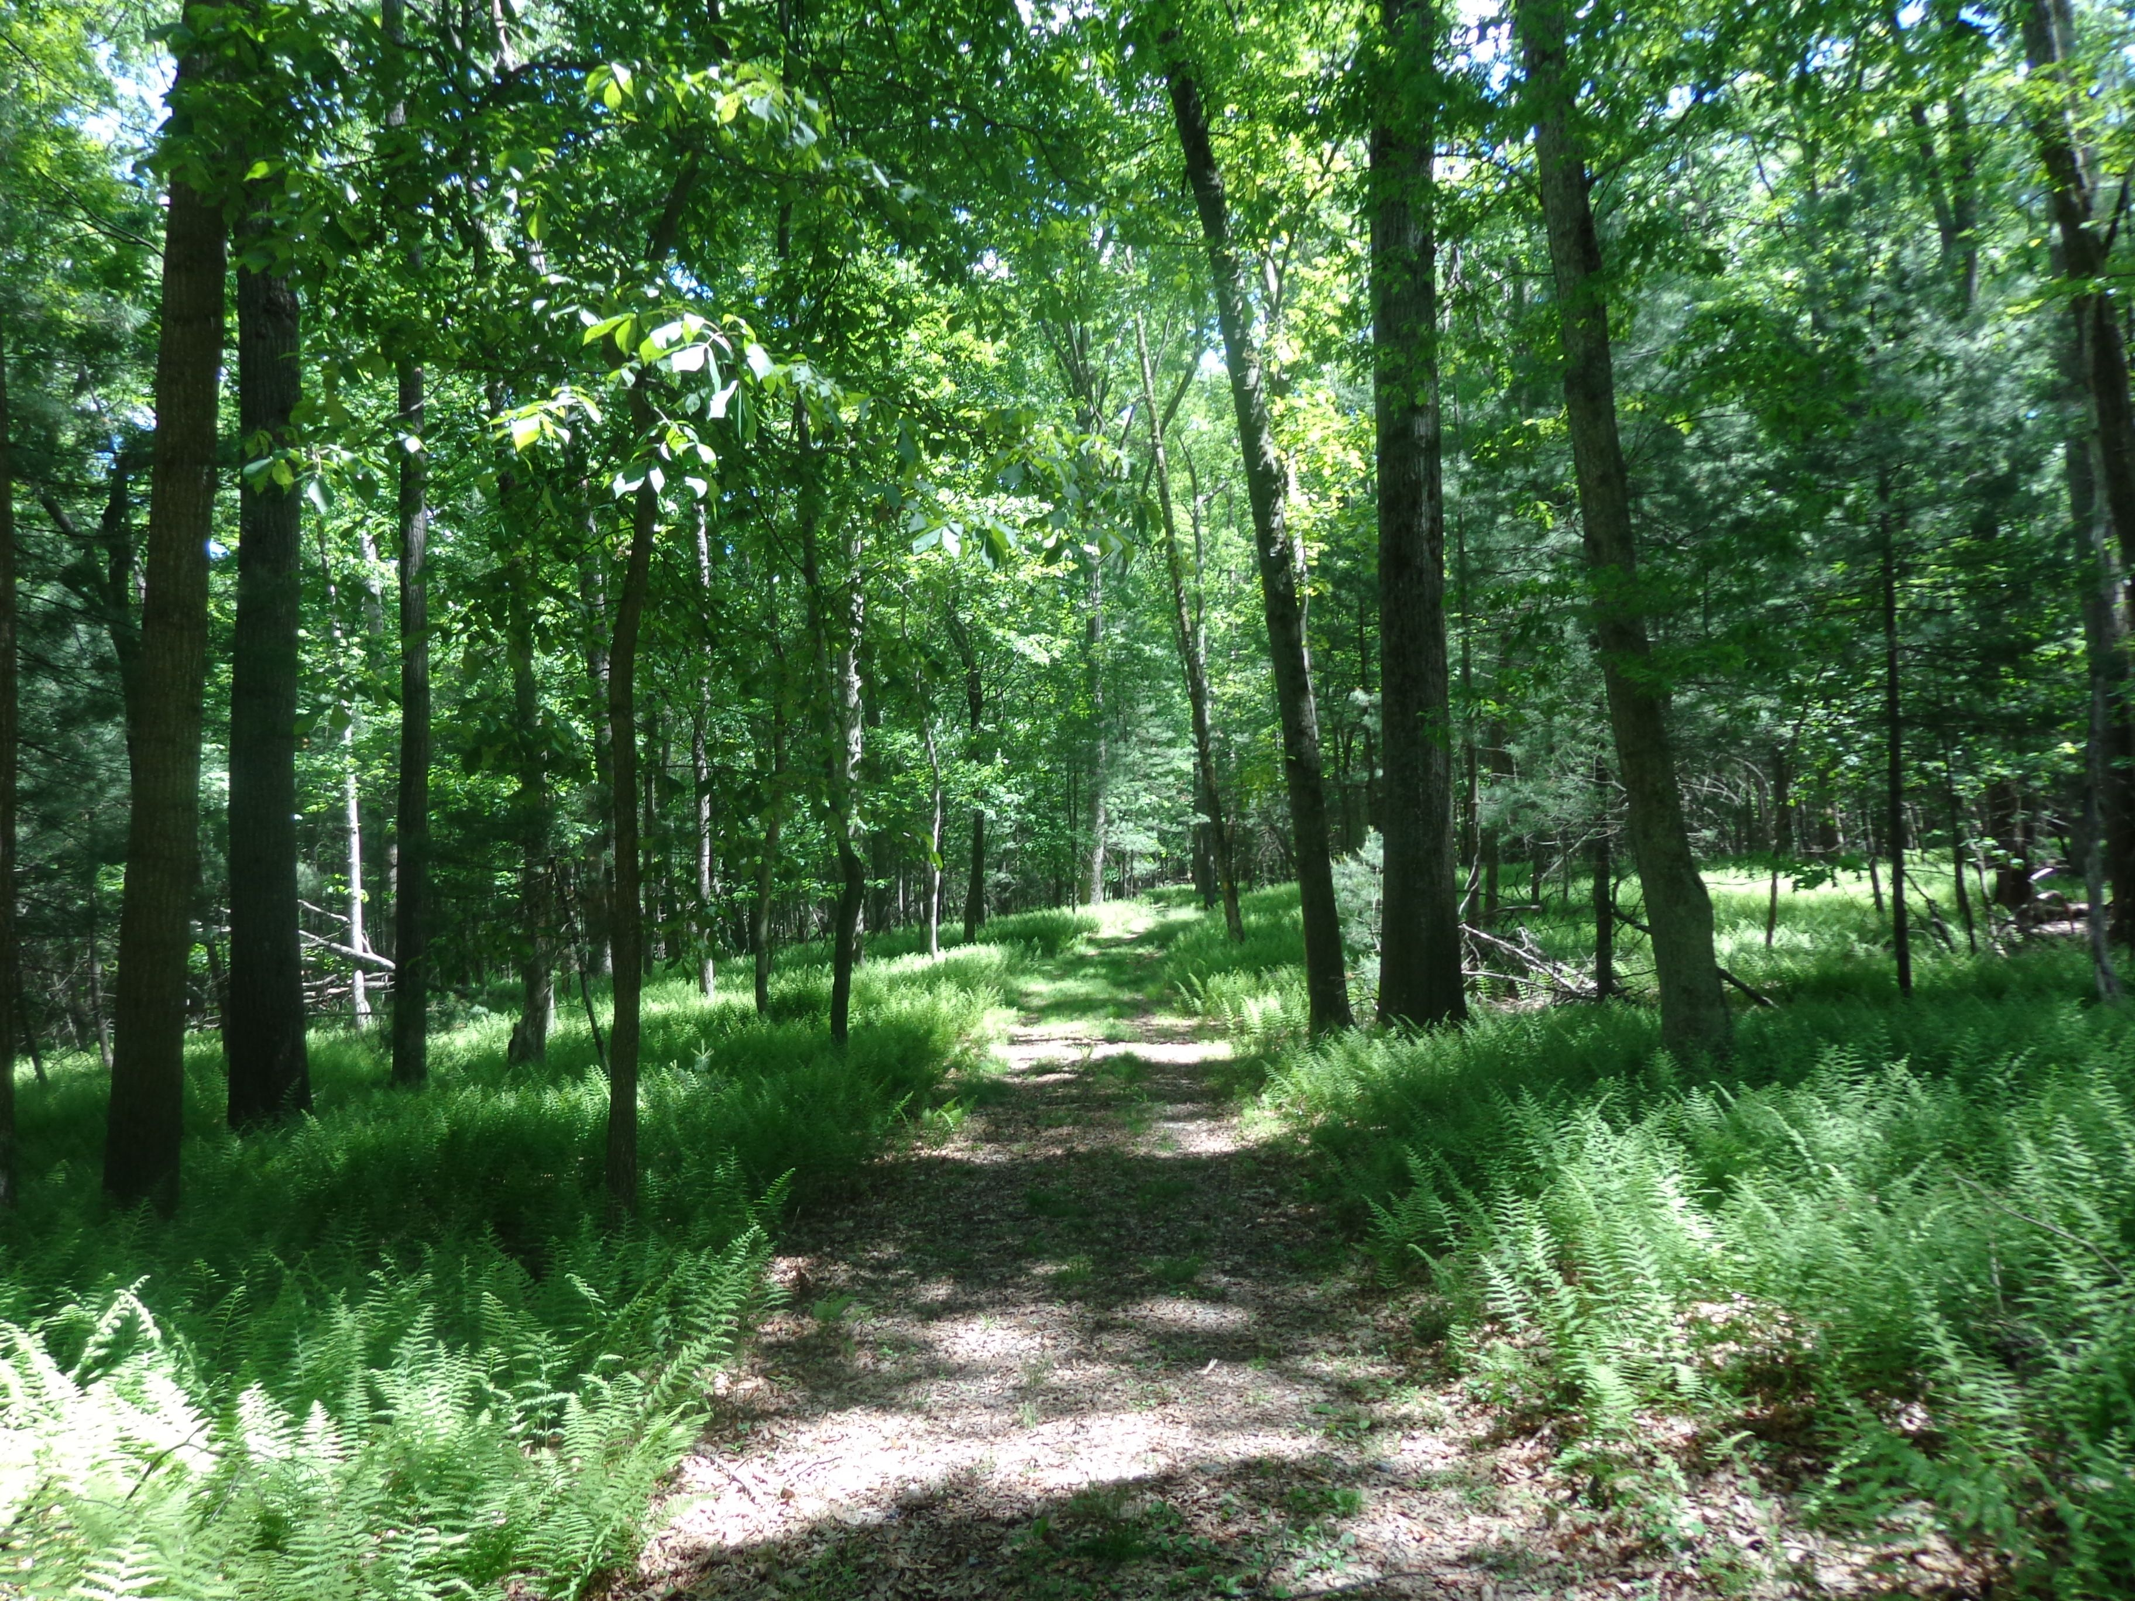
Is point of view a problem?
There are some situations that require a neutral point of view: for example, technical reports, newspaper articles, and science writing.

Slide 20
Is point of view a problem?
As long as an author supports a point of view with evidence, though, it can help to make a piece of writing more lively and interesting.

Slide 21
What have you learned?
What are some words that we can use to describe an author’s point of view?

Slide 22
What have you learned?
What are some words that we can use to describe an author’s point of view?
negative neutral positive

Slide 23
Photos and text by Emily Kissner
©2019

