Slide 1

Shape’s

Slide 2

CIRCLE

Slide 3

TRIANGLE

Slide 4

OVAL

Slide 5

RECTANGLE

Slide 6

SQUARE

Slide 7
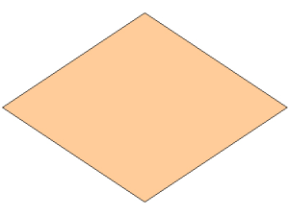
RHOMBUS

Slide 8
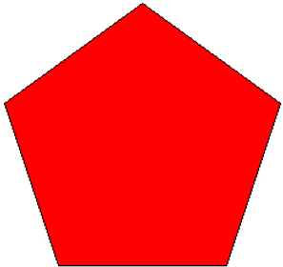
PENTAGON

Slide 9
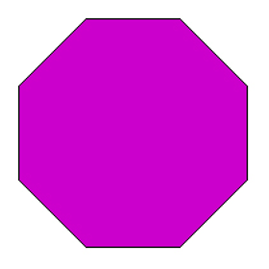
OCTAGON

Slide 10
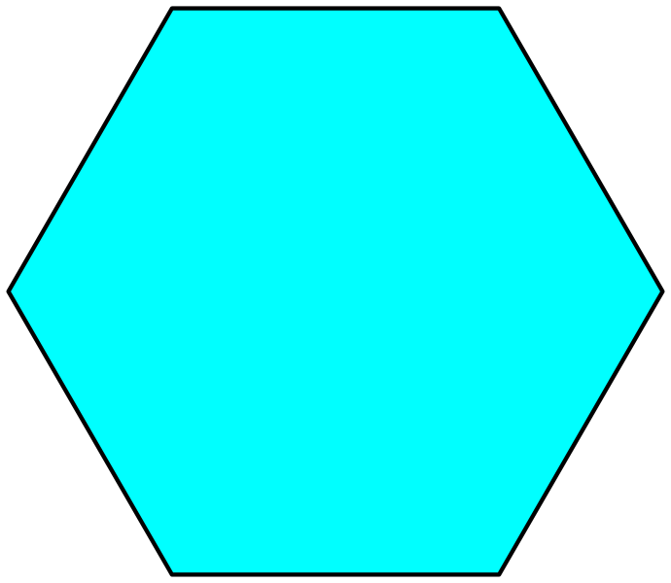
HEXAGON

